Slide 1


The Voice Process:
Listen, Learn, Lead
Dr. Lisa Lande
March 20, 2025

Slide 2


Slide 3


Slide 4
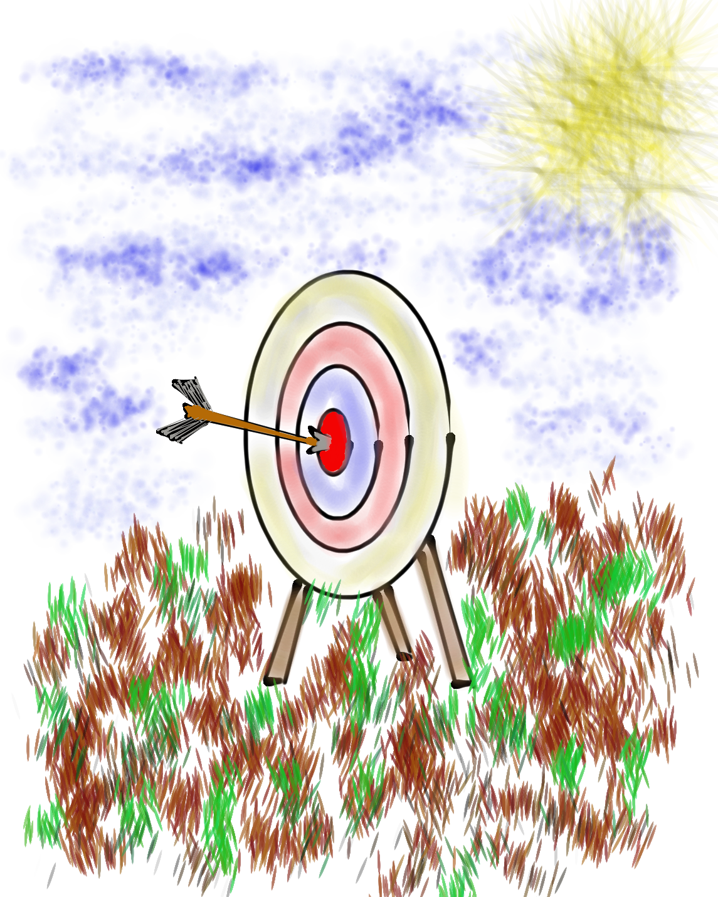
Learning Intention
We are learning about the the School Voice Process & how it can support our efforts to amplify student voice.
Success Criteria
Discover the components & nuances of the School Voice Process: Listen, Learn, Lead.
Consider how the School Voice Process can contribute
to fostering a positive school culture & an effective
learning environment.
Apply what has been learned about the School Voice
Process to efforts at your school to amplify Student
Voice & support all students in reaching their
fullest potential.
Today will be a home run for me if…

Slide 5
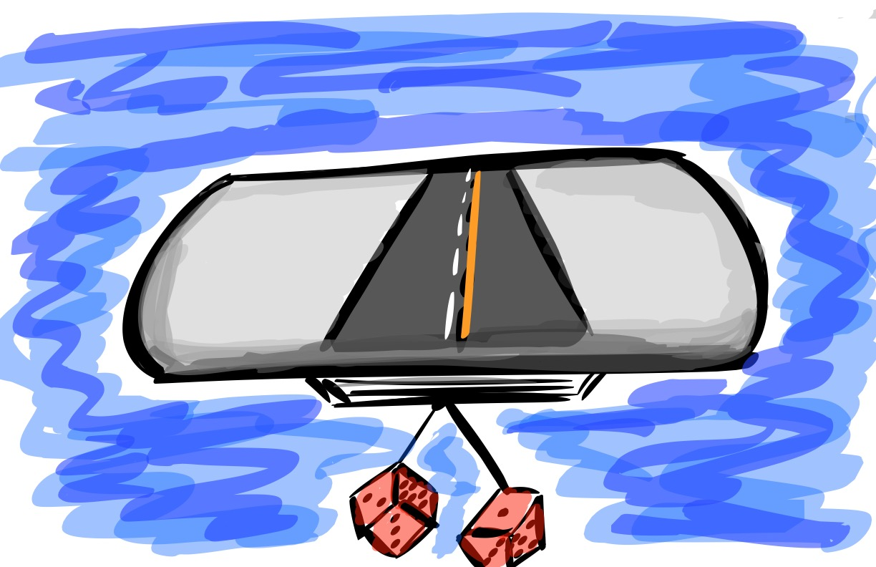
Quick Review
What do you remember from our last session? ☺

Slide 6

The 3 Components of Student Voice
Sharing thoughts & ideas in an environment underpinned by trust & respect.
Offering realistic suggestions for the
good of the whole.
Accepting responsibility for not only what is said but also what needs to be done.

Slide 7

Student Voice Map
Create a map that reflects your journey with Student Voice.
-Key Understandings
-Important Experiences
-Moments of Triumph
-Epic Challenges
-Next Destination

Slide 8
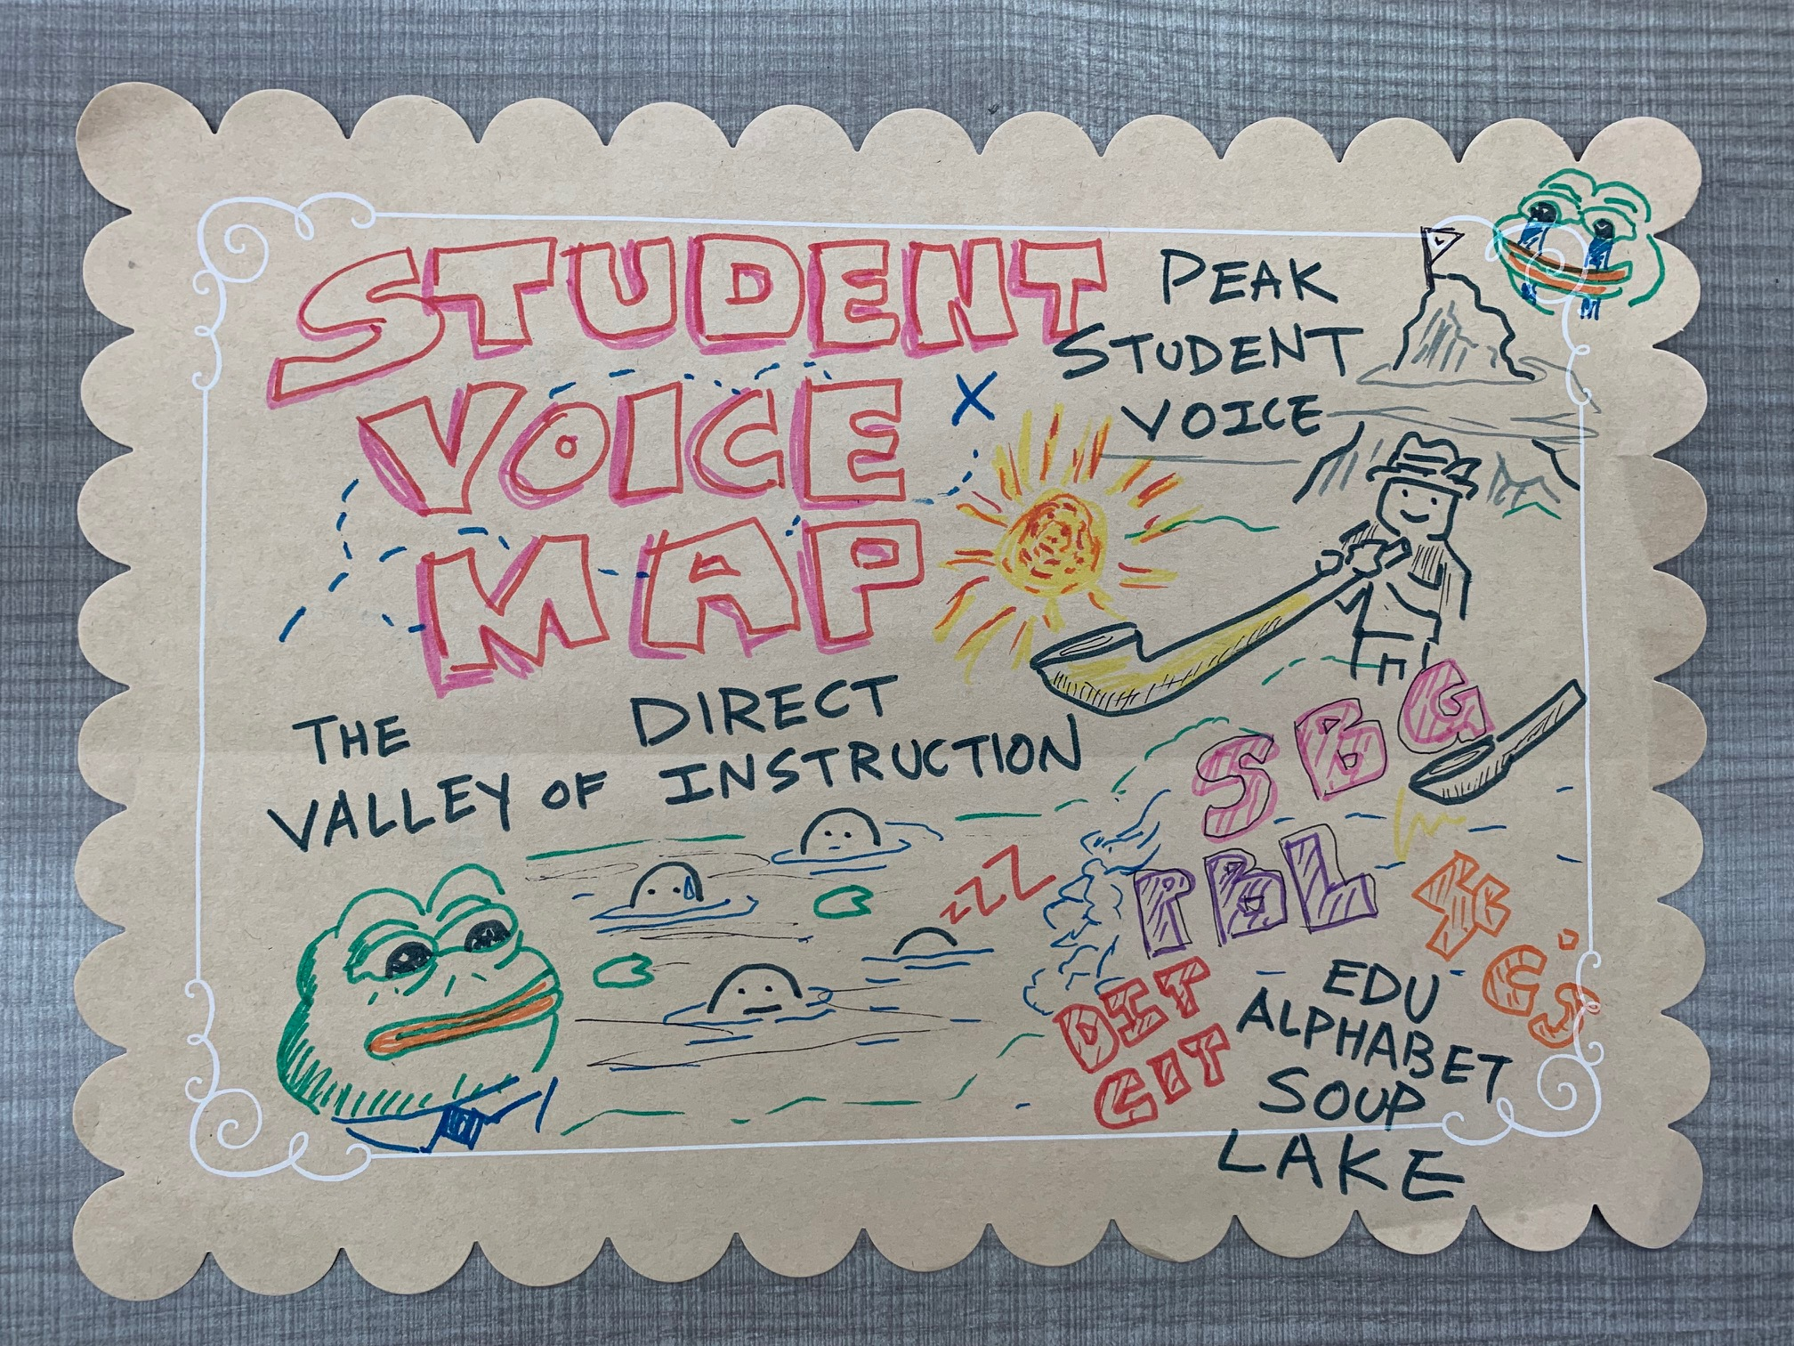
Student Voice Map

Slide 9
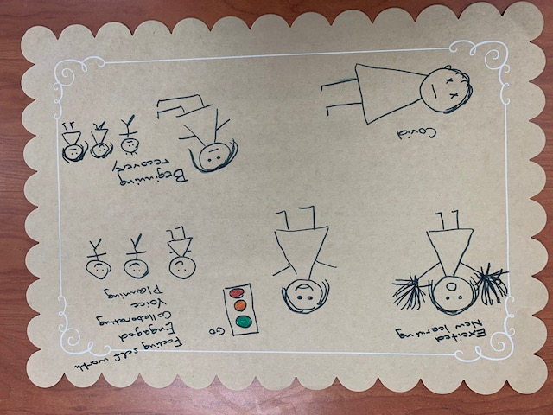
Student Voice Map

Slide 10

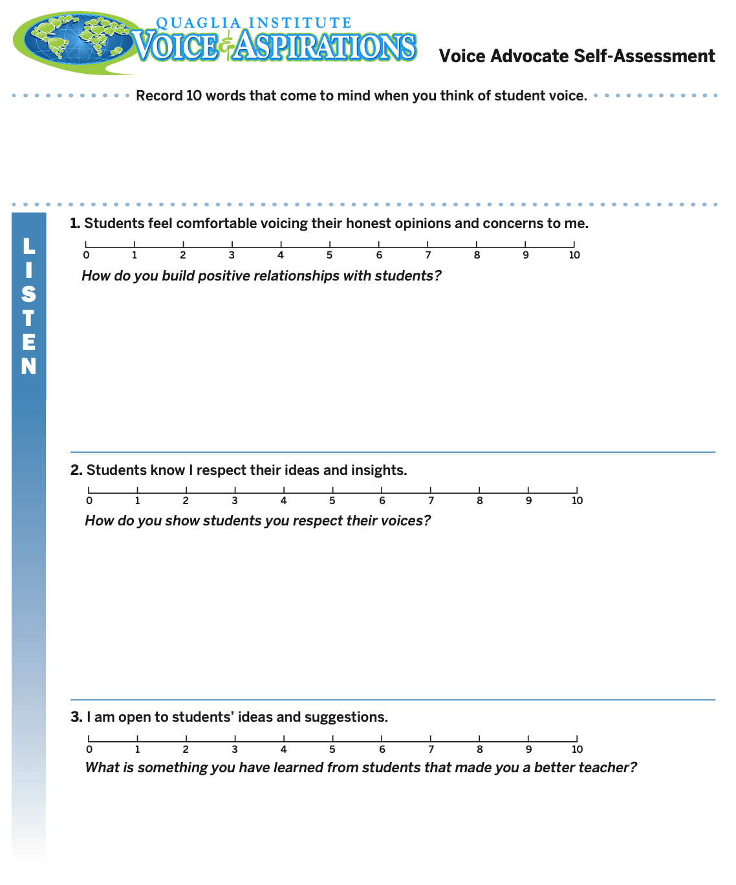
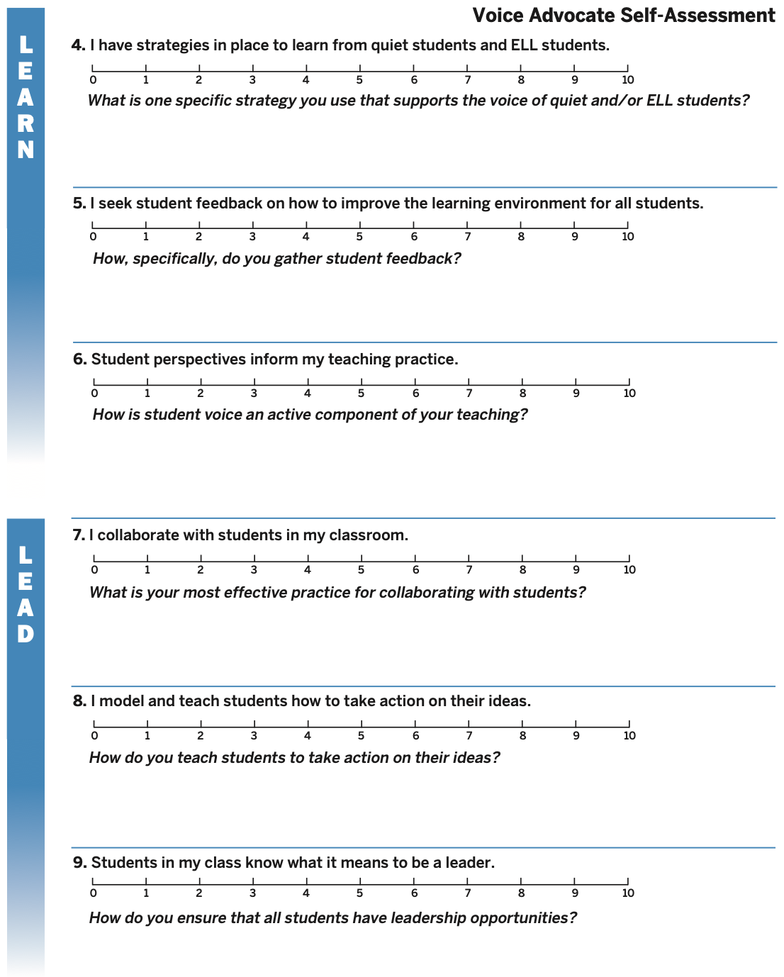
Voice Advocate
Self-Assessment
Complete the
Self-Assessment.
What did
you learn?

Slide 11
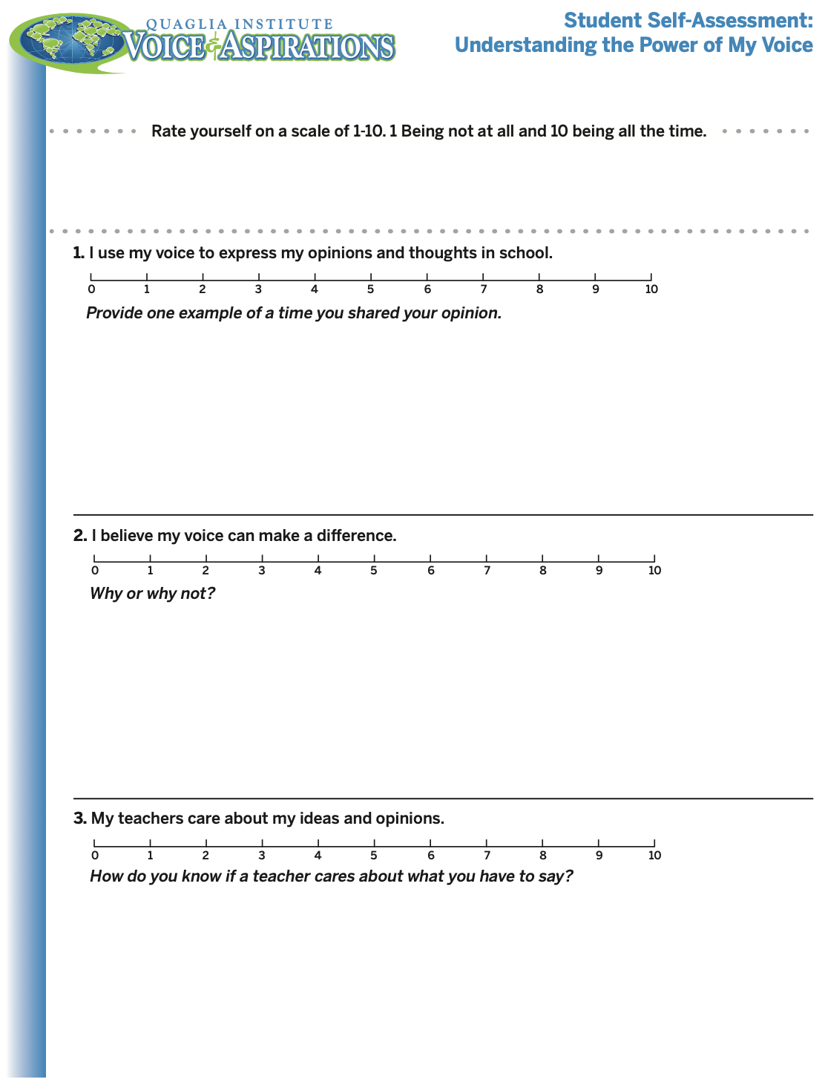
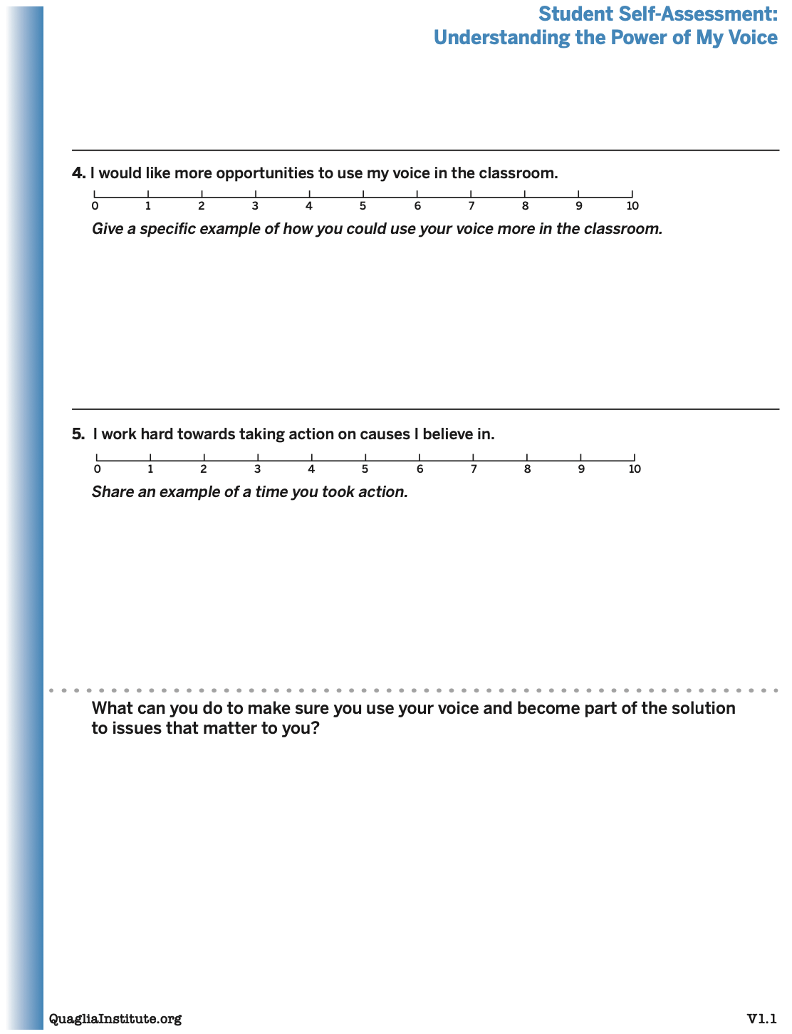
Student Voice
Self-Assessment
Consider having your students
complete this
“Understanding
the Power of
My Voice”
self-assessment.

Slide 12
Time to journey
onward & explore
the Voice Process:
Listen, Learn,
& Lead

Slide 13
LEAD
TAKE ACTION
with others
Share
RESPONSIBILITY
LEARN
UNDERSTAND
& RESPECT
different points
of view
Build
TRUST
LISTEN
SEEK OUT
opinions from
others
Voice Process

Slide 14
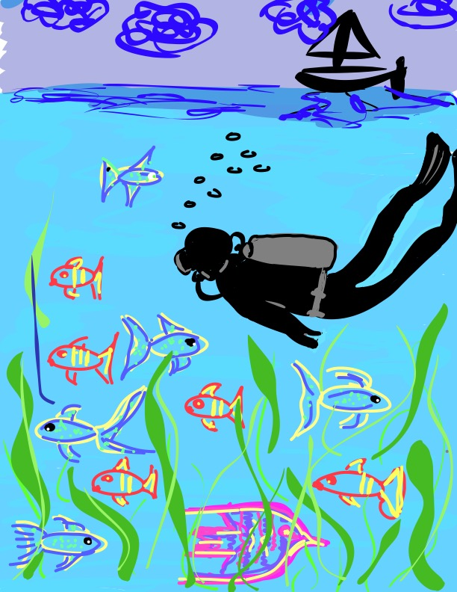
Let’s Dive Deeper…
Listen
Learn
Lead

Slide 15

Listen

Slide 16
The Art of Listening
Vimeo:
http://vimeo.com/qisva/listening
or
YouTube:
https://youtu.be/ooE9dKobjZU
Video

Slide 17
Listen
Reach out & listen to voices
you typically don’t hear from
Stay focused (put away your phone!)
Be genuine & truly interested
Engage in 2-way conversations that are
life-giving
Be perpetually open to new ideas

Slide 18


Challenge Time!
Drawing Dictations
Round 1: Find a partner &
assign one person to be the
Describer, & one person to
be the Artist. Sit back to back. Without looking or asking
questions, describe to your
partner how to replicate
your picture.
Round 2: Switch roles
(Describer & Artist) &
repeat, but this time you
can ask clarifying questions.

Slide 19

Reflect
What are the biggest challenges/barriers to effectively “listening”
to students?

Slide 20

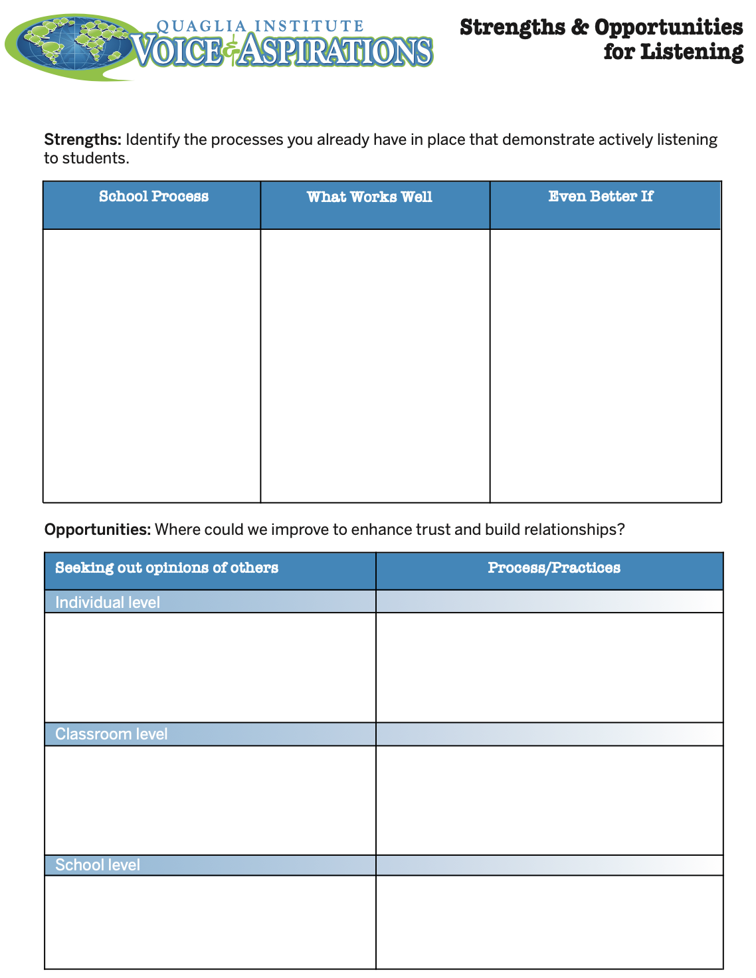
Reflect
What are your
strengths &
opportunities when it
comes to listening
to students?
How are you building
trust & positive
relationships with
ALL students?

Slide 21

Learn

Slide 22
Taking Time to Learn
Vimeo:
vimeo.com/qisva/time
or
YouTube:
https://youtu.be/tYKcvRfxK0o
Video

Slide 23
Challenge Time!
Connections
Find the connection
between the 4 individual pictures.

Slide 24
Connections
Vimeo:
vimeo.com/qisva/connection1
or
YouTube:
https://youtu.be/Yl3JrRtyGHc
(all 9 slides)

Slide 25
Vimeo:
vimeo.com/qisva/connections2

Slide 26
Vimeo:
vimeo.com/qisva/connections3

Slide 27
Vimeo:
vimeo.com/qisva/connections4

Slide 28
Vimeo:
vimeo.com/qisva/connections5

Slide 29
Vimeo:
vimeo.com/qisva/connections6

Slide 30
Vimeo:
vimeo.com/qisva/connections7

Slide 31
Vimeo:
vimeo.com/qisva/connections8

Slide 32
Vimeo:
vimeo.com/qisva/connections9

Slide 33
Challenge Time!
Your Connections
Pick a word that reflects your hopes & dreams for Student
Voice at Canoga Park
& create 4 images.
Can the group guess
your word?

Slide 34
Reflect
What voices might you still need to learn from?
What students are easiest & which are the most challenging for you to listen to & learn from?

Slide 35
Learn
Ask questions for clarity & take notes
Move from a place of judgement to wonder
you can learn from anyone
regardless of age, position, or any factor
Follow up & communicate what you
LEARNED from listening
Be prepared to change
Do not fear what you do not know

Slide 36
Challenge Time!
Why Why Why?
With a partner, consider the
provided scenario.
Write a list of possible reasons WHY behind your scenario.
Try to get 30 reasons or MORE!

Slide 37
Reflect
Why do we jump to conclusions
& solutions so quickly?
How might the component of “learn” impact your school improvement efforts?

Slide 38


Slide 39
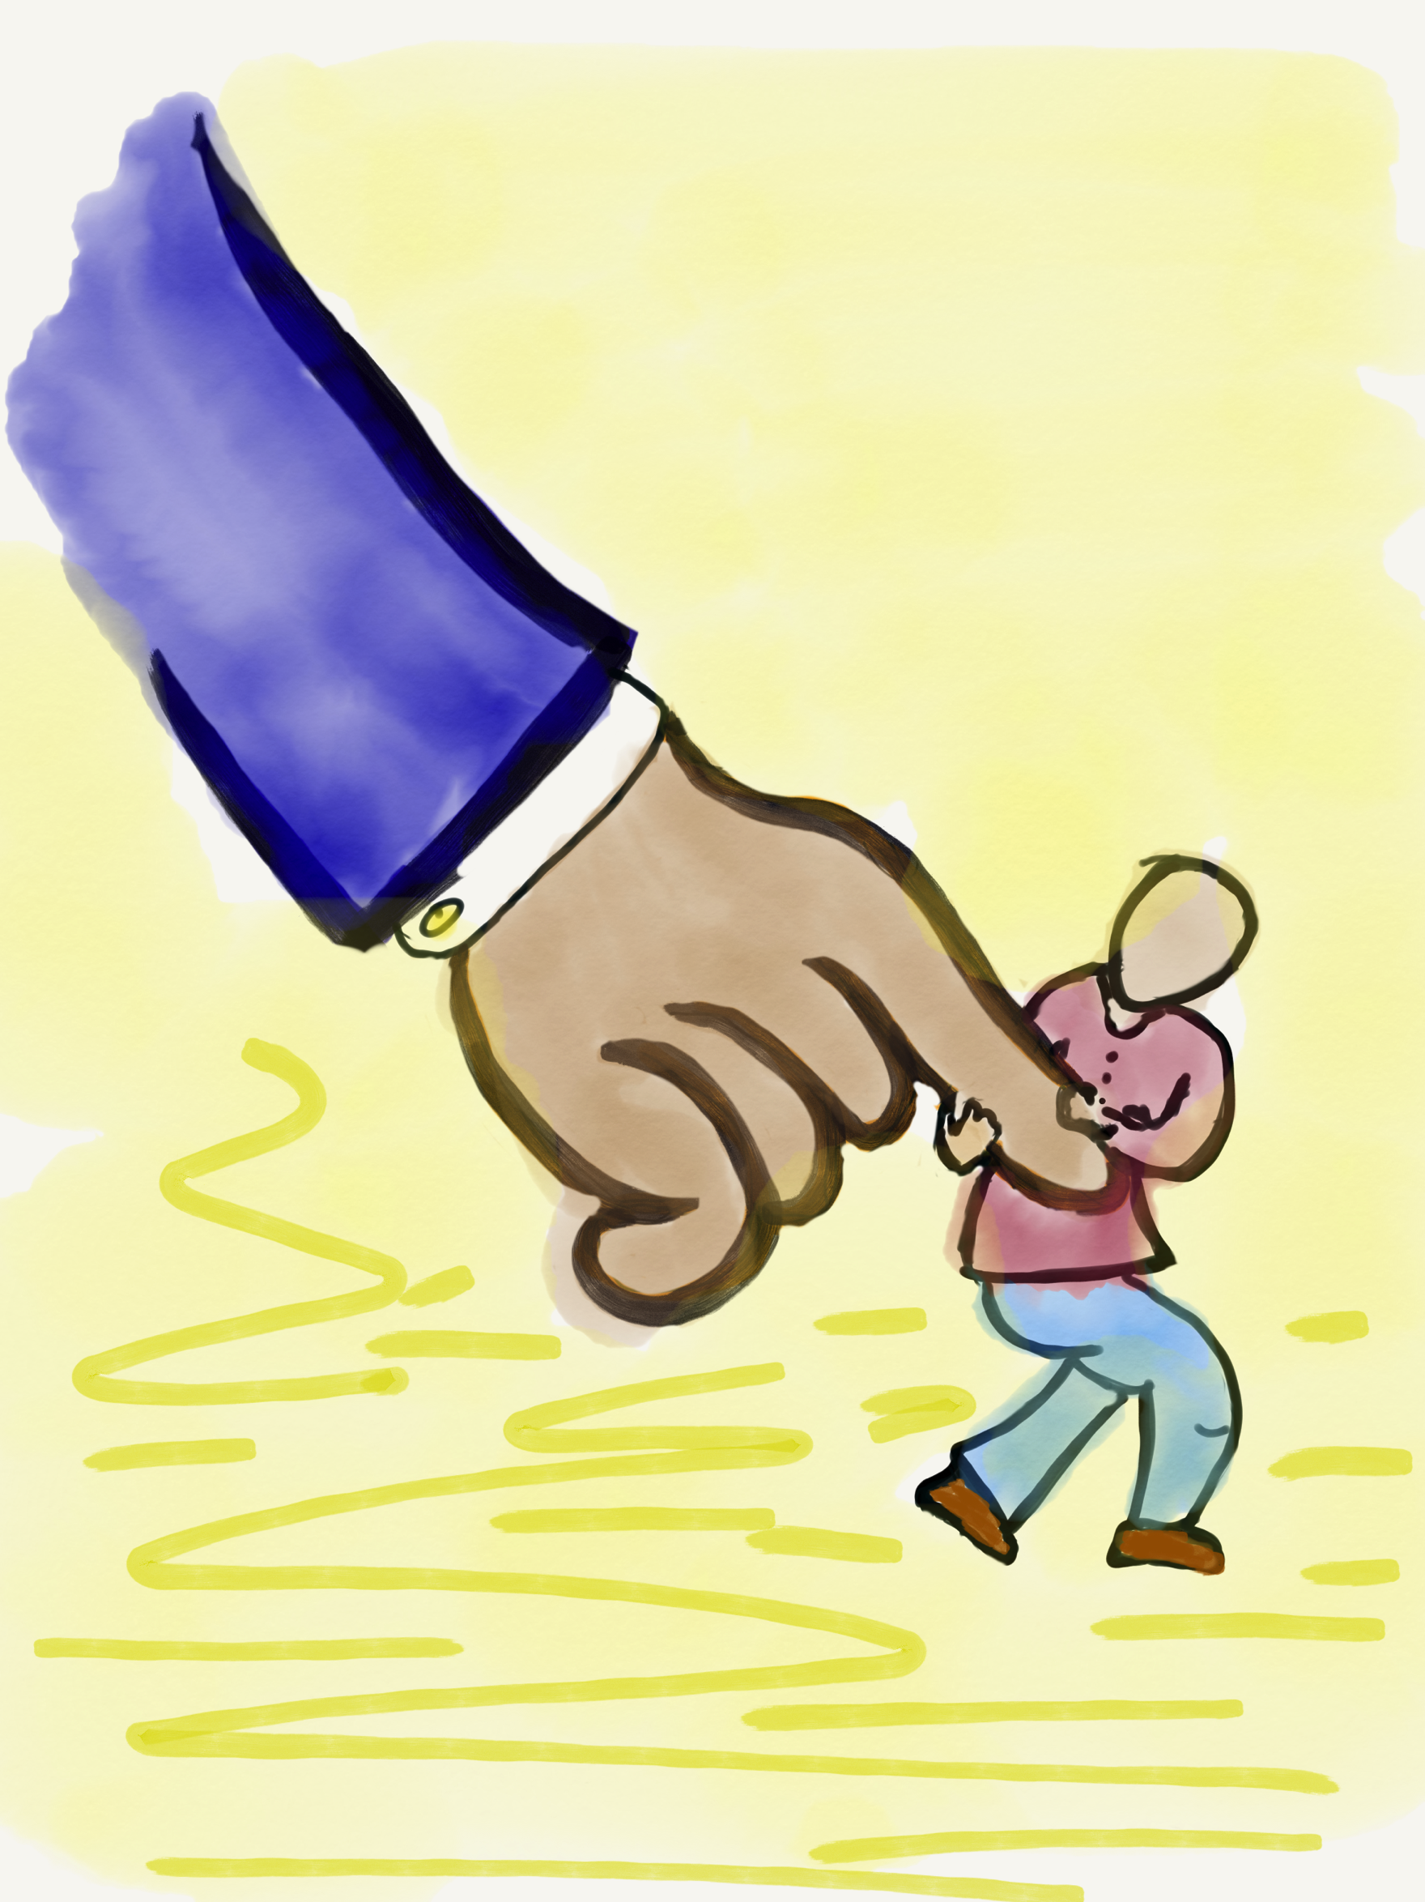
Lead

Slide 40
Leading Together…
Vimeo:
https://vimeo.com/qisva/together
or
YouTube:
https://youtu.be/RTvZCdUP7N4
Video

Slide 41

Reflect
What did you observe related to the term Lead in this video?

Slide 42
Lead
Use what you have heard & learned to drive meaningful change.
Leading is not a solo endeavor; take action in true partnership with others.
Created a shared sense of purpose.
Voice is not about getting your own way.
You can’t please everyone; but you can
demonstrate value & respect for all voices.

Slide 43

Lead
What do
you value?

Slide 44
Auction Time!!
Your team
gets $2,000!
Determine what items you want to buy at the
auction.
How much are
you willing to
spend on what?

Slide 45
Values Auction
Meaningful Collaboration
Planning Time
Professional Development
Opportunities
Small Class Size
Amazing Administration
Supportive Parents
High Student Achievement
Effective Communication

Slide 46
Reflect
What was the process like determining
your team strategy for the auction?
Why is it difficult to listen to & learn
from individuals who have different
values from yours?
How do you go about leading when
differing values, points of view, ideas exist?
(in your professional context)

Slide 47
RESOURCES

Slide 48

Website Just For YOU!
https://quagliainstitute.org/canoga-park-high-school

Slide 49
Where do we go next?
Aspirations Profile: Balancing
Dreaming & Doing
Aspirations Framework:
Self-Worth, Engagement, Purpose
(8 Conditions That Make a Difference)
Systems Thinking for Sustainable Change

Slide 50
Thank you for the opportunity to learn together today!
Dr. Lisa Lande
lande@quagliainstitute.org
@Lisa_Lande

