Slide 1


Student Voice & Aspirations
Dr. Lisa Lande
@QISVAtweets @Lisa_Lande
lande@quagliainstitute.org
www.QuagliaInstitute.org
January 21, 2025

Slide 2

Choose a card that represents a future you would like to create.

Slide 3

Learning Intention
We are learning about the power of amplifying voice in schools to support students in reaching their fullest potential.
Success Criteria
Embrace a common definition for student voice & understand the difference between Noise & Voice.
Consider strategies for supporting all students in
developing & using their voice to impact school
culture & the classroom learning environment.
Apply voice skills & pathways to instructional
practices at your school.
Today will be a home run for me if…

Slide 4
Fundamental Beliefs
Students are the potential, not the problem.
Students have something to teach us.
Working together is the only way forward.

Slide 5

Reflect
Blue: What comes to mind when you hear the term
Student Voice?
Yellow: Share an example
you have seen of Student Voice in Action.

Slide 6
Speed Dating
Vimeo
https://vimeo.com/854655576
YouTube
https://youtu.be/jA9u9zaaJRs
Video

Slide 7
Academic Speed Dating

Slide 8

Challenge Time…

Slide 9

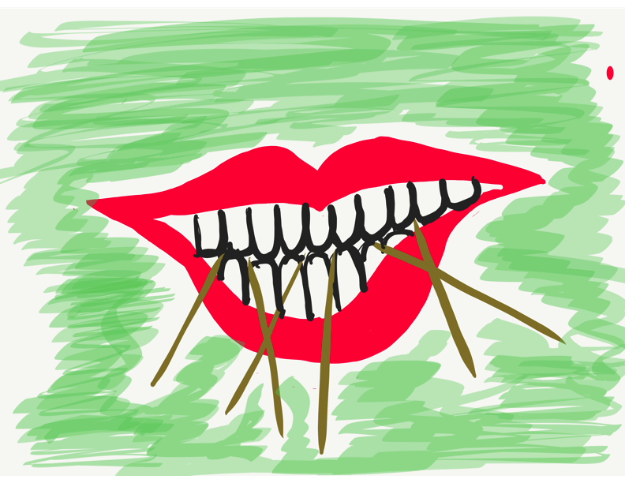
Toothpick Challenge
Using 6 toothpicks,
make 4 and only 4
equilateral triangles
(all 3 sides the same size).
You may not break the toothpicks.

Slide 10
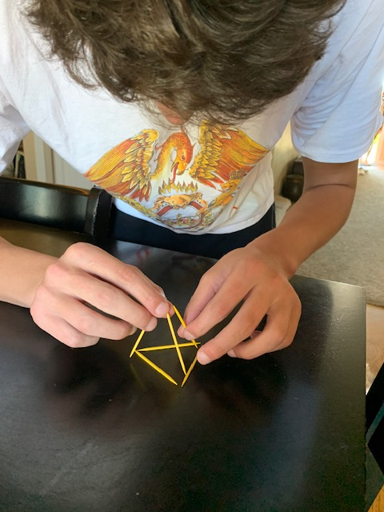
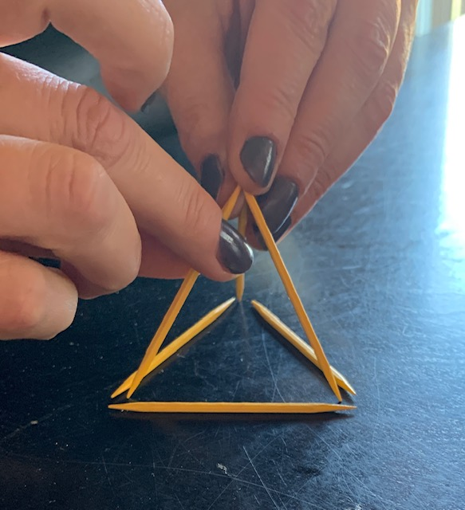
Today we invite you to do
some 3-D thinking!

Slide 11
Students Listen
to Teachers
Vimeo
https://vimeo.com/qisva/lausd
YouTube
https://youtu.be/eQubDPwngaw
Video
https://www.youtube.com/watch?v=O5Tt3H73IR0
Los Angeles, California, USA

Slide 12

Quaglia Institute Research
17 years of data
43 states
13 countries
980,905 Student Voice Surveys Grades 6-12
142,186 Student Voice Surveys Grades 3-5
628,975 iKnow My Class Surveys
56,353 Teacher Voice Surveys
27,115 Parent Voice Surveys
Notes:
Updated Jan 3, 2022

Slide 13
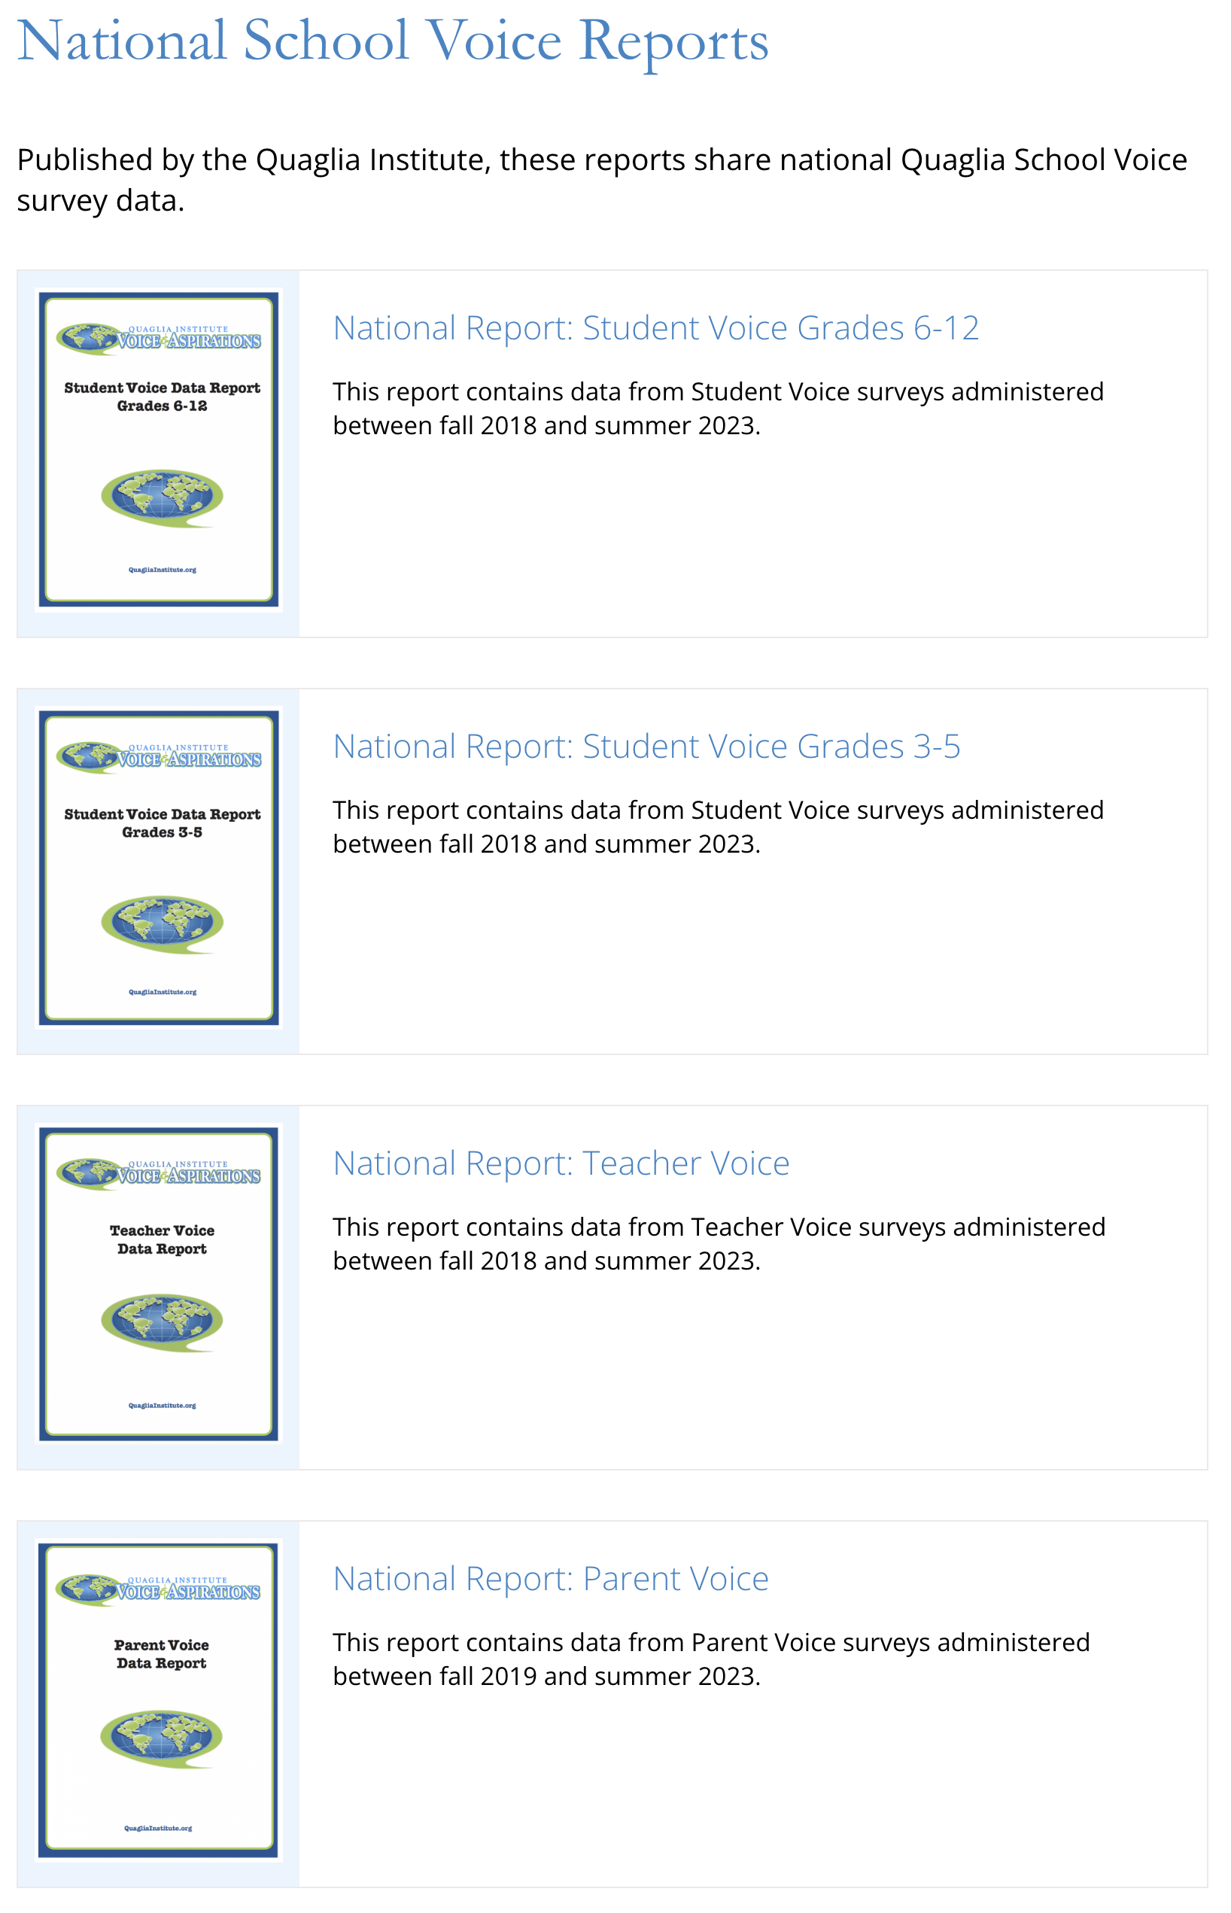
Quaglia Institute
Research
QuagliaInstitute.org

Slide 14

Why Student
Voice?

Slide 15
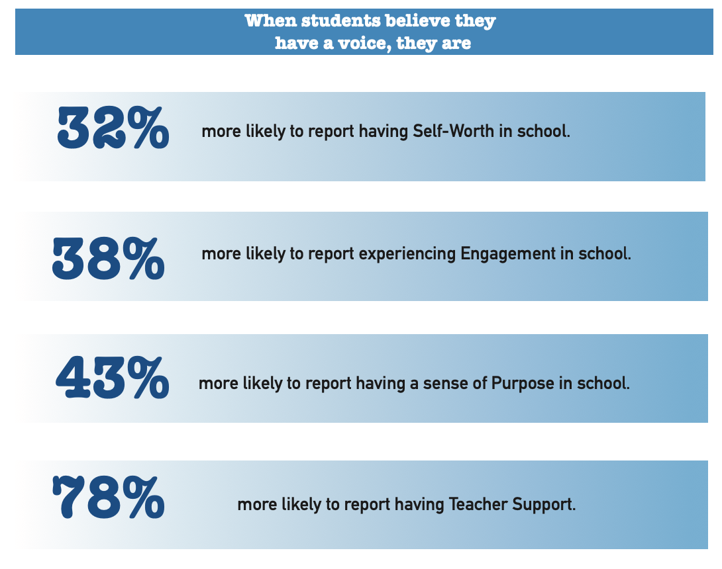

Slide 16

54% of students report that adults listen to student suggestions.

Slide 17

52% of students report using their voice to express their thoughts & ideas.

Slide 18

52% of students report having a voice in decision making at school.

Slide 19

51% of students say they work with adults to make their school better.

Slide 20

Student Voice
is not YET a
natural way of
being.
Why Not?

Slide 21

The Student Voice
Journey Begins!
First, we need a clear
definition of Student Voice
that we can all
understand, accept, &
put into practice.

Slide 22

The 3 Components of Student Voice
Sharing thoughts & ideas in an environment underpinned by trust & respect.
Offering realistic suggestions for the
good of the whole.
Accepting responsibility for not only what is said but also what needs to be done.

Slide 23

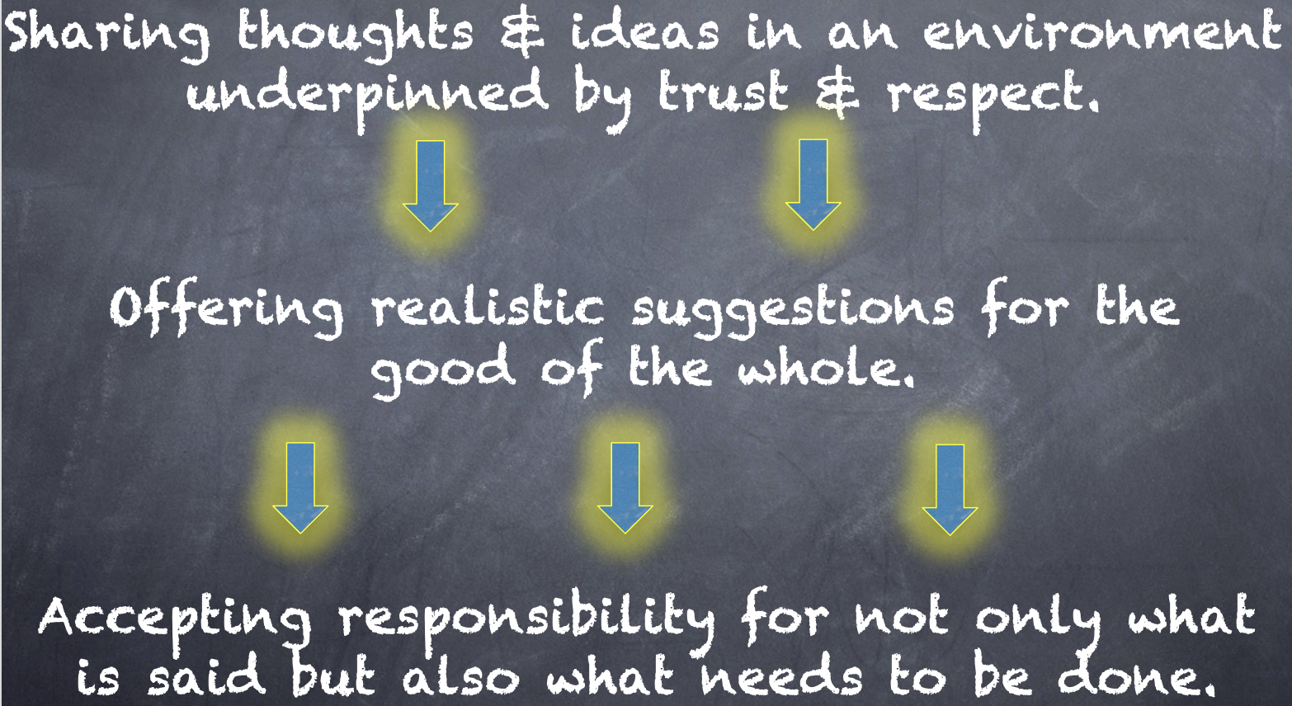
Meet With Your Feet
How does this voice definition connect with goals, initiatives, programs, etc. at Canoga Park?

Slide 24
Challenge Time…

Slide 25


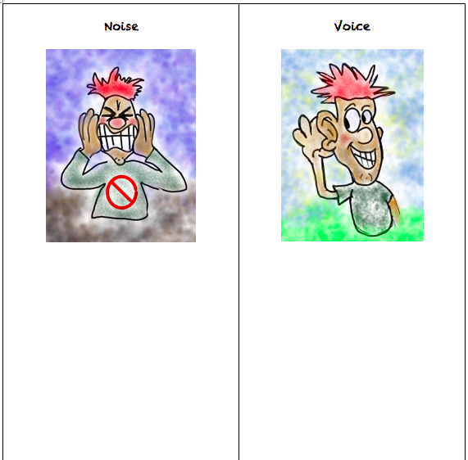
Challenge
Noise vs. Voice
Share words, phrases, &
examples of
Noise.
Now share words, phrases, &
examples of
Voice.

Slide 26
Noise vs Voice
Student Noise
Demands/commands/chaotic
Student opinion is most important
All adult voice is negative
Everyone needs to change but me
Complaining/whining
Student Voice
Requests/inquiry/focused
Our ideas are stronger in partnership
Students are open to learn
Personal reflection
Accepting responsibility

Slide 27
Students Control the Volume
Voice Inhibitors
Anger/extreme emotion
Rhetoric
Volume/Tone
Close Minded
Self-Serving
Voice Amplifiers
Authenticity/Genuineness
Knowledge
Refocus, Reanalyze, Readjust
Relentless
Being a “student”

Slide 28
Challenge
Noise vs. Voice Art
As a table group, create a visual representation that reflects the difference between Noise v. Voice.
When finished, post your art masterpiece on the walls around the room.

Slide 29
Gallery Walk
Welcome to the Silent Gallery!
Take a wander around the room and take in the Noise v. Voice artwork created by the group.

Slide 30

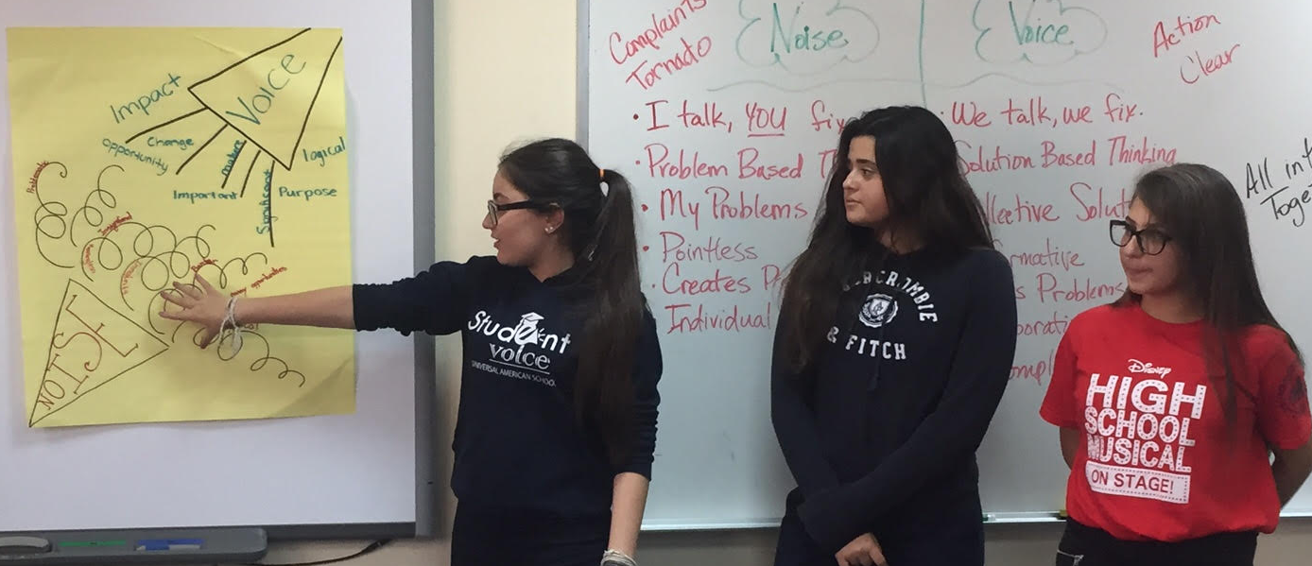
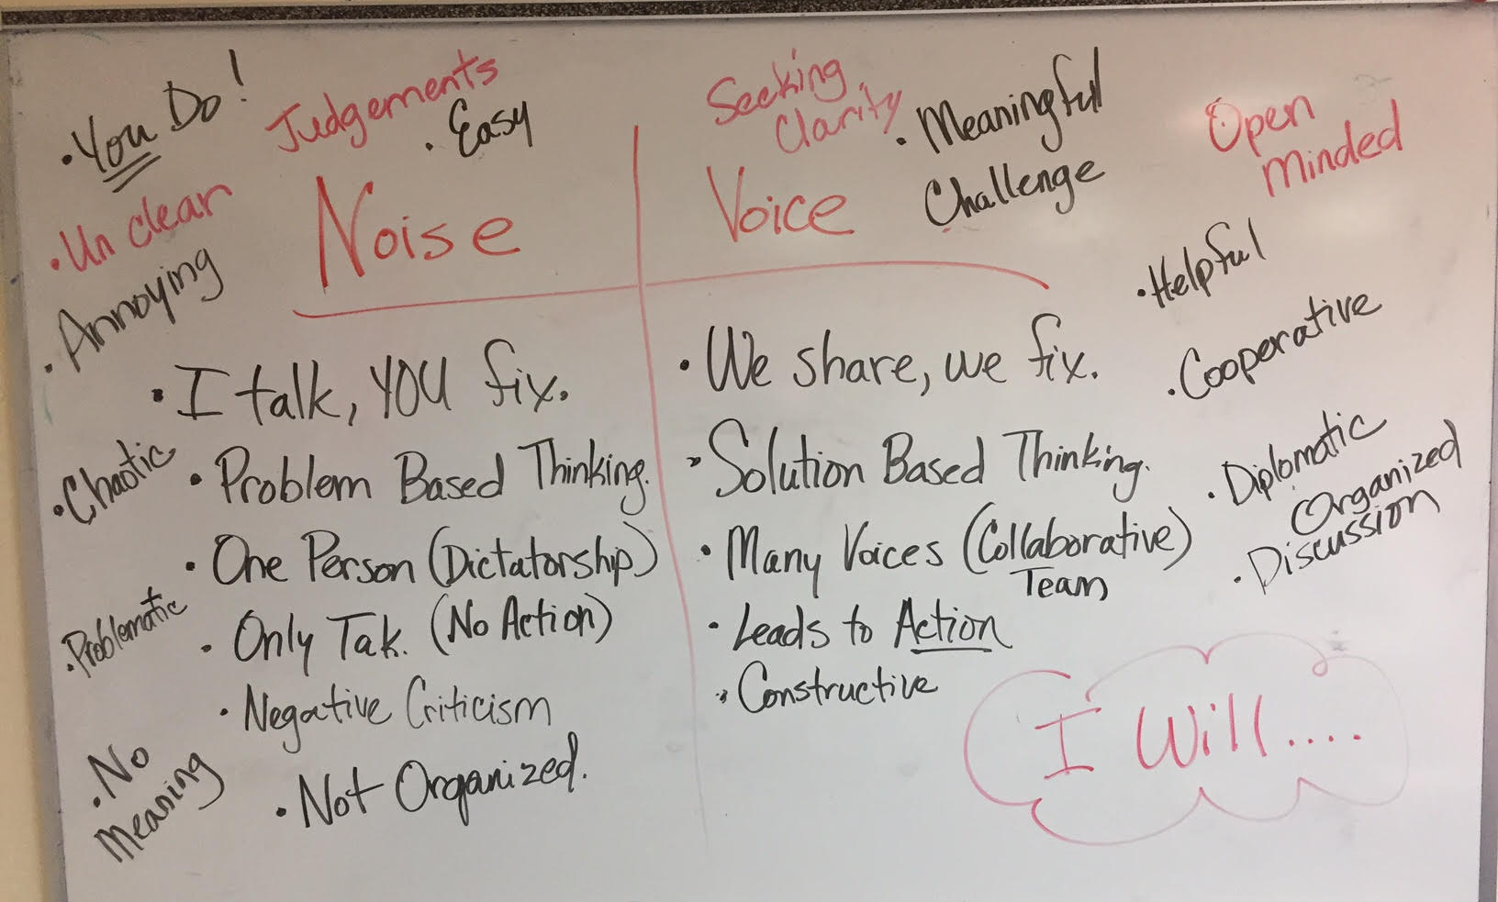
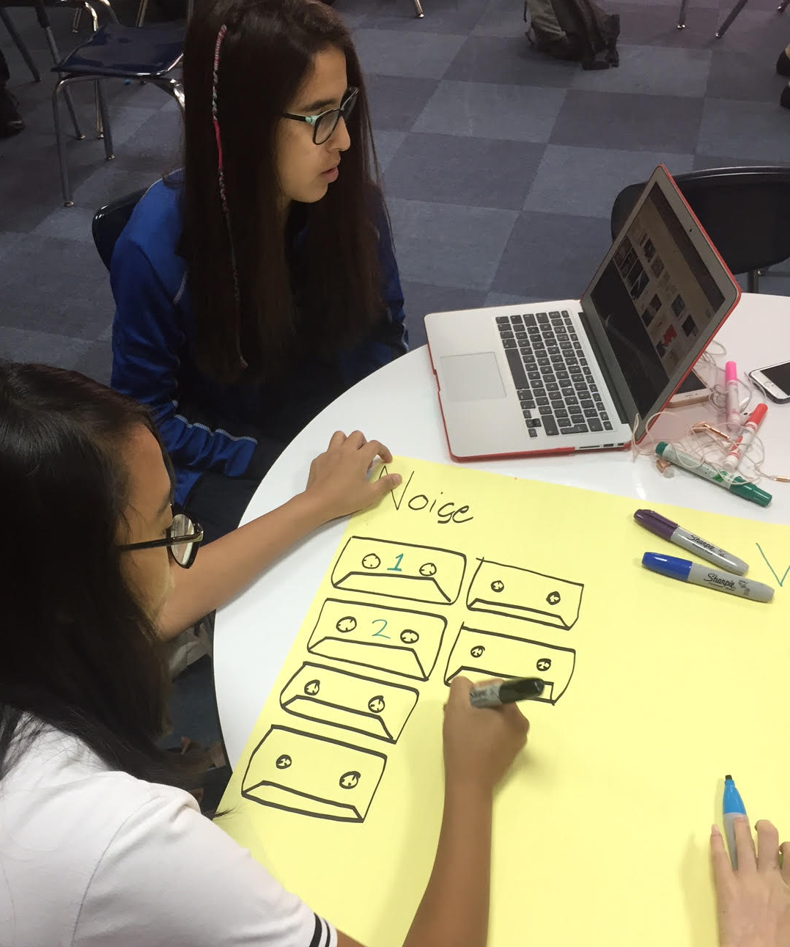
Student Voice in Action
Universal American School,
Dubai, UAE

Slide 31
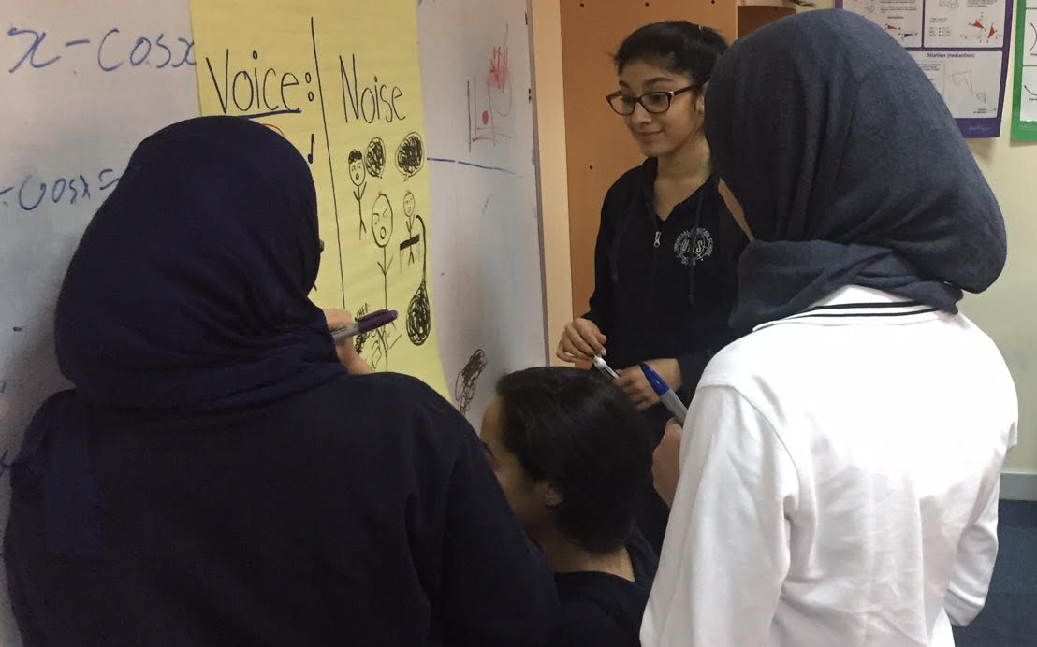
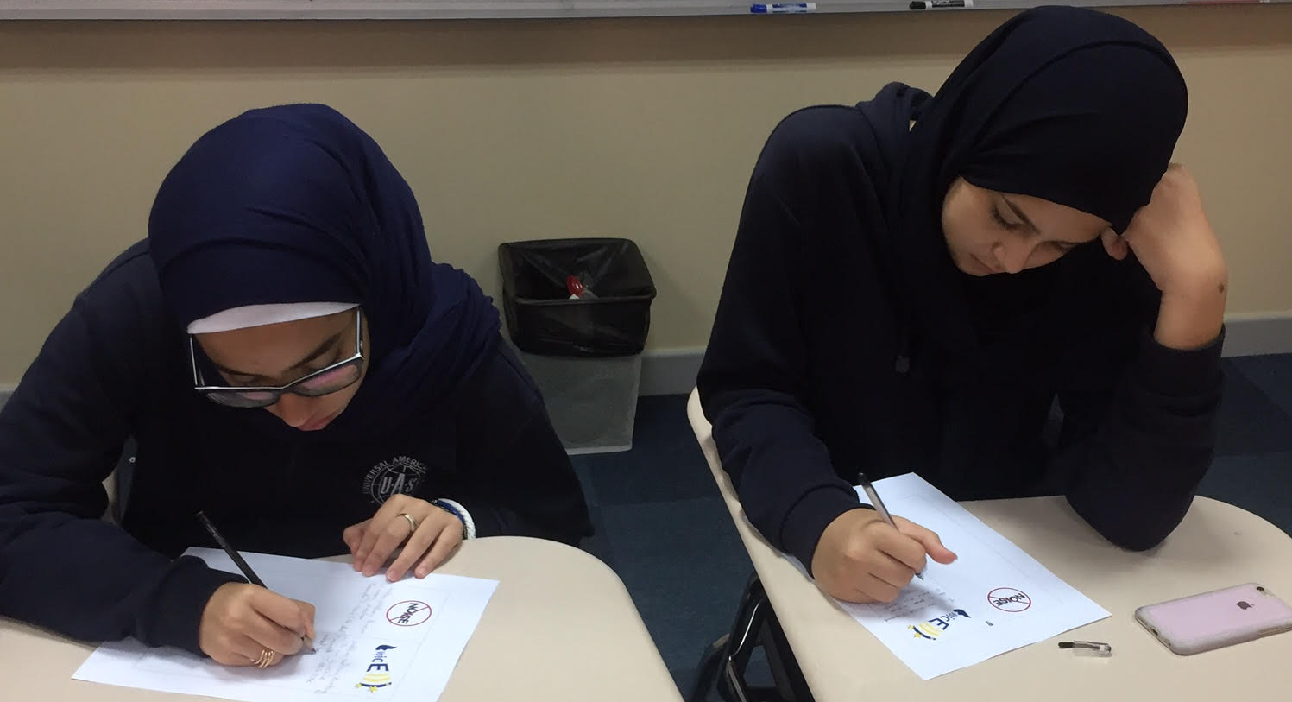
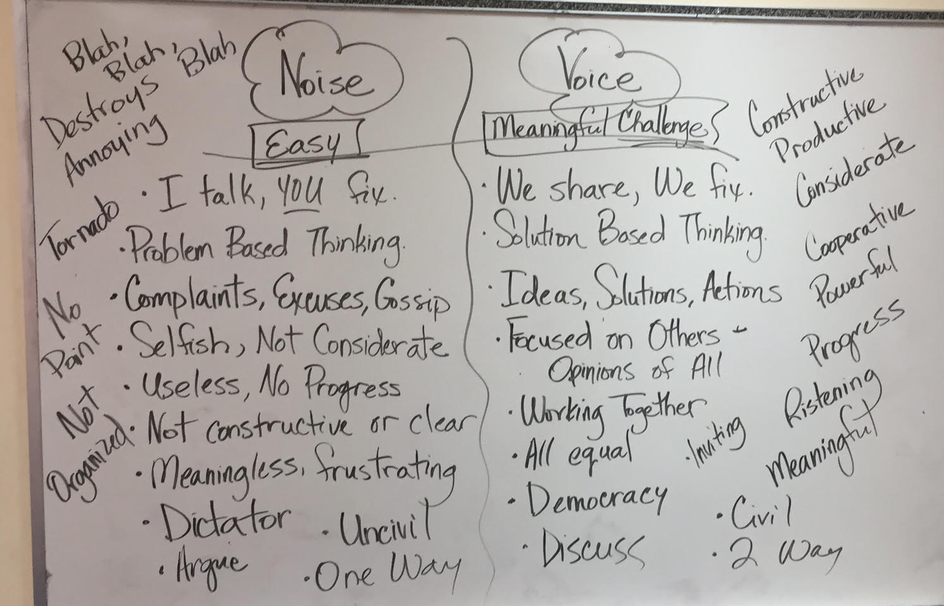
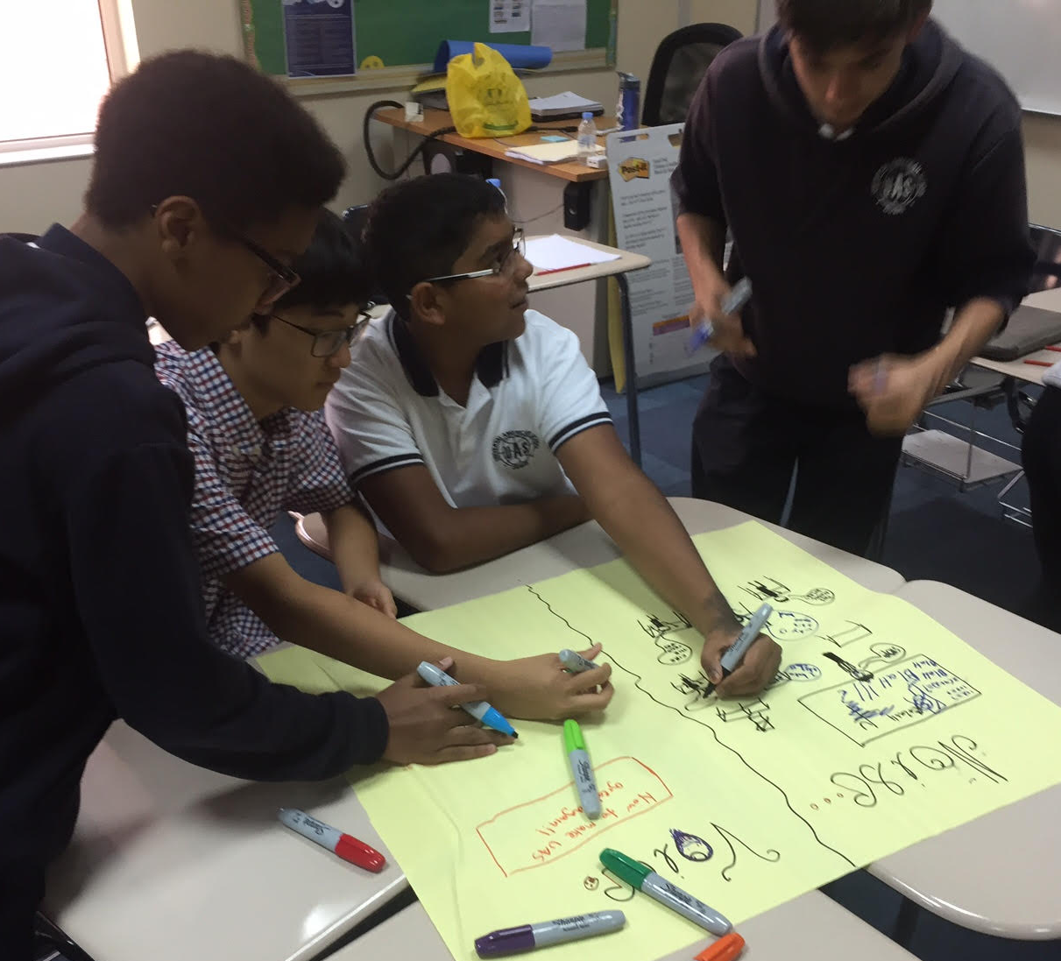
Student Voice in Action
Universal American School, Dubai, UAE

Slide 32
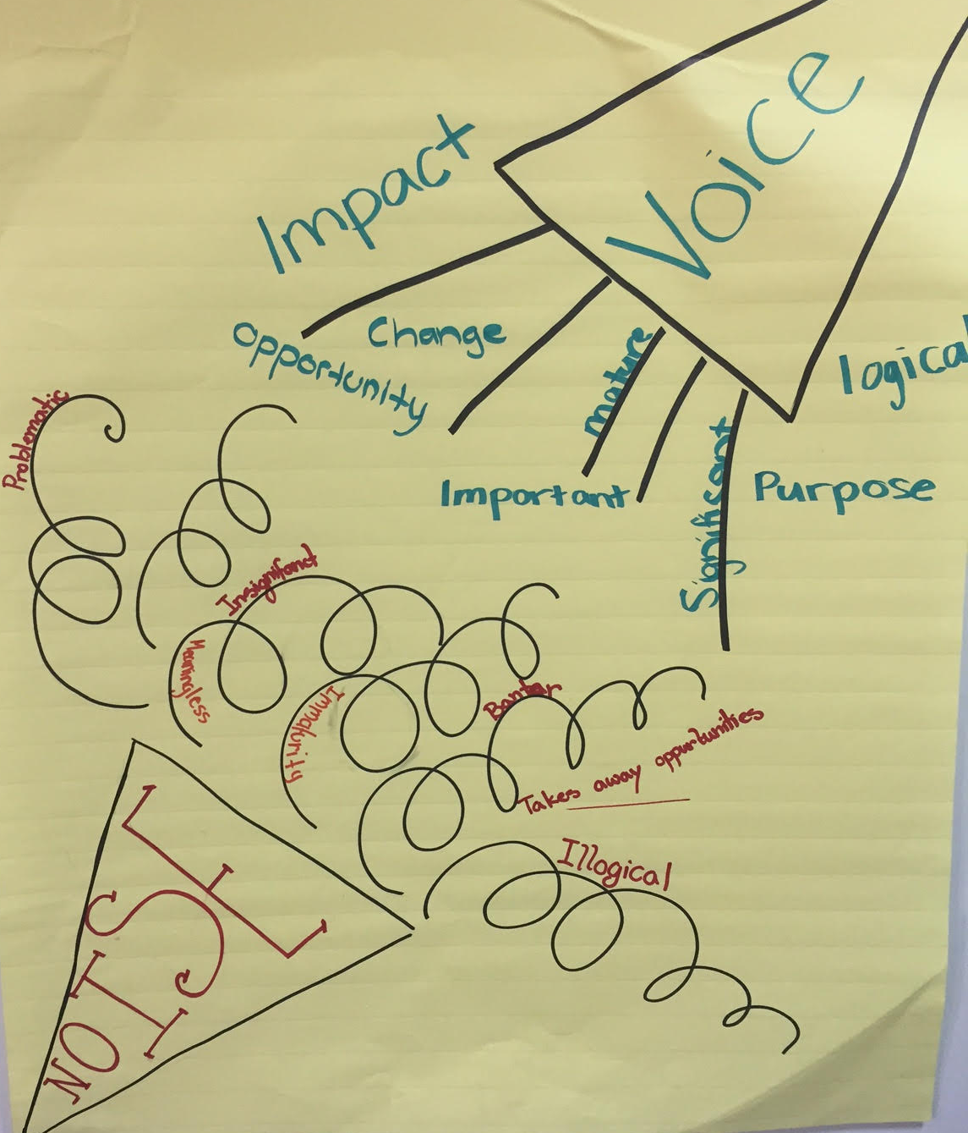
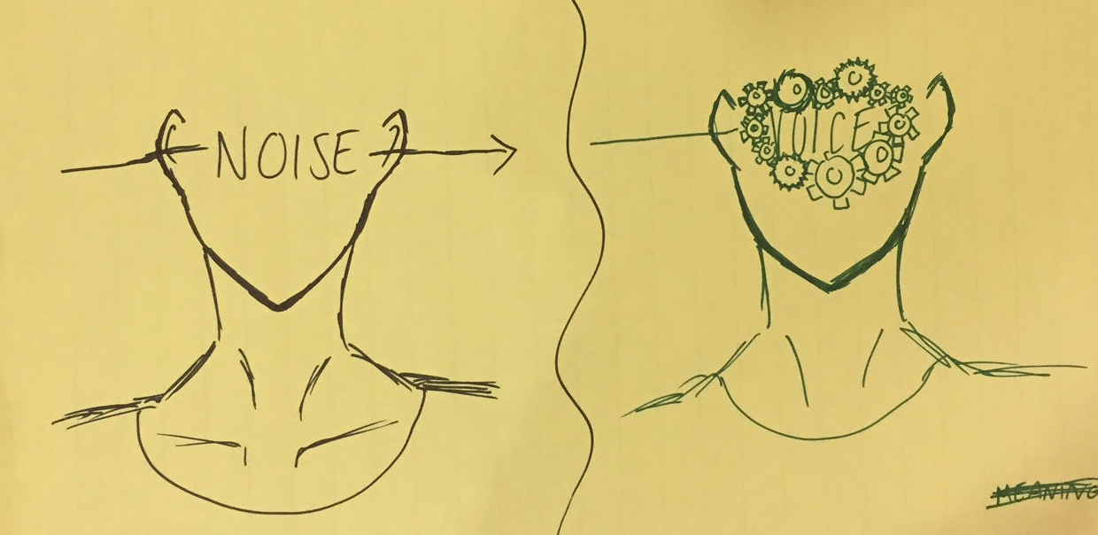
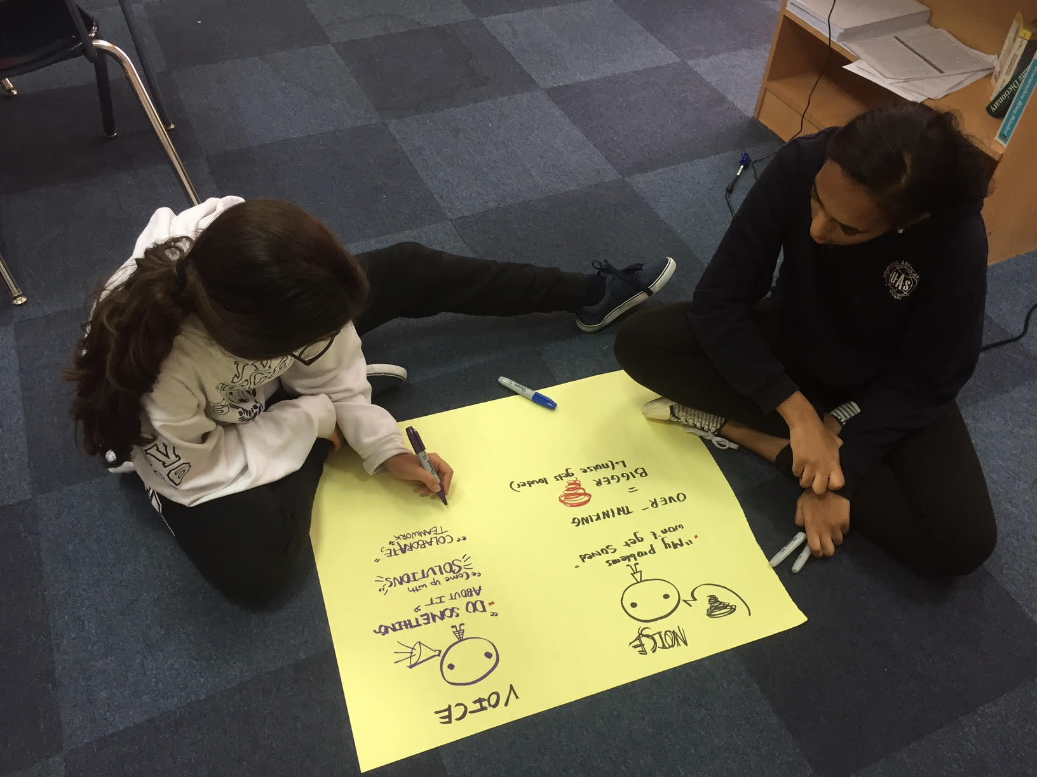
Student Voice in Action
Universal American School, Dubai, UAE

Slide 33
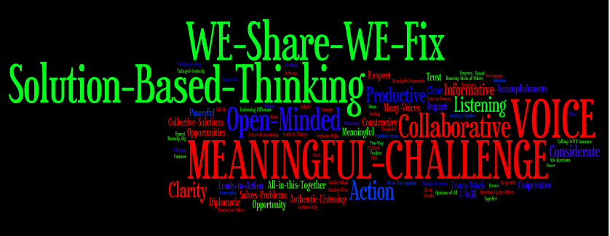
Student Voice in Action
Universal American School, Dubai, UAE

Slide 34
Student Voice in Action
Vimeo:
https://vimeo.com/1008816318/7a58ebf306
YouTube:
https://youtu.be/GLZdjHKUC6A
Video
Lawrence Middle School, Los Angeles, California, USA

Slide 35
REFLECT
What skills do your students need for their voices to be heard?

Slide 36
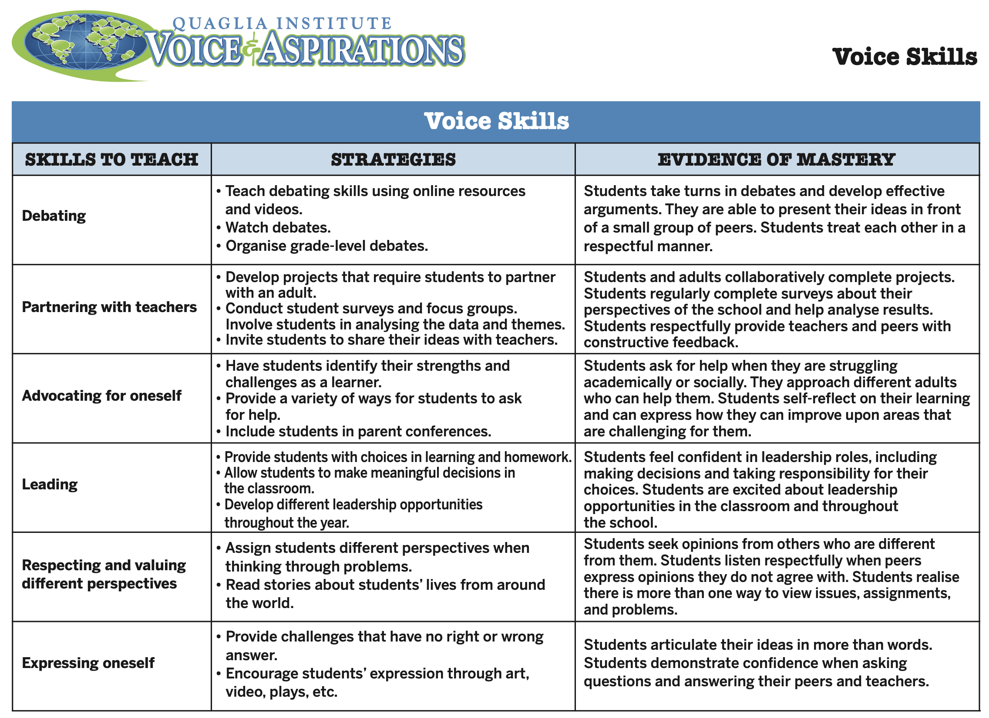
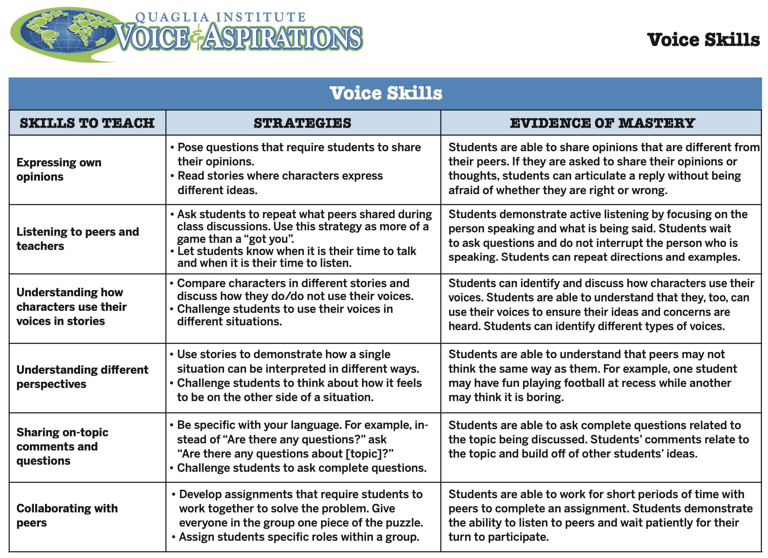

Slide 37

Voice Implementation

Slide 38
Where do we go next?
Student Voice Process:
Listen, Learn, Lead
Aspirations Profile: Balancing
Dreaming & Doing
Aspirations Framework:
Self-Worth, Engagement, Purpose
(8 Conditions That Make a Difference)
Systems Thinking for Sustainable Change

Slide 39
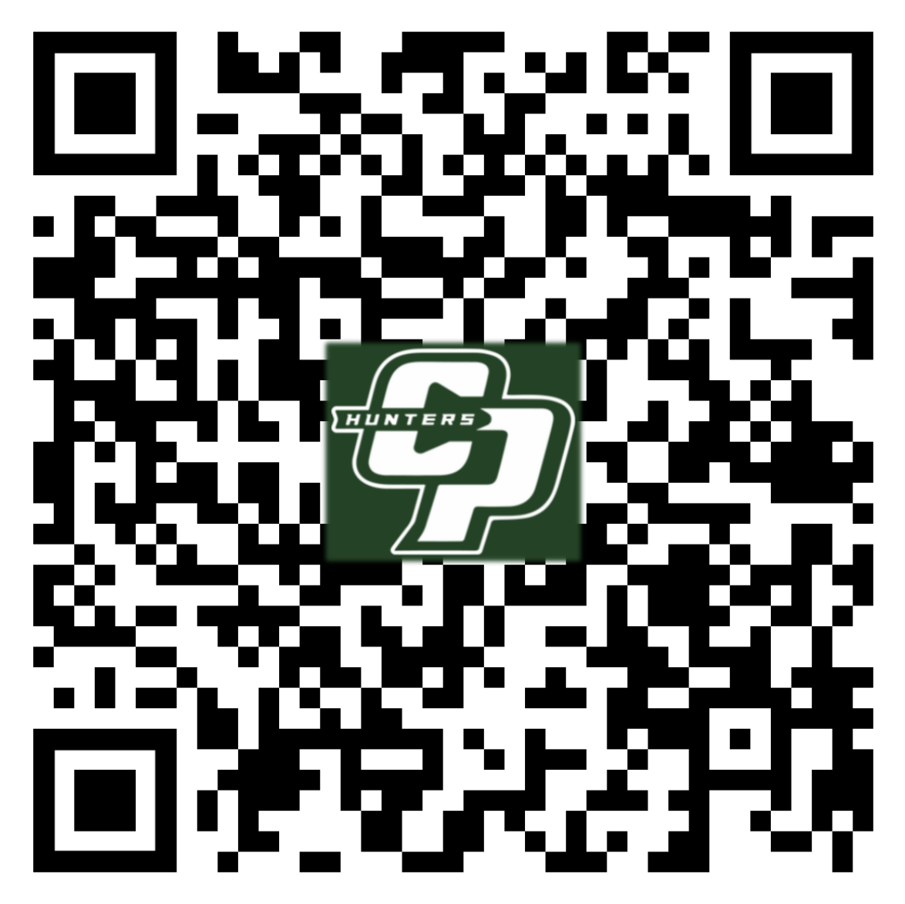
Website Just For YOU!
https://quagliainstitute.org/canoga-park-high-school

Slide 40
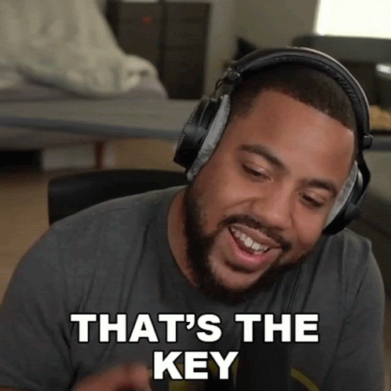
What is your key take away from today’s session you can share with colleagues &/or students?

Slide 41

What is your key take away from today’s session you can share with colleagues &/or students?

Slide 42

Thank you for the opportunity to learn together today!
Dr. Lisa Lande
lande@quagliainstitute.org
@Lisa_Lande

