Slide 1





Belonging
Heroes

Slide 2

Warm Up
In small groups,
share 3 statements
about yourself.
2 should be truths and 1 should be a lie.
Your group will try to guess which is the lie.

Slide 3
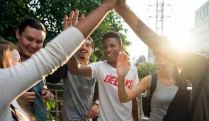
What did you learn
about one of your peers?

Slide 4
Where Do I Belong?
This is a silent game. NO TALKING!
No looking at your own dot or telling
others what color dot they have.
Group yourselves according to the dots.
Let’s play a Game!

Slide 5
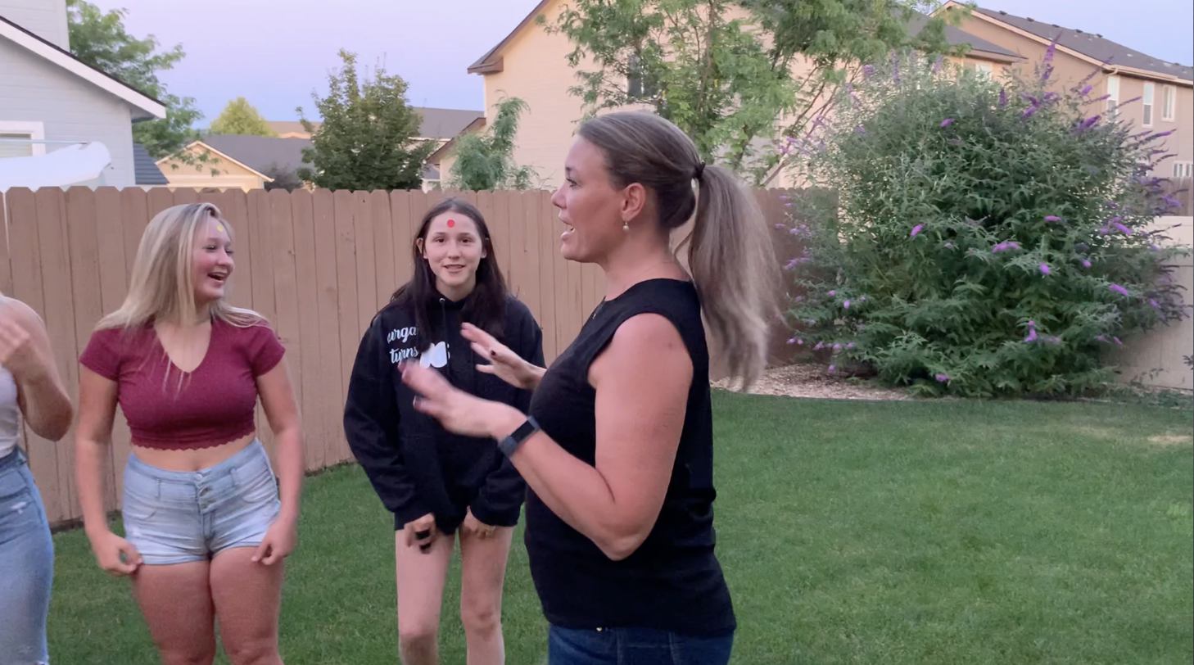
Vimeo
https://vimeo.com/qisva/odddot
YouTube
https://youtu.be/x8r7BDQzaTY
Notes:
This video was taken in my backyard during COVID and used for virtual professional learning sessions with teachers to demonstrate the Odd Dot Out activity and a debrief conversation with students. This group of high school students were in a COVID learning pod together—so don’t worry—I didn’t break any quarantine rules! ☺ Also, sorry for the background noise—my neighbor decided that while I was recording this video would be the perfect time to mow the lawn! Haha! Thought this might be helpful for you to see a sample of how this activity plays out—but would not suggest showing it to other students when you teach the lesson.

Slide 6
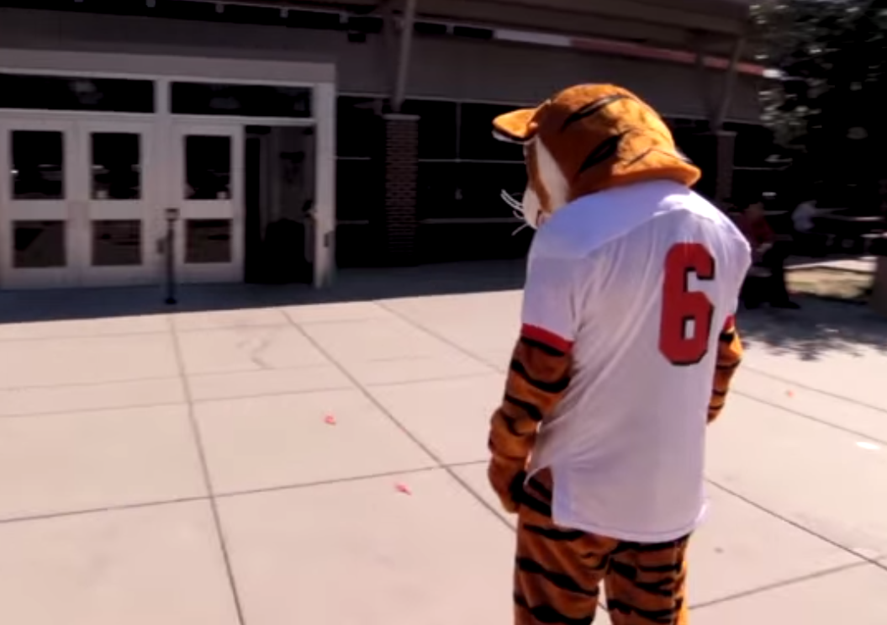
Think About It
Why does it seem natural to connect with people who
are like you?
What benefits are there to connecting with students who
are different from you?
What was it like trying to find where you would fit?
Does it require words to let someone know they are
welome & that they belong?

Slide 7

Vimeo
https://vimeo.com/1179963999/3540d2d82d
YouTube
https://youtu.be/eLd-92BywlU

Slide 8
BELONGING
Feeling like you are an important part of
the group, while knowing you are special for who you are as an individual.
What can you do to help someone at
Woodside feel valued & like they belong?

Slide 9
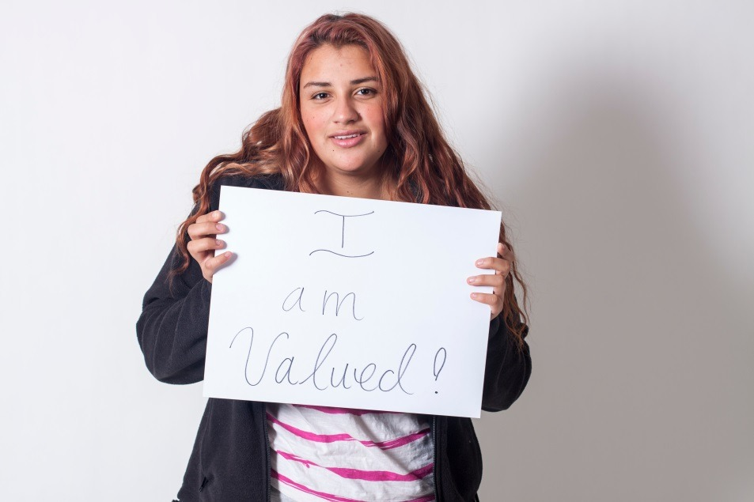

Slide 10
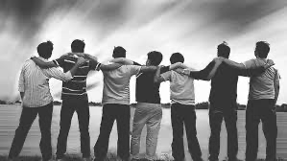
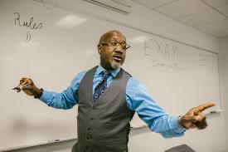

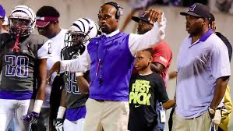
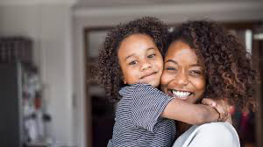
Heroes
An everyday person who encourages you to do your best. Someone you look up to and whom
you can turn to for help when you need it.

Slide 11


Slide 12

Be A Hero!
In groups of 4, discuss the
Hero Scenarios

Slide 13
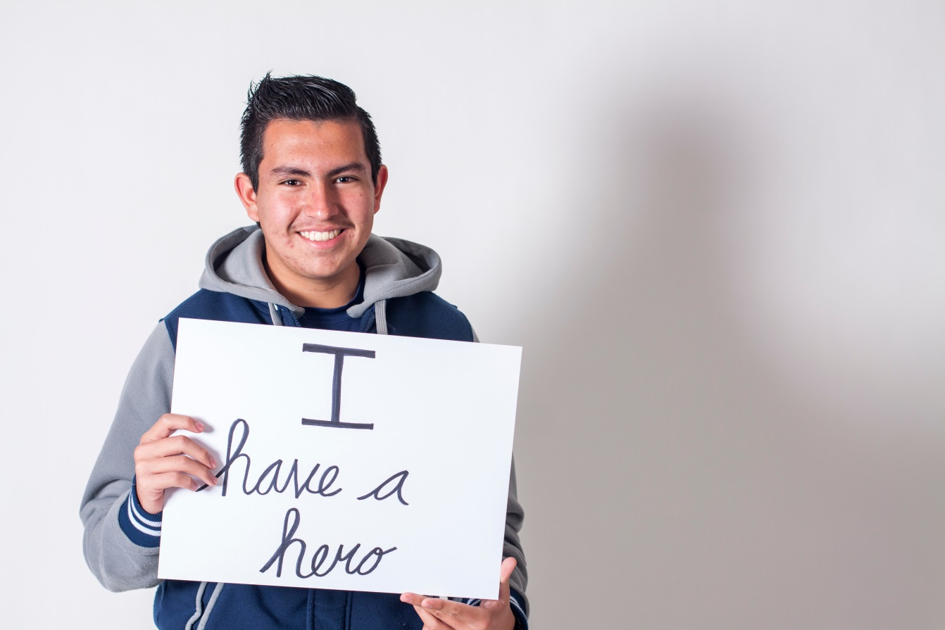
Be A Hero!
What can you do to be a Hero
at Woodside?

Slide 14
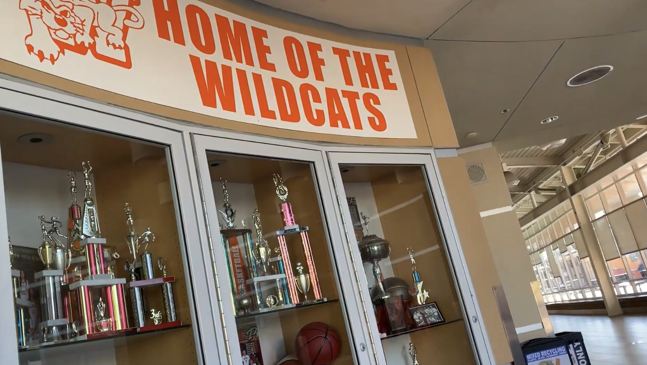
I Am Woodside
Vimeo:
https://vimeo.com/1179951302/79254d6f3a
YouTube:
https://youtu.be/LwNe9qSVaGM

Slide 15

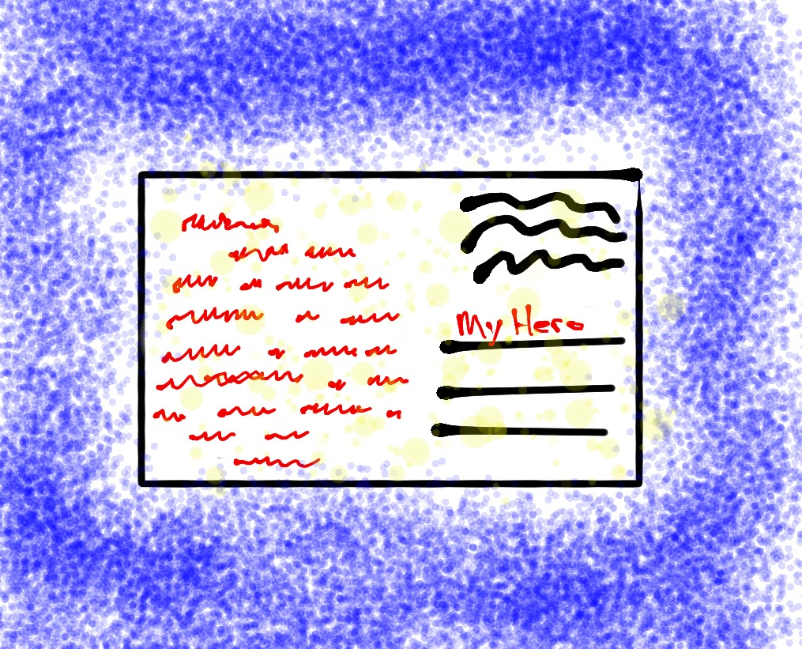

Attitude of Gratitude
Write a note of thanks to someone who
has been a Hero in a small or big way for you.
(Don't forget to deliver it!)

Slide 16
Student Voice & Aspirations
Belonging and Heroes

