Slide 1


Aspirations:
Balancing Dreaming & Doing to Reach Your Fullest Potential
Dr. Russ Quaglia
www.quagliainstitute.org
September 28, 2025

Slide 2
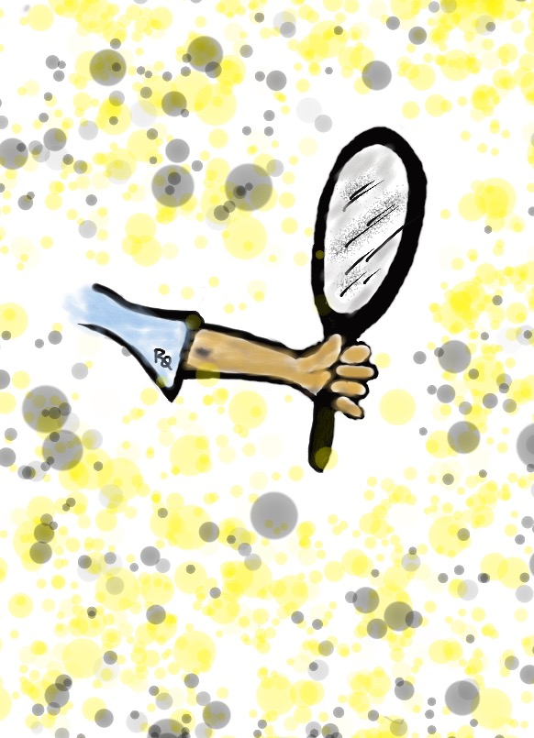
Reflect
What challenged you?
What inspired you?
What did you learn about
yourself?

Slide 3
ASPIRATIONS
The ability to
dream & set goals
for the future,
while being inspired
in the present
to reach those dreams.

Slide 4




high
Imagination
Aspiration
DREAMING
Hibernation
Perspiration
low
DOING
high

Slide 5
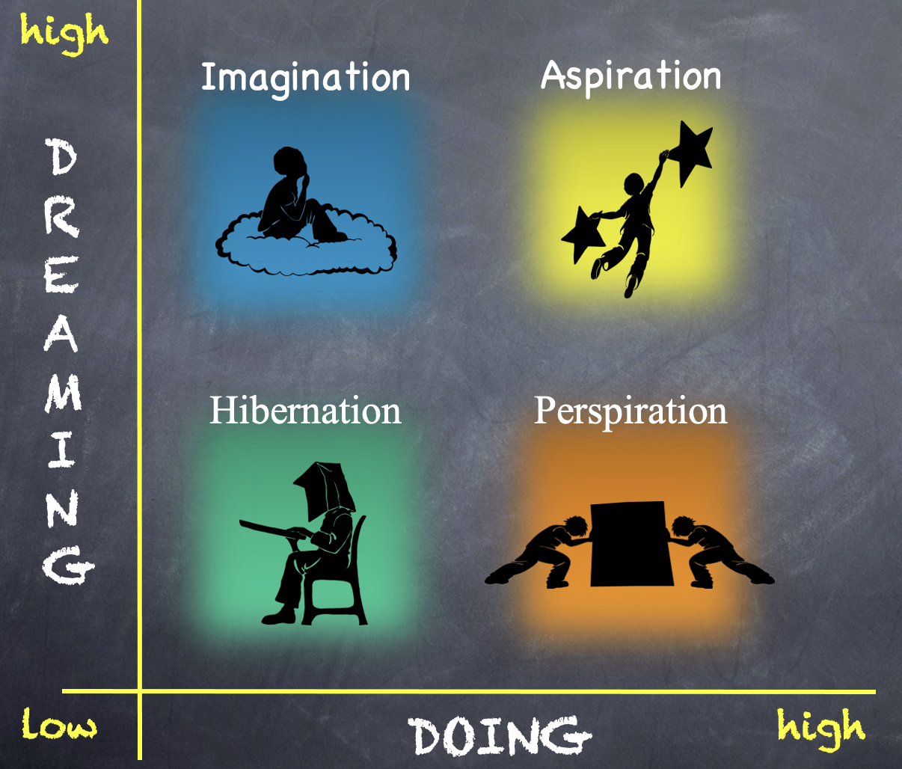
Reflect
WHY???
What do I need to do to get to the Aspirations Quadrant?

Slide 6

Time to Dig Deeper!

Slide 7
high
DREAMING
Hibernation
low
DOING
high

Slide 8
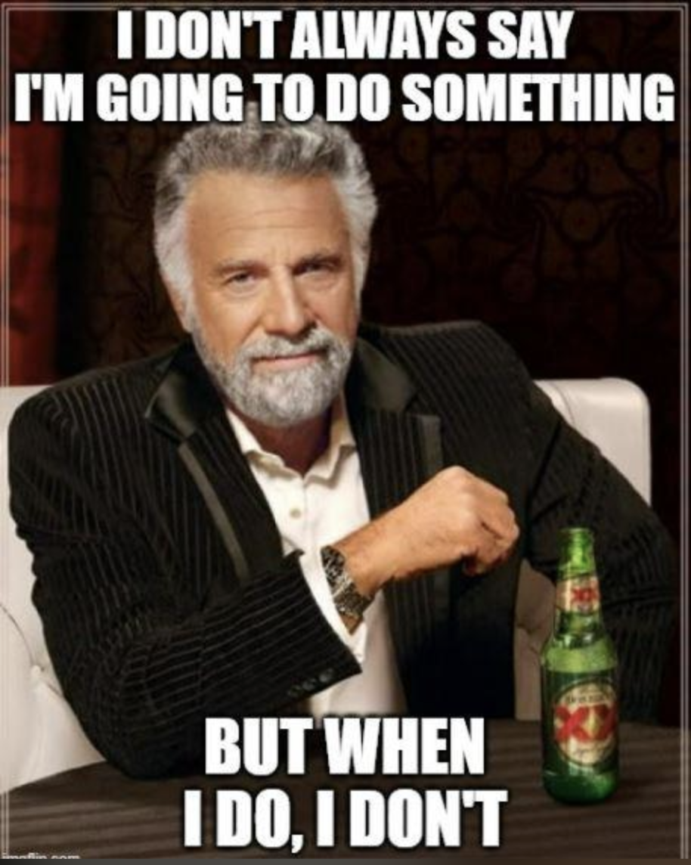

Slide 9

Staff in Hibernation
Potential Cons:
Passive & unmotivated
Poor self-esteem &
defeatist attitude
Struggle to take
responsibility for
anything
Potential Pros:
Time to reflect
Space to recharge
Staff report:
Feeling isolated
Stuck
Misunderstood
Bored
They need to:
Feel valued
Be recognized for success
Have positive role models
Have a sense of purpose

Slide 10
high
Imagination
DREAMING
low
DOING
high

Slide 11
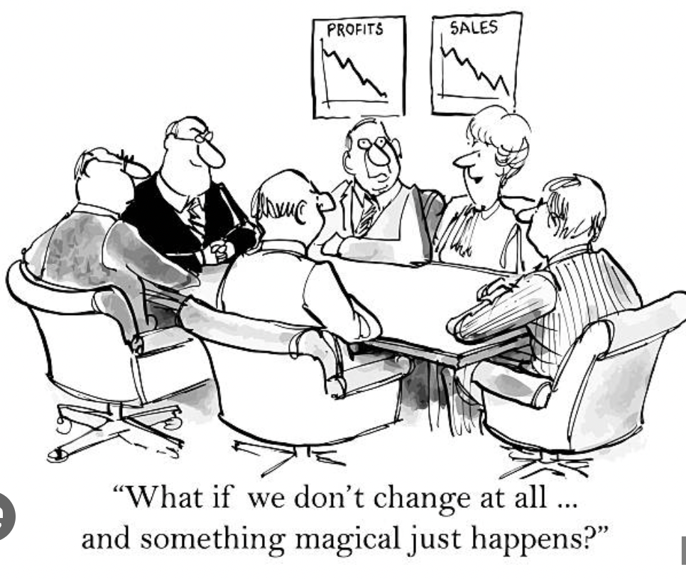

Slide 12

Staff in Imagination
Potential Pros:
Enthusiastic
Fun to be around
Lots of creative ideas
Potential Cons:
Limited follow-through
Not well connected
to reality
Staff report:
Having big dreams
Eagerness to explore
Craving creative outlets
They need to:
Develop action plans
Focus
Be realistic

Slide 13
high
DREAMING
Perspiration
low
DOING
high

Slide 14
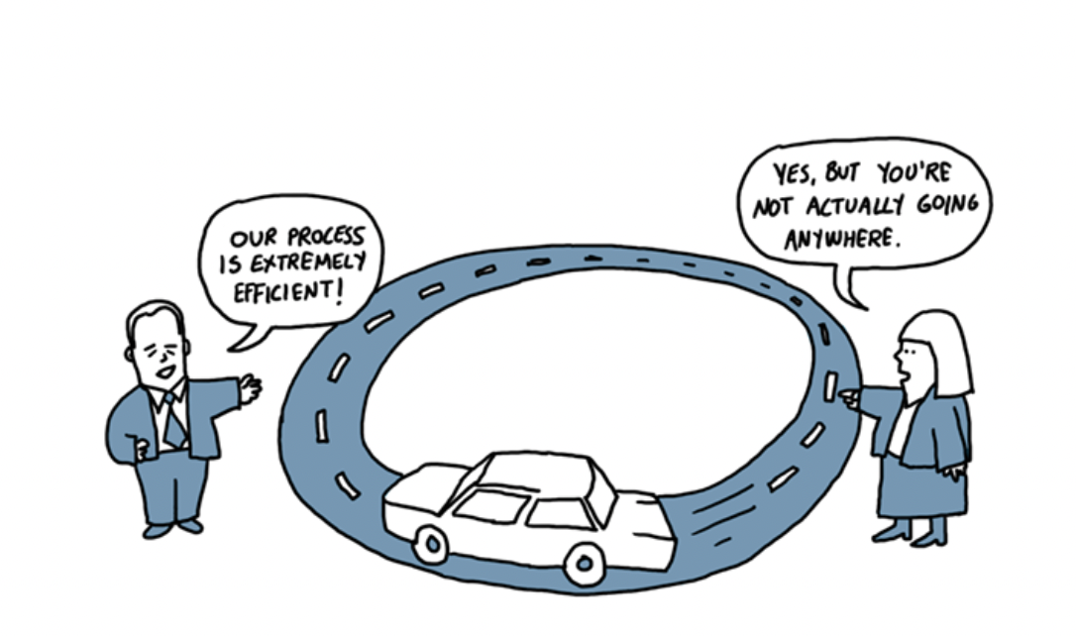

Slide 15

Staff in Perspiration
Potential Pros:
Determined
Hard Working
Driven to Succeed
Potential Cons:
Overly concerned
about what other
people think of them
Single-minded,
narrow-focused
Staff report:
Feeling stressed
Not sure of their “why”
But they don’t want to let
anyone down
They need to:
Have a greater purpose
More rythym between work and life outside of school
Link teaching/leading to their passions

Slide 16
high
Aspirations
DREAMING
low
DOING
high

Slide 17
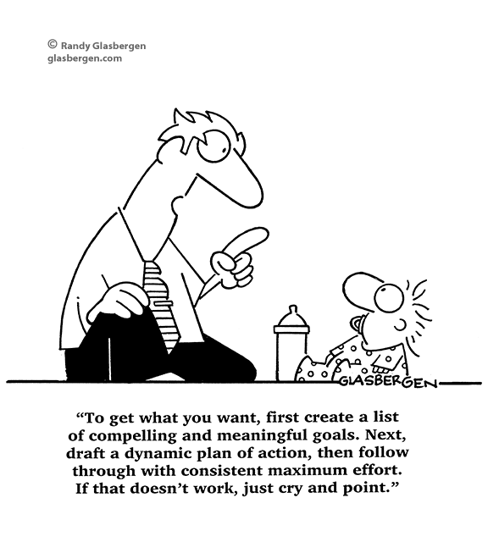

Slide 18

Staff in Aspirations
Potential Pros:
Connects present
actions to future
dreams
Good idea of
potential options
Potential Cons:
Relaxation is Challenging
Self-inflicted pressure
Does not play well
with others
Staff report:
Never feeling
satisfied
Driven by being best
Frustration with peers
who are not as
dedicated as they are
They need to:
Be assured they
are on a positive track
Experience meaningful academic challenges
Breathe!

Slide 19
high
Imagination
Aspiration
DREAMING
Hibernation
Perspiration
low
DOING
high

Slide 20
I WILL….

Slide 21
Thanks to AGIS for inspiring all of us…it is now time for YOU to inspire others!

Slide 22
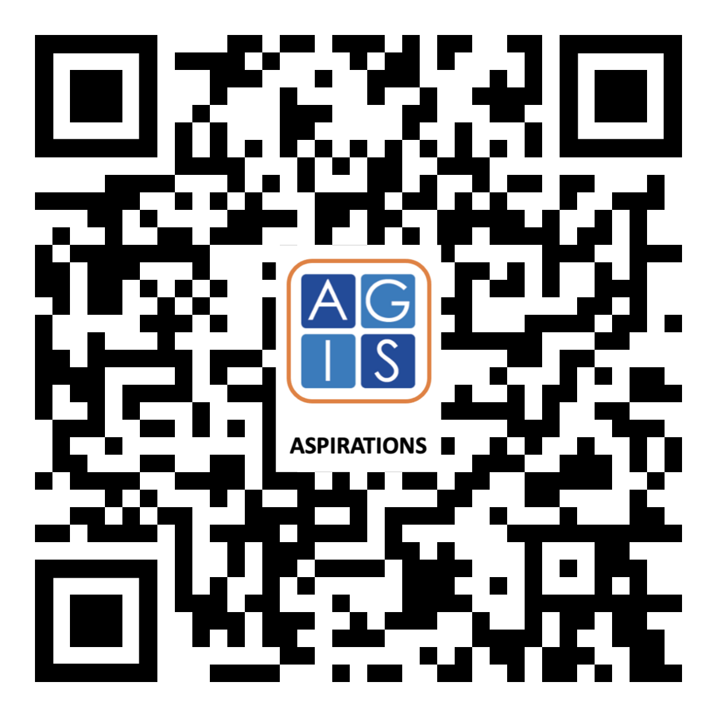
Website Just For YOU!

Slide 23
Voice and :
Balancing Dreaming & Doing to Reach Your Fullest Potential
Dr. Russ Quaglia
www.quagliainstitute.org
September 28, 2025

