Slide 1


Listen, Learn, Lead:
Putting Voice into Practice
Dr. Russ Quaglia
www.quagliainstitute.org
September 28, 2025

Slide 2

The 3 Components of Student Voice
Sharing thoughts & ideas in an environment underpinned by trust & respect.
Offering realistic suggestions for the
good of the whole.
Accepting responsibility for not only what is said but also what needs to be done.

Slide 3

Time to journey
onward & explore
the Voice Process

Slide 4
LEAD
TAKE ACTION
with others
Share
RESPONSIBILITY
LEARN
UNDERSTAND
& RESPECT
different points
of view
Build
TRUST
LISTEN
SEEK OUT
opinions from
others
School Voice Process

Slide 5

Voice is…
*Listening more than speaking.
*Learning more than convincing.
*Leading more with others.
Which is most difficult for you?

Slide 6

Listen

Slide 7
Listening Facts
Most people retain only 25% of what
they hear.
The brain processes words faster than
we speak.
Listening is the communication skill we
use the most, but learn the least.

Slide 8


Slide 9
Improve Listening
Reach out & listen to voices
you typically don’t hear from.
Active listening requires full presence.
Ask questions to be a better listener.
Practice makes perfect (better).

Slide 10

Learn

Slide 11
Learning Facts
Multisensory learning improves retention
up to 70%.
Spaced repetition can double long-term
memory retention.
People learn best when they feel
emotionally safe.
Sleep is critical, memory consolidation
happens when we sleep.

Slide 12
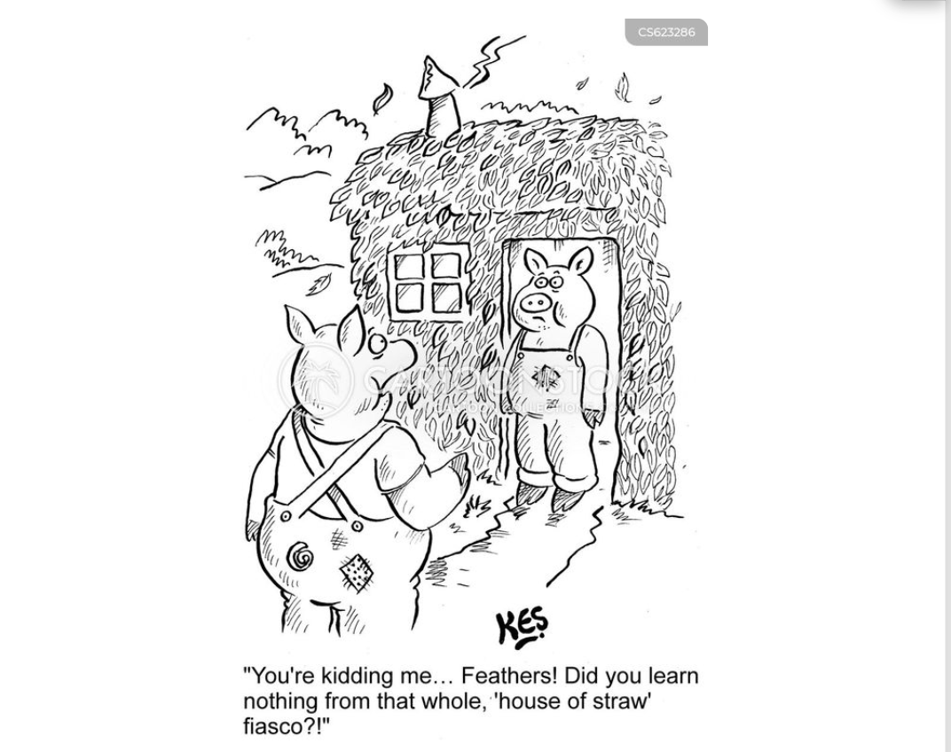

Slide 13
Improve Learning
Setting specific goals improves
focus and motivation.
Be open, you can learn from anyone
regardless of age, position, or experience.
Be prepared to change.
Do not fear what you do not know.
Take notes! Follow up & communicate what
you LEARNED from listening.

Slide 14

Lead

Slide 15
Leadership Facts
Collaborative leadership increases team
engagement by 17%.
Leading together builds organizational
agility.
Shared leadership boosts innovation
by up to 28%.
The person who sends the calendar invite
becomes the “leader” by default.

Slide 16
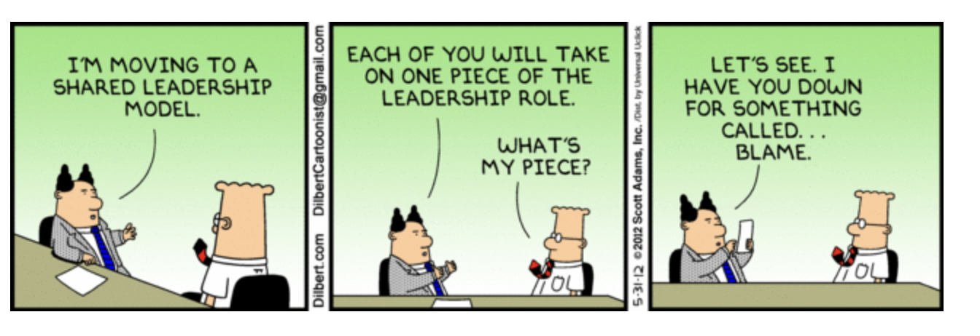

Slide 17
Improve Leadership
Make meetings matter.
Be honest, even when it hurts.
You can’t please everyone; but you can
demonstrate value & respect for all voices.
Patience, because leadership is not about
getting your own way.
Take the time you need to build trust.
Use your voice!

Slide 18
LLL Takeaways
Less
More
Talking
Listening
Complaints
Solutions
Isolation
Collaboration
Excuses
Action
Frustration
Celebration

Slide 19
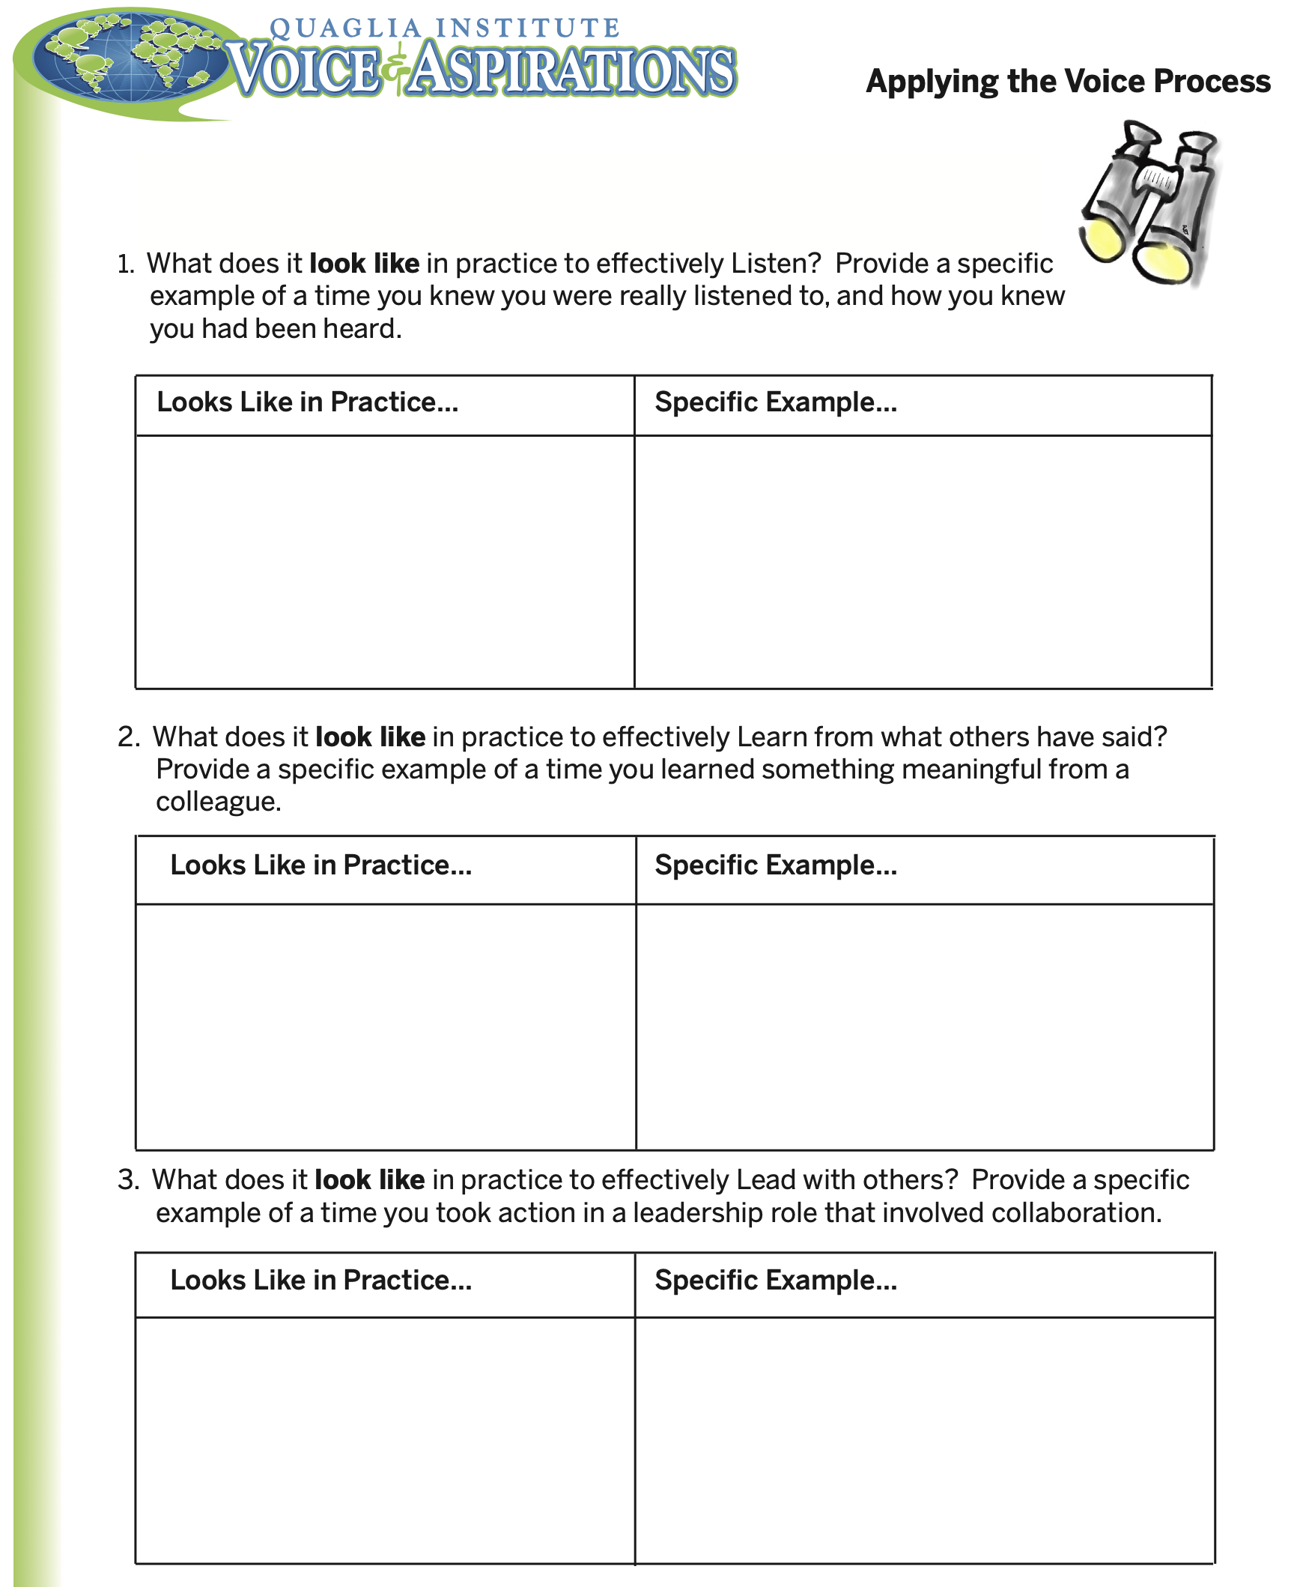

Slide 20
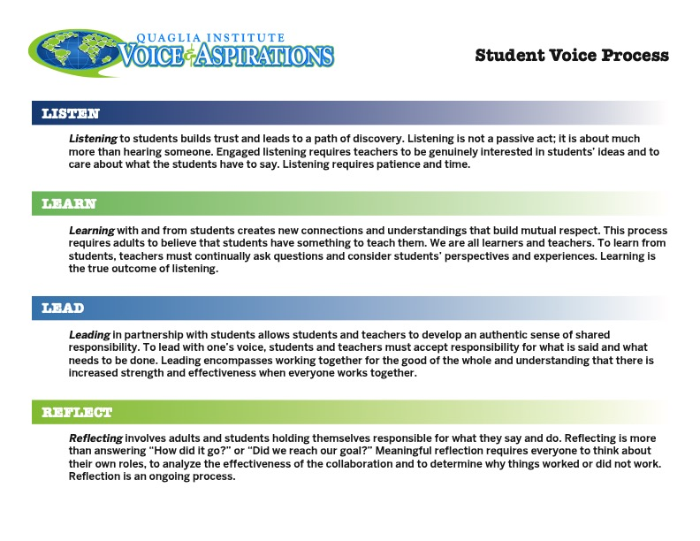

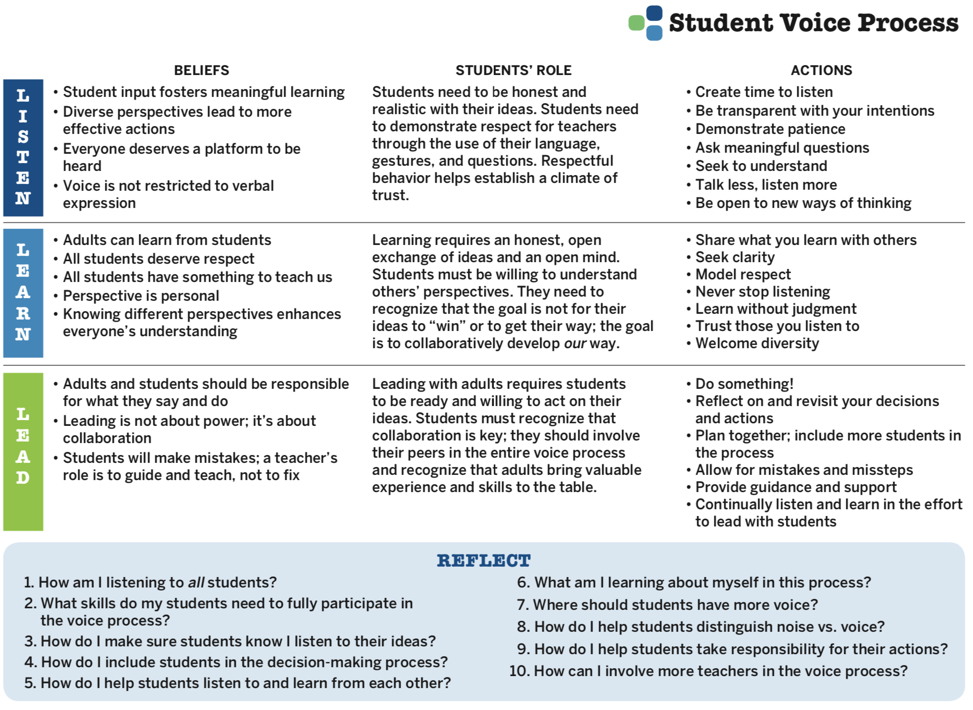
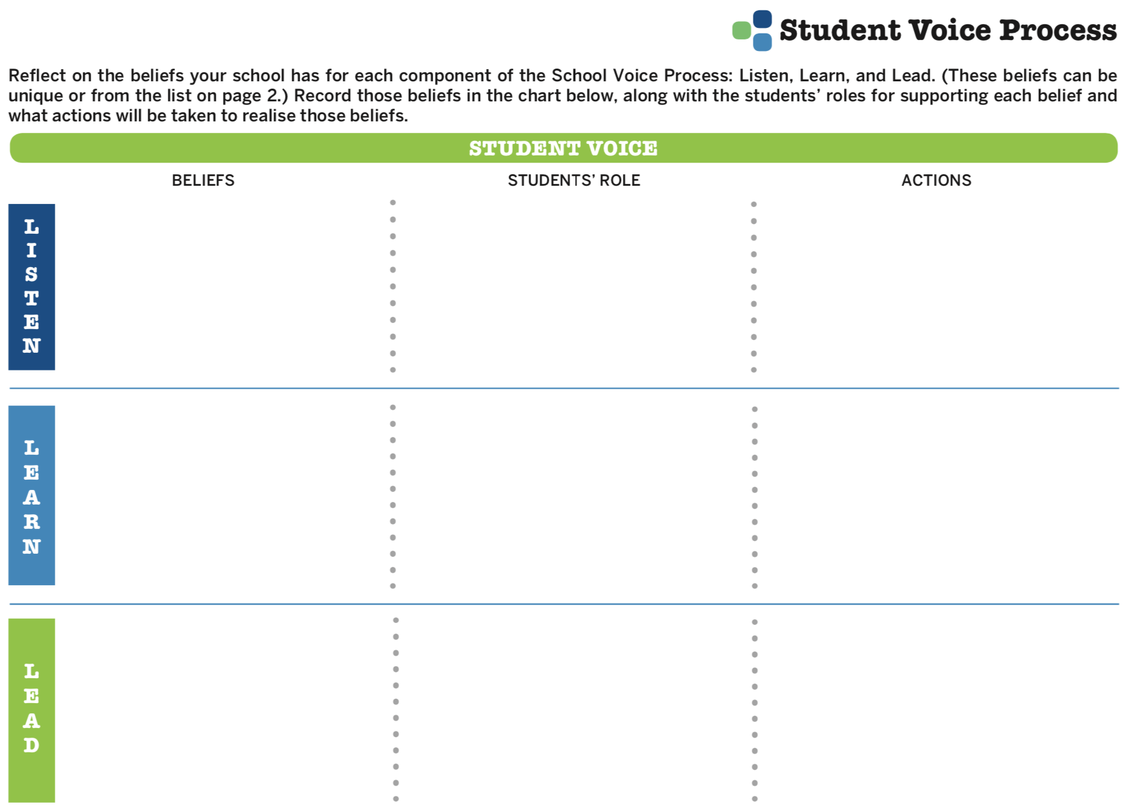
Student Voice Process Tool

Slide 21
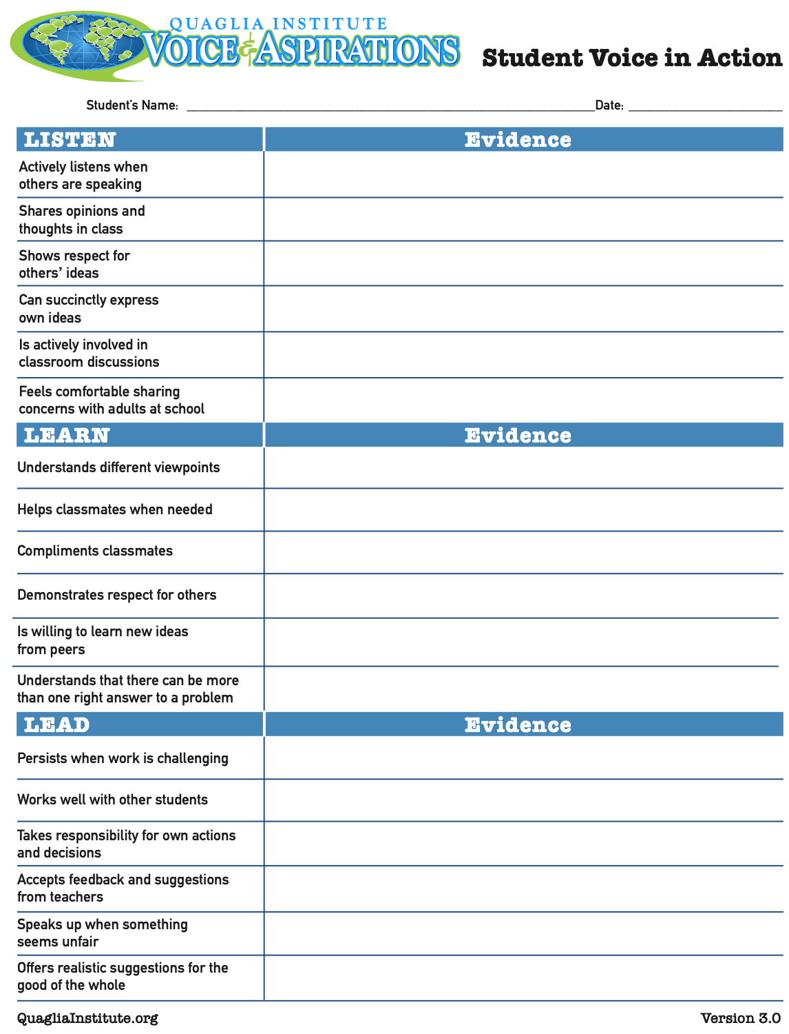

Slide 22
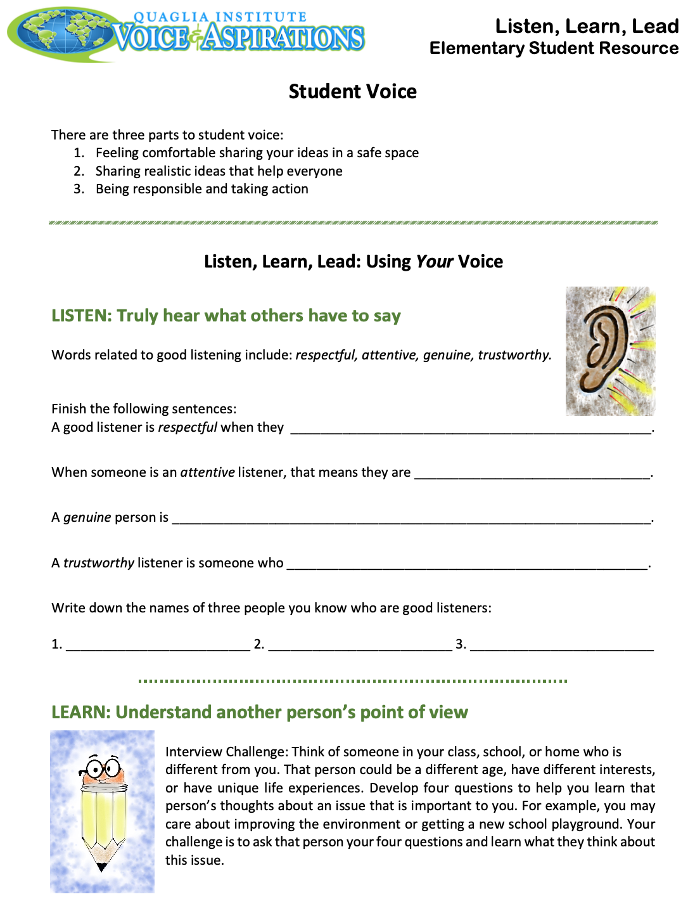
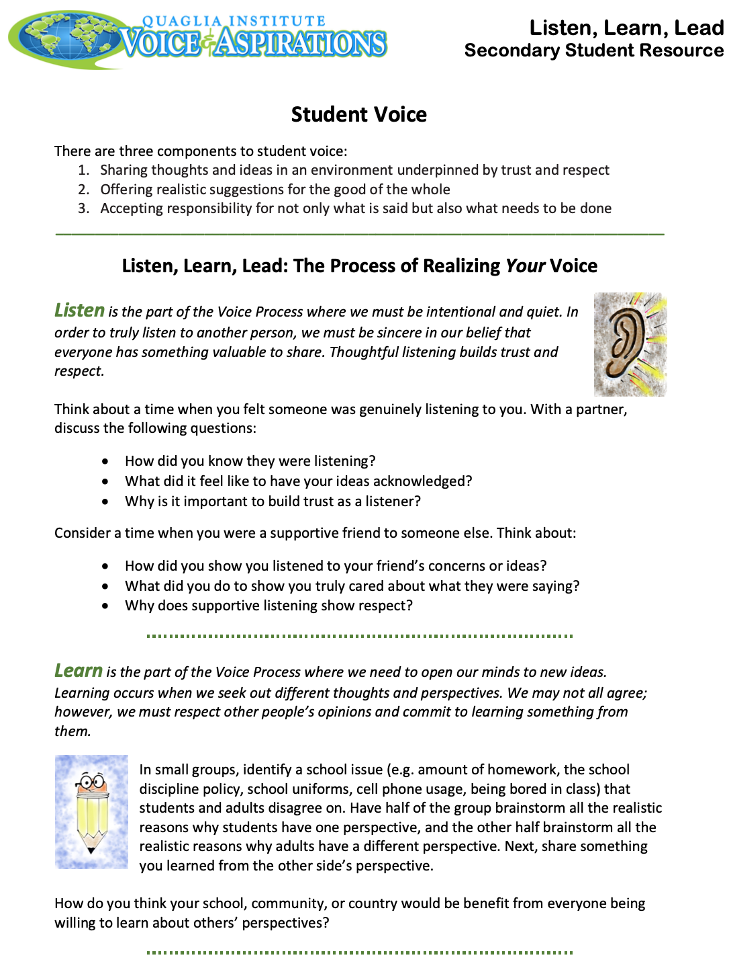
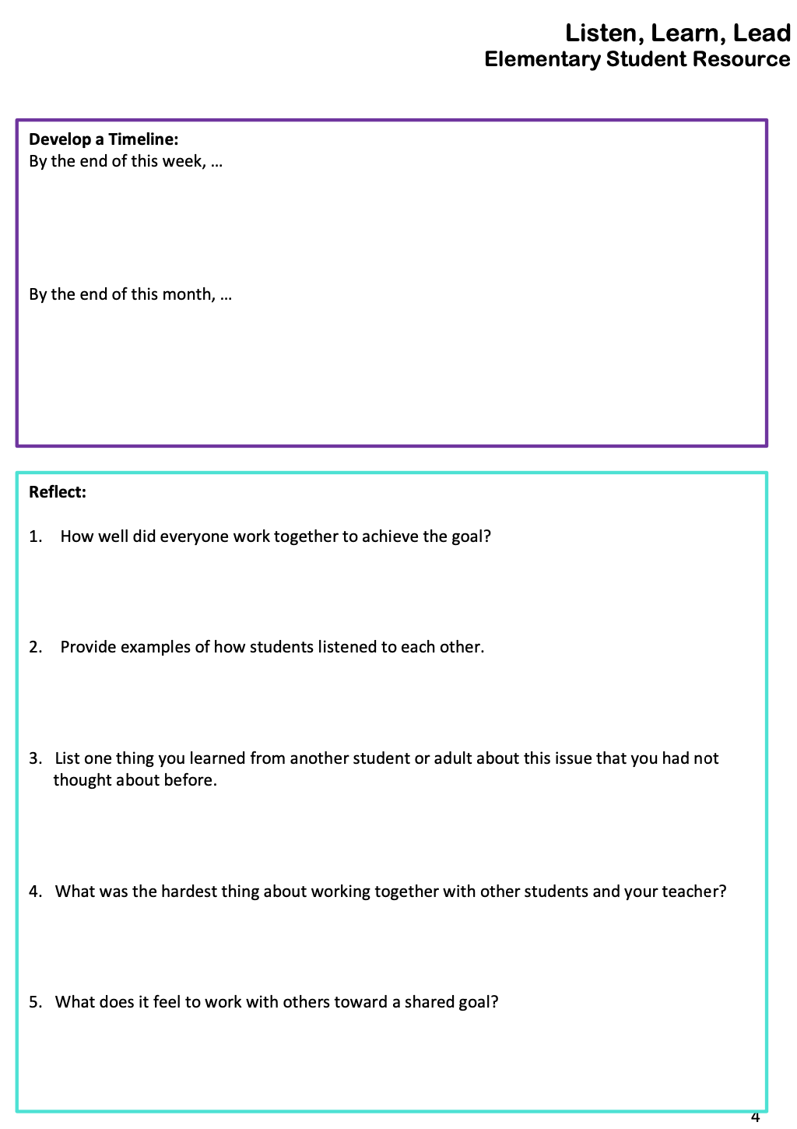
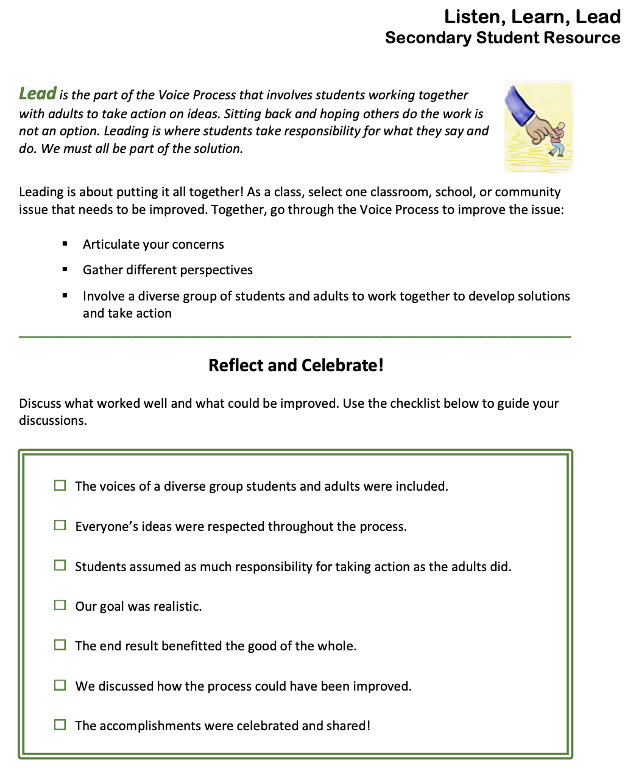
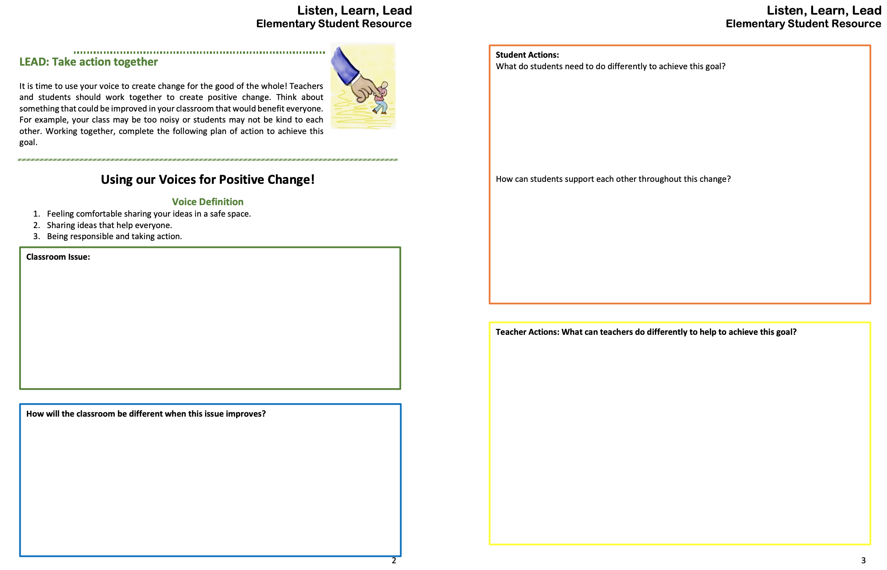

Slide 23
Student Voice Process
Explore beliefs, students’ role, & actions related to Listen, Learn, & Lead.
Discuss the reflection questions.

Slide 24
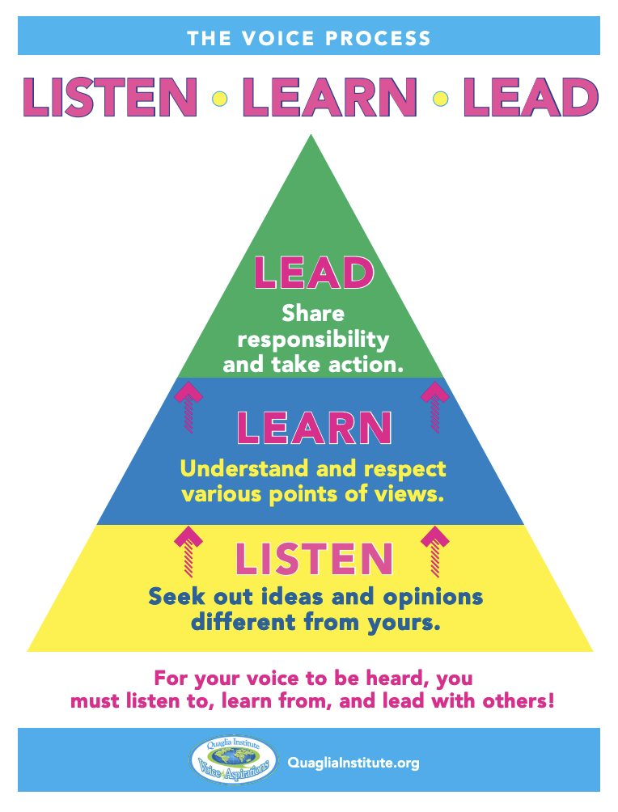

Slide 25

Website Just For YOU!

Slide 26
Challenge Time!
For the remainder of this AGIS Conference
I want you do go into every session and ask
yourself two questions:
How can I use my voice to
promote/implement what I have just learned?
2. How has my new learning impacted my
sense of purpose?
(values, passion, aspirations, & talents)

Slide 27
Listen, Learn, Lead:
Putting Voice into Practice
Dr. Russ Quaglia
www.quagliainstitute.org
September 28, 2025

