Slide 1


The Power of
Student Voice
Dr. Russ Quaglia
www.quagliainstitute.org
September 27, 2025

Slide 2

Fundamental Beliefs
Students are the potential, not the problem.
Students have something to teach us.
Working with students is the only way forward.

Slide 3
Learning Intentions
Discover the power of student voice in transforming schools.
Reflect on how your own sense of purpose sparks growth and impact.

Slide 4

Why Student
Voice?

Slide 5
Student Voice
Implications….
When students believe they have a voice:
32% report greater self-worth.
38% report more engagement in learning.
43% report a greater sense of purpose.
© Quaglia Institute

Slide 6
Student Voice
Implications….
Human perspective in a tech-driven world.
Reimagining the purpose of education.
Democratic engagement + global citizenship.
Cultural responsiveness and inclusion.
Social glue
© Quaglia Institute

Slide 7
What is holding us back??
There is not a clear
definition of student voice
that all of us can
understand, accept, and
put into practice.
© Quaglia Institute

Slide 8

REFLECT
What comes to mind when you think of the term student voice ?
© Quaglia Institute

Slide 9
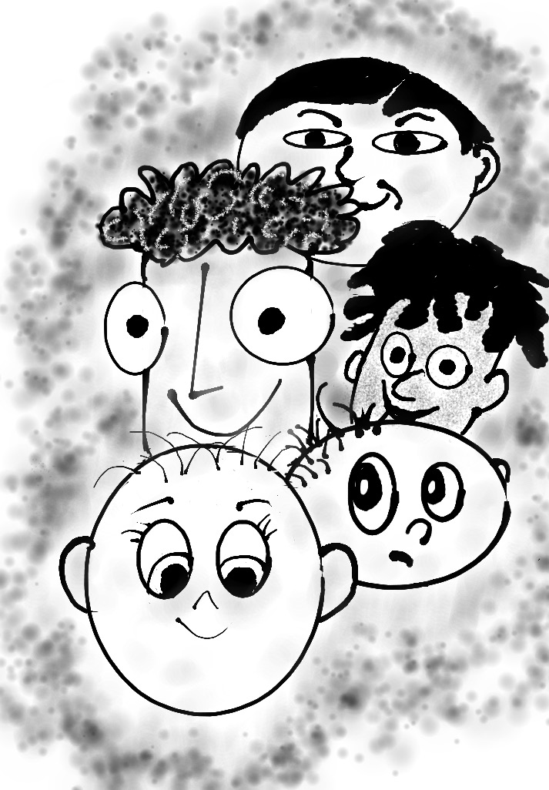
Students and Staff
tell us...
© Quaglia Institute

Slide 10

The 3 Components of Student Voice
Sharing thoughts & ideas in an environment underpinned by trust & respect.
Offering realistic suggestions for the
good of the whole.
Accepting responsibility for not only what is said but also what needs to be done.

Slide 11

Challenge Time…

Slide 12
Over the next few days I want you to think about YOU!
Why am I here?
What do I need to learn from my colleagues?
What can my colleagues learn from me?
How can I use my voice to make a difference?
Notes:
Here are four strong self-reflective questions for educators to consider as they enter a three-day conference:
1. What do I hope to learn, feel, or be inspired by during this conference—and how will I stay open to unexpected insights?
Encourages intentionality while allowing room for growth beyond the agenda.
2. How does my current practice align with my core values as an educator, and where am I feeling most disconnected?
Prompts honest reflection on values-driven work and potential areas of misalignment.
3. Whose voices—students, colleagues, families—do I need to listen to more deeply in order to improve my impact?
Re-centers relationships and elevates empathy as a tool for professional growth.
4. What is one mindset, habit, or assumption I am willing to challenge or change based on what I experience here?
Encourages courage and flexibility in applying new learning meaningfully.

Slide 13
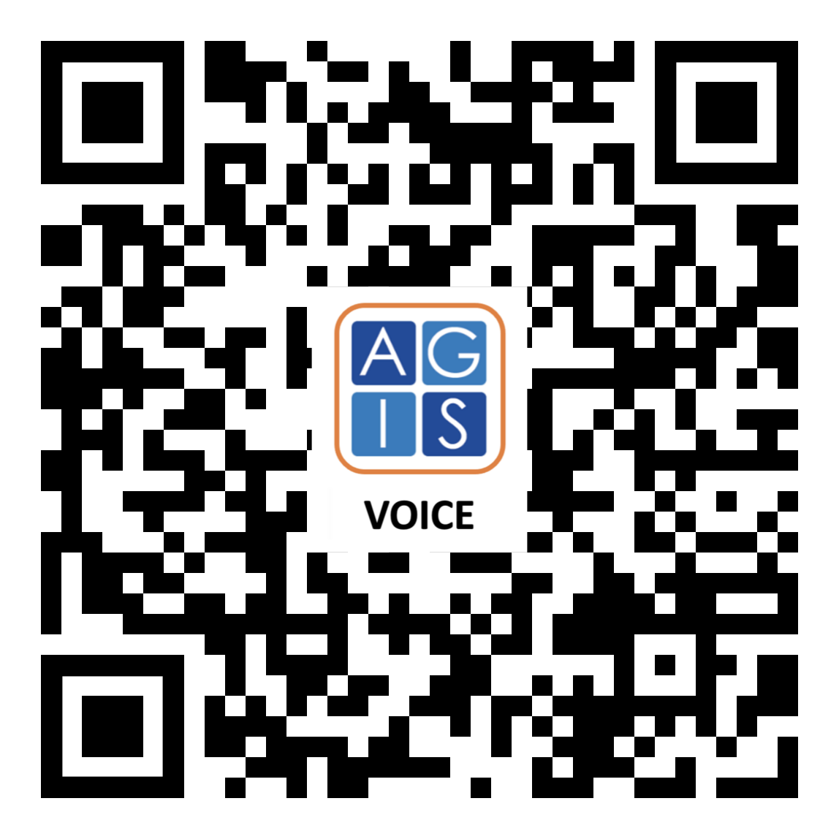
Website Just For YOU!

Slide 14
The Power of
Student Voice
Dr. Russ Quaglia
www.quagliainstitute.org
September 27, 2025

