Slide 1
CCHS LEGACY PROJECT

Slide 2
Brief Description
Archive Student Voice
Strengthen meaningful relationships between Alumni and current students and staff.
Solicit, Catalogue, and Share Alumni Journey thru and after CCHS.
Current students build library of short videos to share Tips for Success with other students.
Create a Professional Corner (online) for specific achievement goals (i.e. Ted Talks) CHATS!

Slide 3
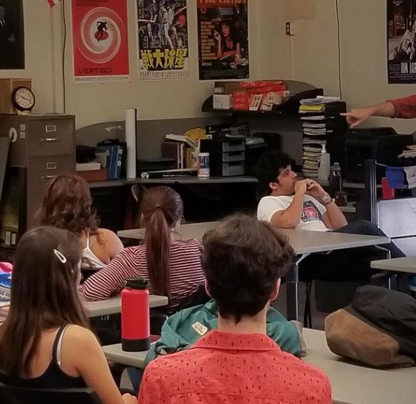
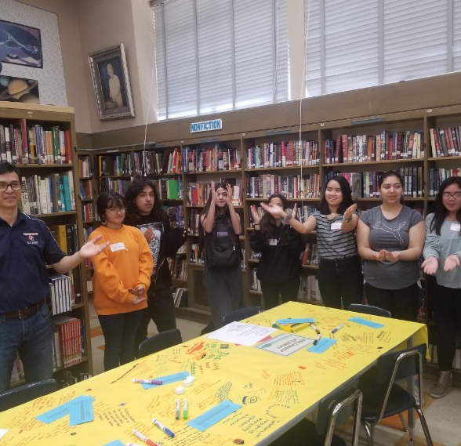
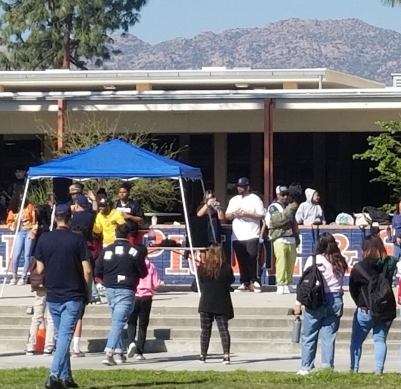
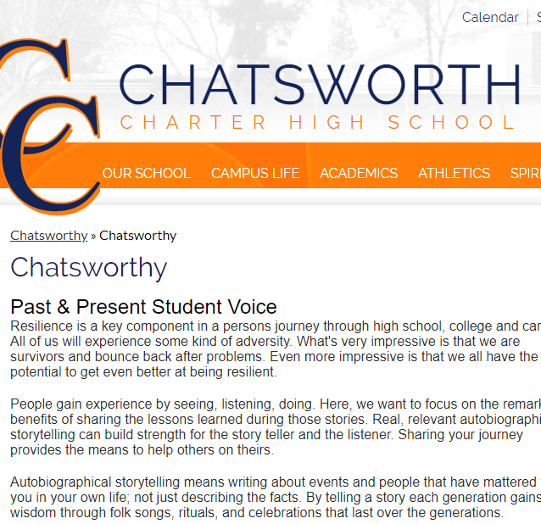
Outcomes
Dedicated web space
Ongoing meetings with Chancellor Nation to understand what the students deem relevant.
More engagement with students
Greater sense of community

Slide 4
Next Steps
Build out electronic platform to accommodate the needs.
Maximize current alumni data base.
Develop process and people that will maintain the video library.
Solicit alumni to share experience

Slide 5
Parents / Guardians / Community
We would like to find a way to have their story be told and presented to students.
Live & Video events

