Slide 1
How can we build student voice?

Slide 2
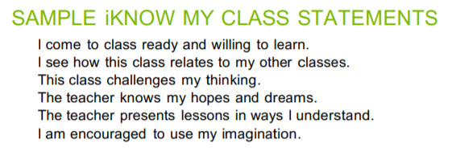
10/26/2020
True or False - Speak or type it in the chat
Counselor Newsletter #6
Student Voice
Any questions or announcements?

Slide 3
11/1/2020
"What makes an awesome leader?"
What is your role in school leadership? What kind of change would you like to bring for students?
Announcements (newsletters)
Google form - How can we improve student attendance? Videos?

Slide 4
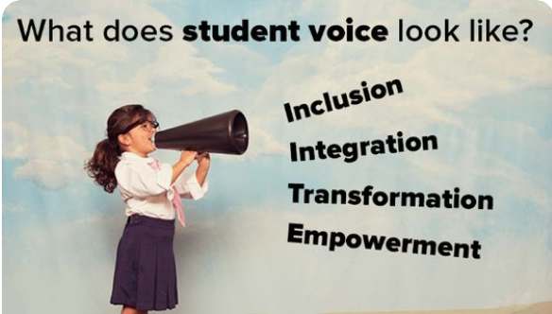
11/9/2020
Review Announcements
Guest: Mr. Garibaldi - COVID student testing, updates for school and more
Google form - Sign in at the end
Notes:
Do students have the option on what kind of COVID test to take?
Do schools know how long testing will be offered to everyone ?
What if we are back at school and someone’s test results as “inconclusive”?- will they be let on campus?
When are we returning to campus?

Slide 5
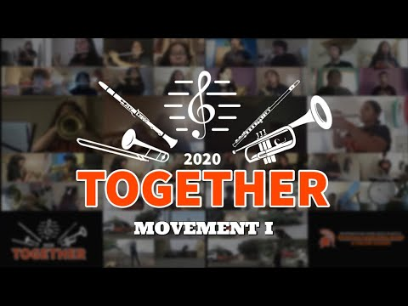
11/16/2020
Student Updates and Concerns (by students)
Review announcements
Warrior Weekly
Administrative Assistant
Shout Out Committee (announce who they are)
Notes:
-senior college apps
-credit recovery
-Grades!!!
-Attendance/concistency
-following meetings: student survey, feedback, improvements

Slide 6
11/30/2020
3 weeks left! Attendance and grades matter
Pizza Delivery - 60 STUDENTS
FINAL GRADES
Winter Credit Recovery
Spring 2021 - January 11

Slide 7
12/7/2020
2 weeks left! Attendance and grades matter
Pizza Delivery - 60 STUDENTS
Winter Credit Recovery
Spring 2021 - January 11
Videos ?

Slide 8
12/14/2020
1 weeks left!
Pizza Delivery - 60 STUDENTS
Winter Credit Recovery
Spring 2021 - January 11

Slide 9
Week of 1/22
If you can take 2 things with you to a deserted island, what would it be? (waterfall in the chat)
Incompletes - due Jan 29th
School Experience Survey- DUE!!
Join and start a club! club links
Design shirt - work on shirt designs! We’ll vote next week
3 Officers - please stay behind for instructions

Slide 10
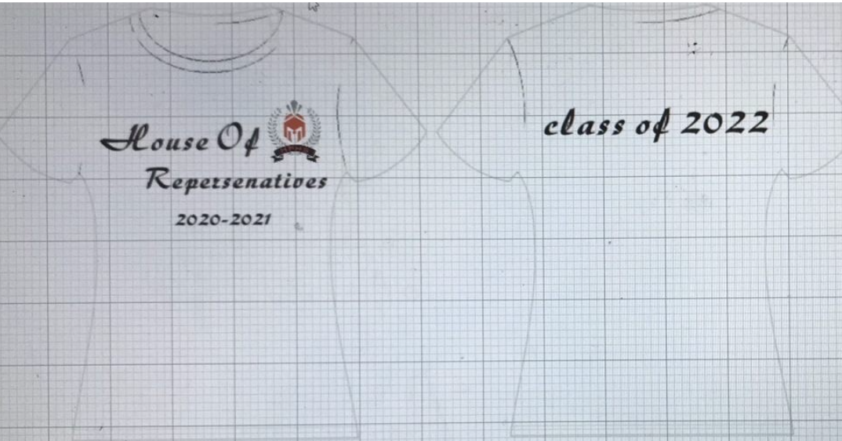

Slide 11
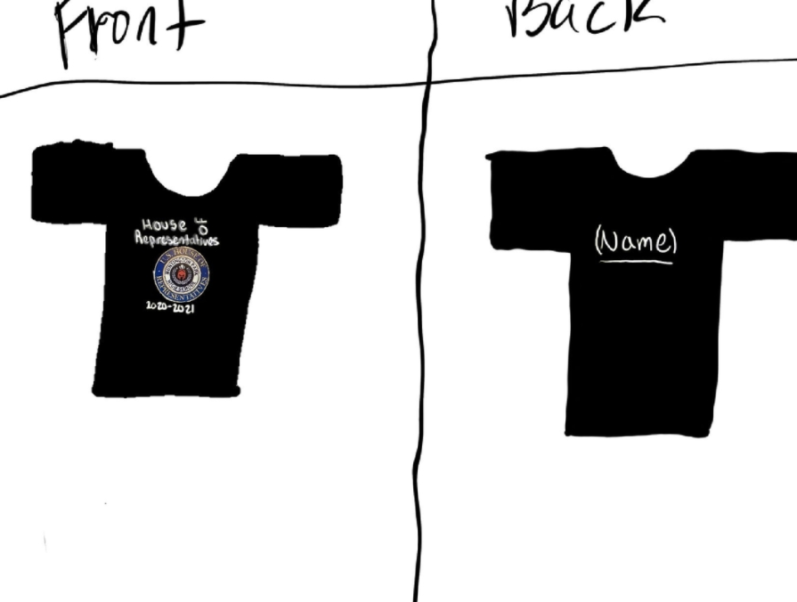
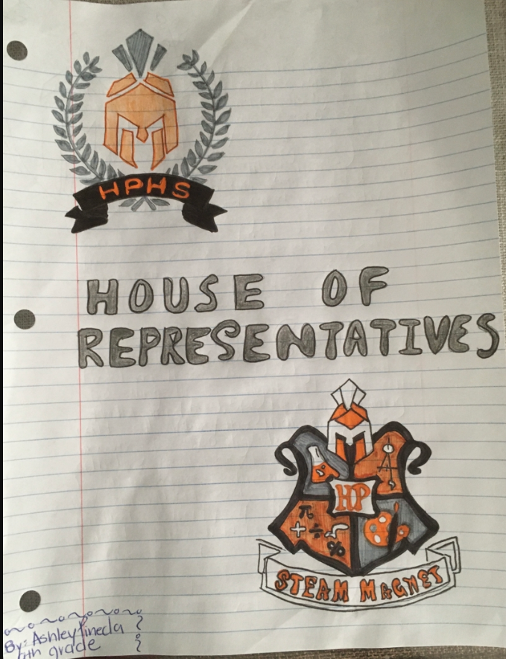
Destiny Garcia

Slide 12
Week of 2/1
Newsletter Announcements
School Experience Survey- DUE!!
ELAC classes and college sign up
Design shirt - any submissions?
Officer speech- Secretary

Slide 13
Week of 2/22
Newsletter Announcements
Course Selection Survey THIS WEEK
Attendance Campaign
Design shirt - updates to come

Slide 14
Week of 3/1
Newsletter Announcements
Course Selection Survey THIS WEEK
Attendance Campaign
Magnet Announcements- Mr. Carcamo
ELPAC Class

Slide 15
Notes:
https://drive.google.com/file/d/1FFX9g8Q8gCyRCIfE-N9RymAw1KH6hy-T/view?usp=sharing

Slide 16
Week of 3/8
Newsletter Announcements
Spring Break 3/26-4/2
Attendance Campaign
Magnet Announcements- Mr. Carcamo
ELPAC Class
MESA Winners
International Women’s Week!
March 7-11

Slide 17
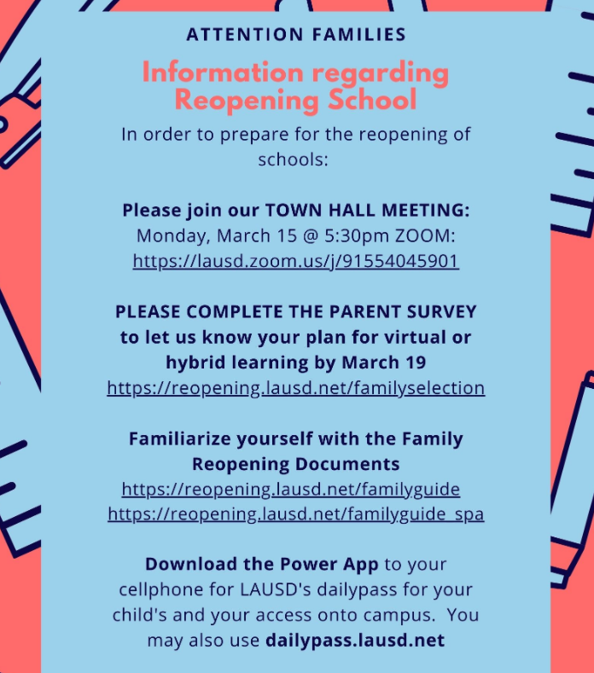
Week of 3/15
Credit Recovery! Sign ups happening now
Spring Break 3/26-4/2
2 Fails or more meeting
Parent/Student Survey

Slide 18
Week of 3/22
Credit Recovery! Sign ups happening now
Spring Break 3/26-4/2
Down Syndrome Awareness Week!
Interest in athletics? School website

Slide 19
Week of 4/12
Daily Pass for school
New vaccine site for community
Autism Awareness Month
AP exam update
Sports Updates
@HphsSpartans
@HpSpartanShield
@HphsLeadership

Slide 20
Week of 4/19
Autism Awareness circle back
Daily Pass for school
New vaccine site for community
Autism Awareness Month
AP exam update
Sports Updates
@HphsSpartans
@HpSpartanShield
@HphsLeadership

Slide 21
Week of 5/12
Mental Health Awareness Month
COVID Testing- Gage MS
New vaccine site for community
Summer School- EMAIL COUNSELORS
Sports Updates
@HphsSpartans
@HpSpartanShield
@HphsLeadership

Slide 22
How We Feel affects how we Communicate
Verbal
Non- Verbal
Listening
Words we use- reflecting,restating, open ended questions
Phrases
Sounds
Tone of Voice
Body language
Eye contact
Gestures
Posture
Movements
Active Listening-is a way of listening and responding to another person that improves mutual understanding
Listening to understand vs listening to respond
Listening without interrupting
Notes:
Maggy- Discuss the concept “How we feel affects how we communicate.” ask the students how it may affect the way they communicate or give an example Ie. being mad and asking mom to go out, whiny voice,etc

Slide 23
Week of 5/17
Pre Summer School sign ups
Summer School sign ups
Fall 2021- AUGUST 16TH!
Enrollment Packets
Recognitions
Congratulations Class of 2021!

Slide 24
Week of 6/7
Mental Health Check in- Communication and examples of Good Communication
Pre Summer School- EMAIL COUNSELORS
Spanish Equivalency Exam
Senior Updates! Meeting Wed. 6pm
COVID Testing- Gage MS
New vaccine site for community

Slide 25
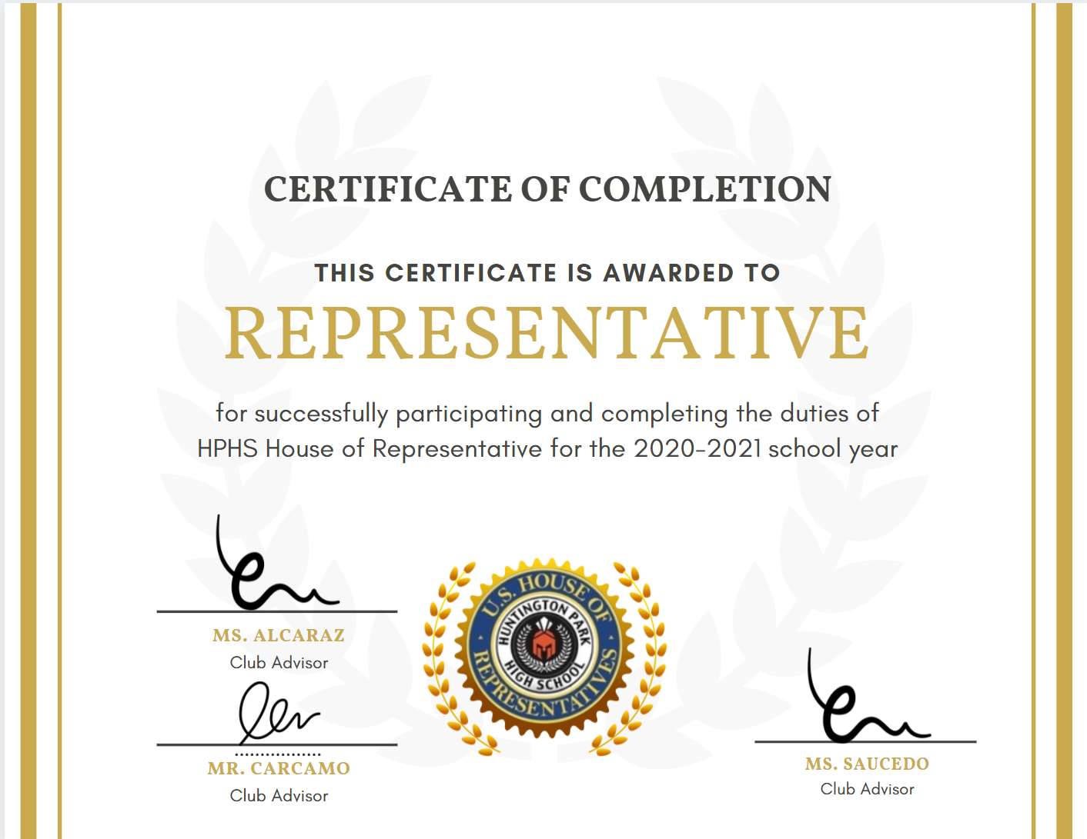
Certificates will be mailed home this week!

