Slide 1
Reseda Charter Legacy Project
Student Aspirations Advocates Program

Slide 2
Overview of SAAP
SAAP is designed as an intensive 9th grade support system for students who have been identified as high risk and could benefit from an additional positive support system.
Behavior
Attendance
Grades

Slide 3
Components of SAAP
SAAP Mentorship Program
Mentors are paired with mentee based on interest survey
Mentors meet with mentees 2x a month
Personal Check-In
Academic/Behavior/Attendance Check-In
Aspiration Activity based on the Month’s Condition
Aspiration Coordinator
Monthly SAAP Pizza lunches with Aspirations Activities
Push In Support/Check Ins
Pull Out/Individual Check Ins (Goal Setting)

Slide 4
Mentorship Program
The SAAP Mentorship program serves to provide each SAAP member with a mentor, role model, and “go to” person on campus. The students selected do not have IEPs, aren’t English Learners, and aren’t in a magnet which all provide an additional layer of support. The SAAP program is designed to provide that additional support through the ongoing support from their matched mentor and the SAAP coordinator.
After completing a survey, each SAAPer is paired up with an adult on campus with common interests. Mentors join SAAP voluntarily and meet with their mentee(s) twice a month, focusing on the student’s personal growth through the Aspirations Framework. Each month is dedicated to a different Condition.

Slide 5
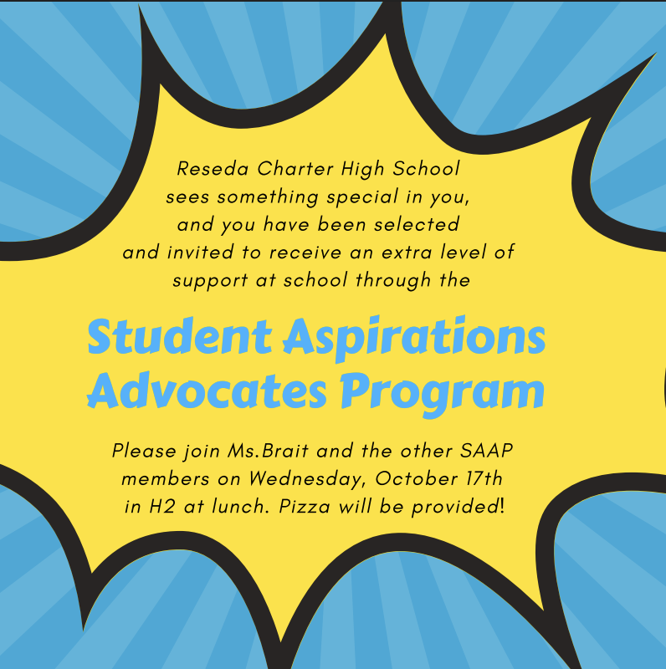
Evidence

Slide 6
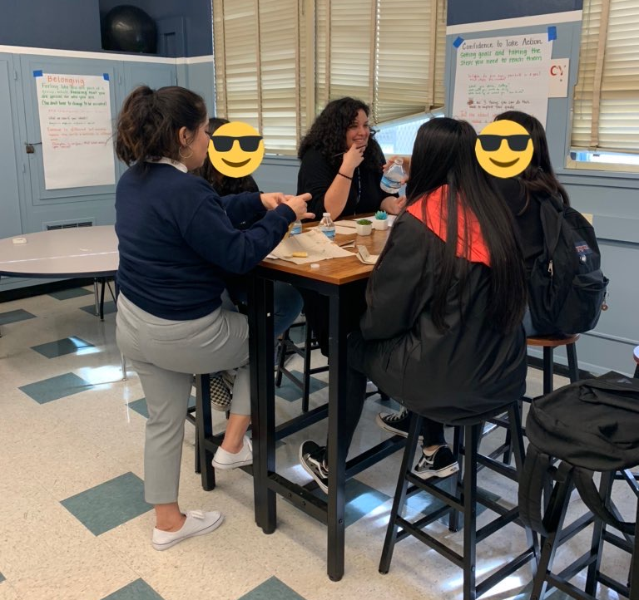
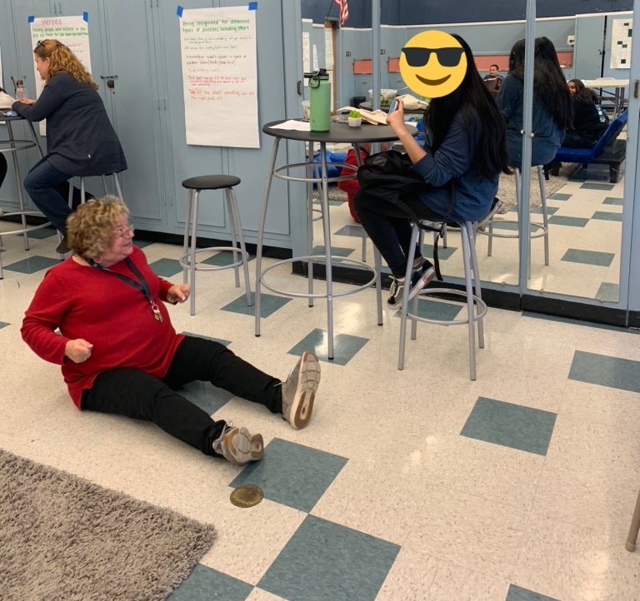
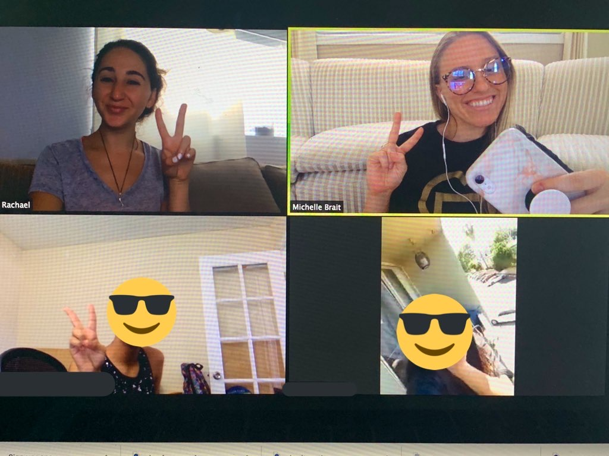
Evidence

Slide 7
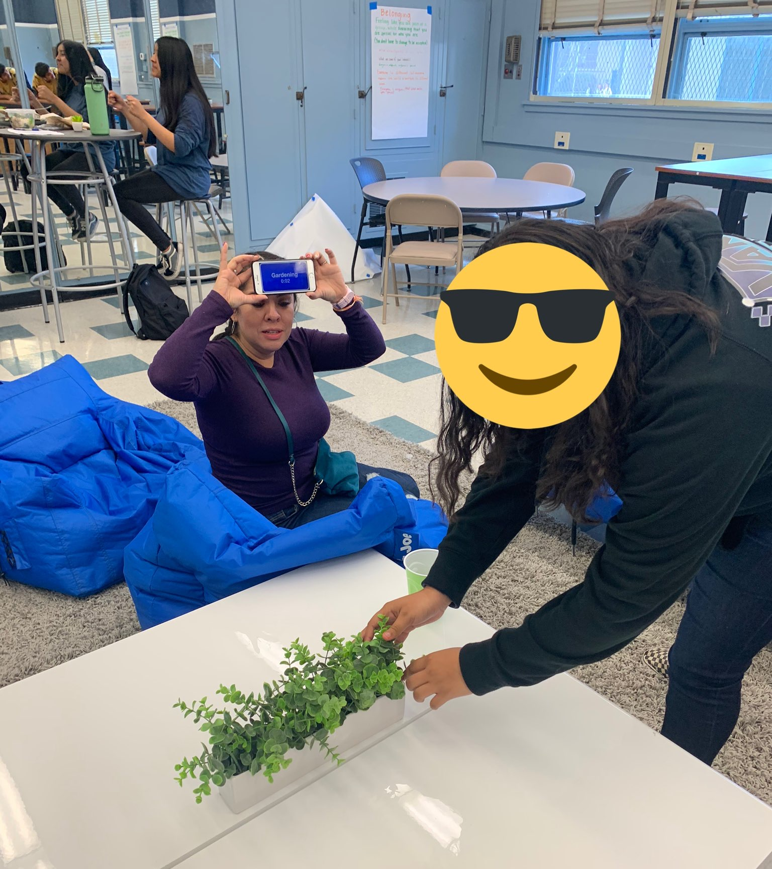
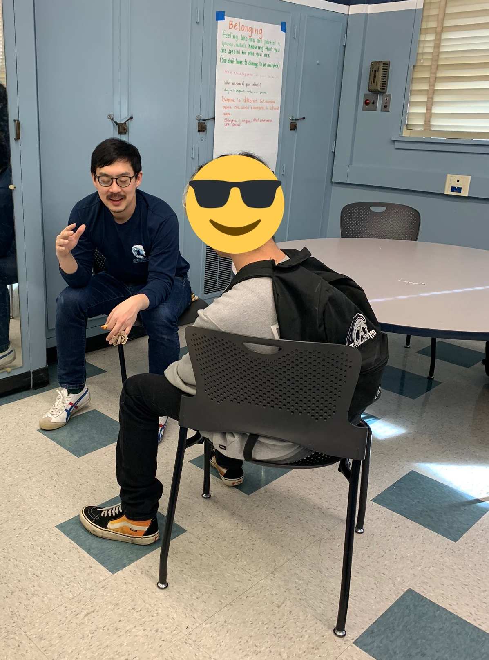
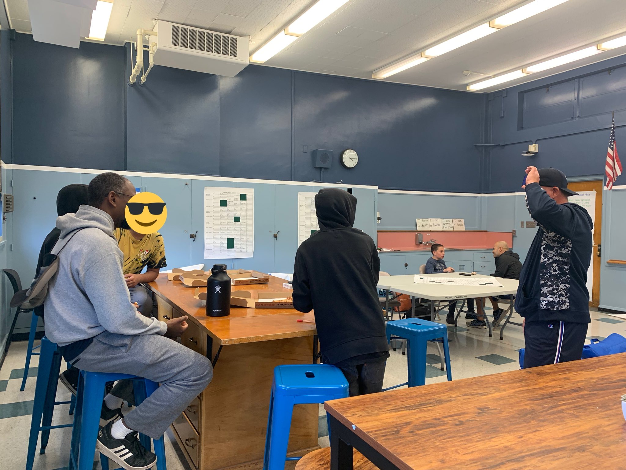
Evidence

Slide 8
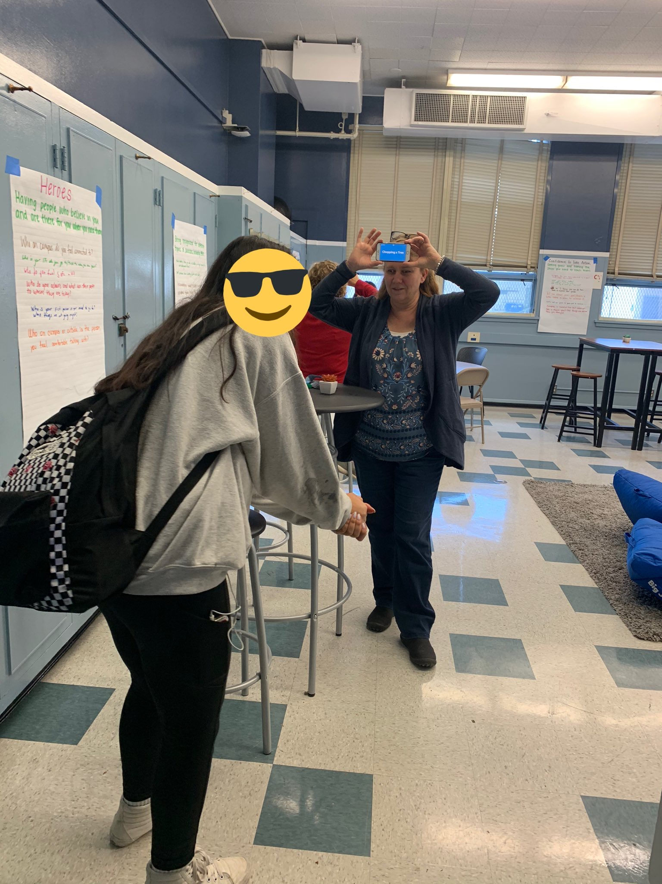
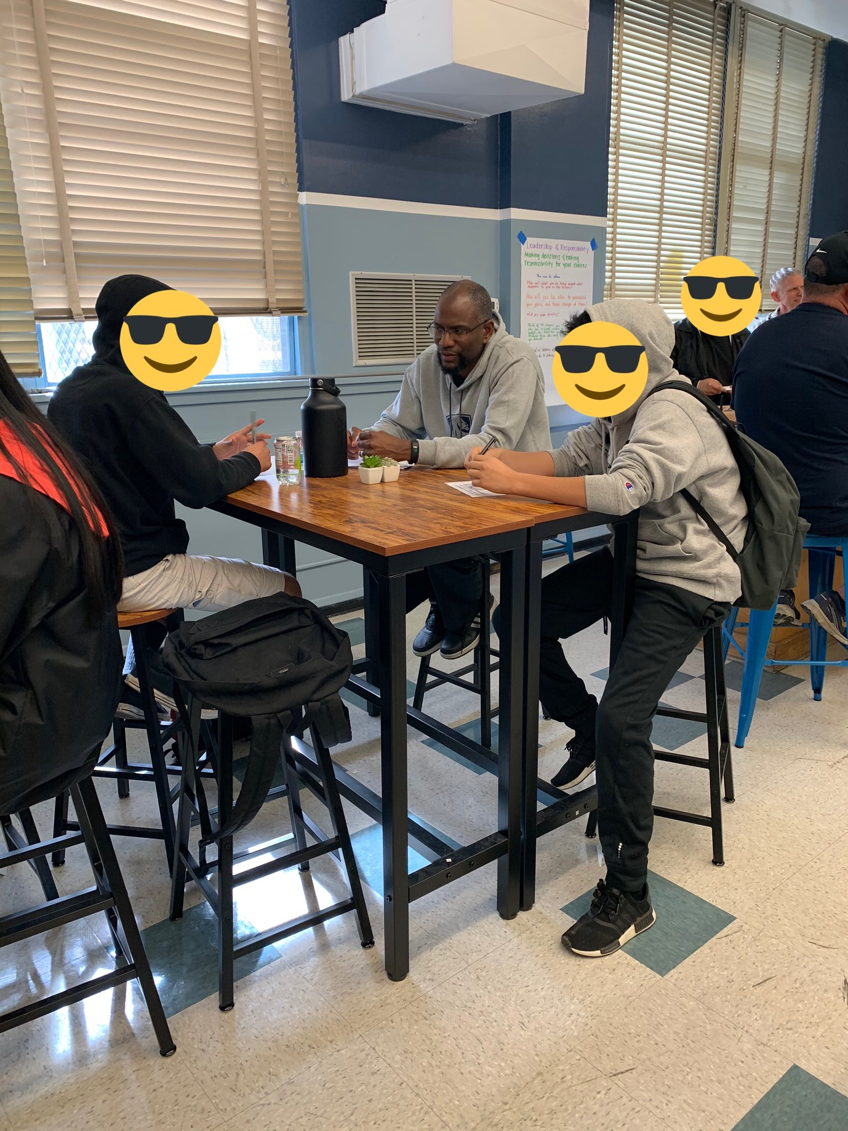
Evidence

Slide 9
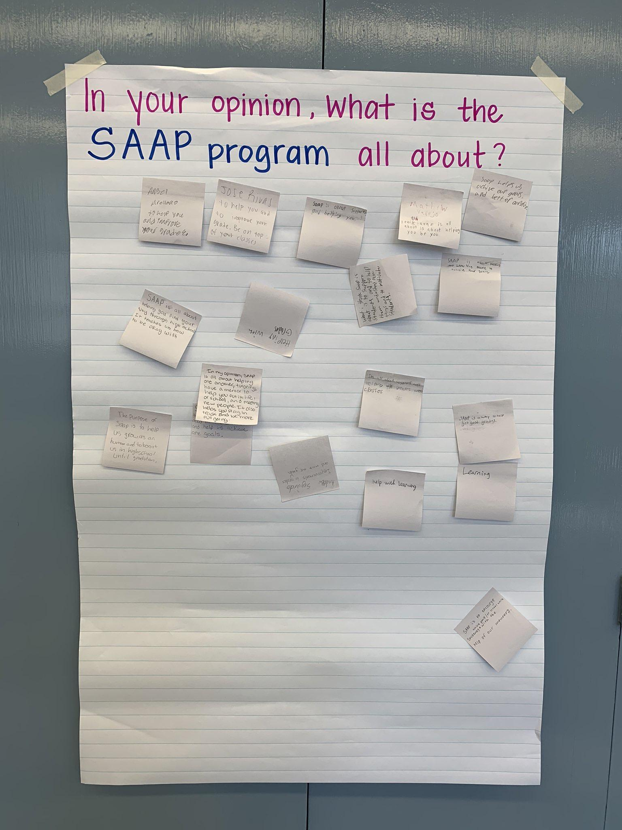
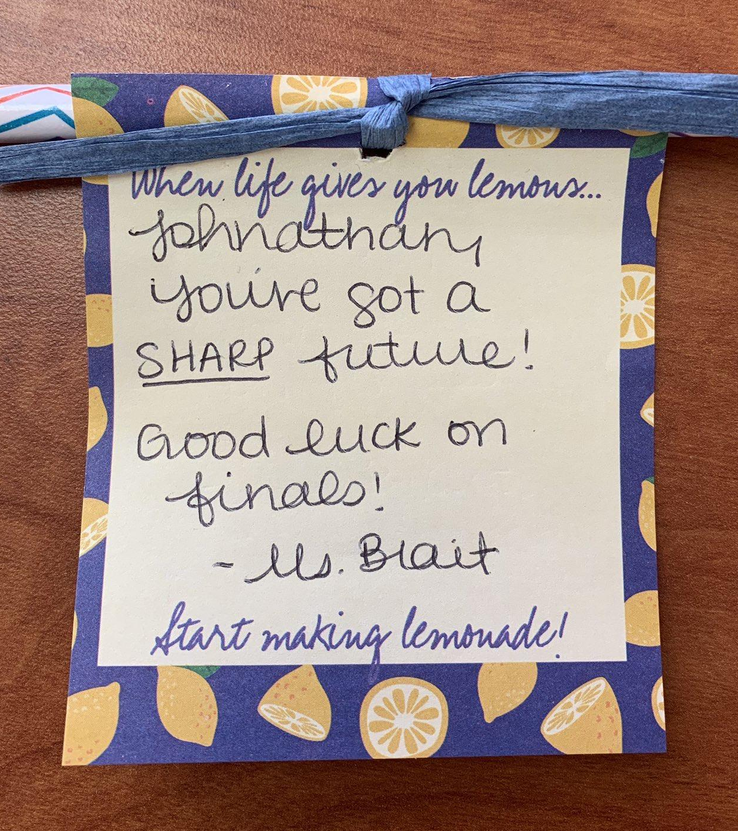
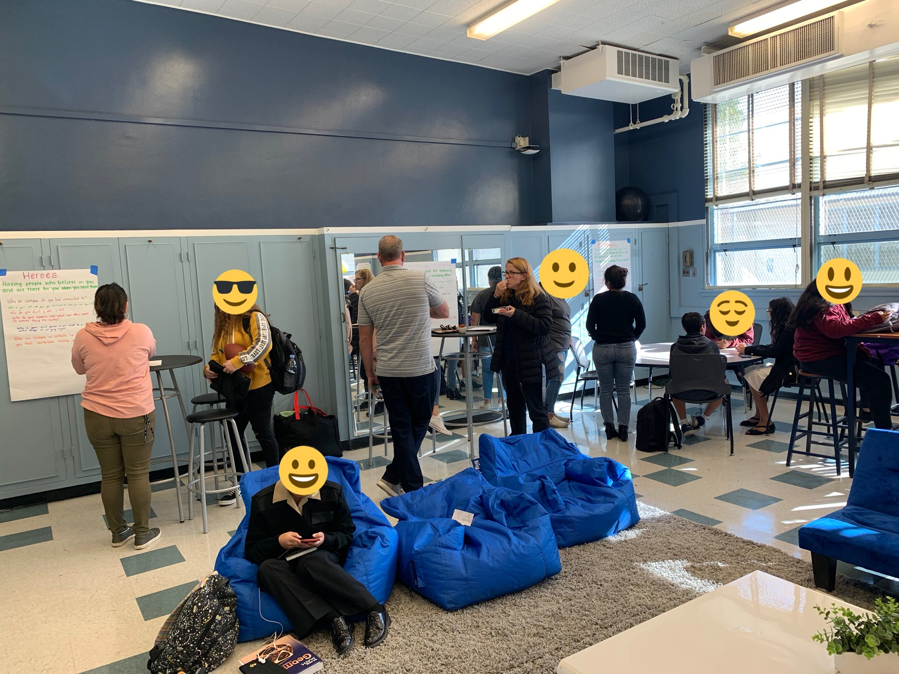
Evidence

Slide 10
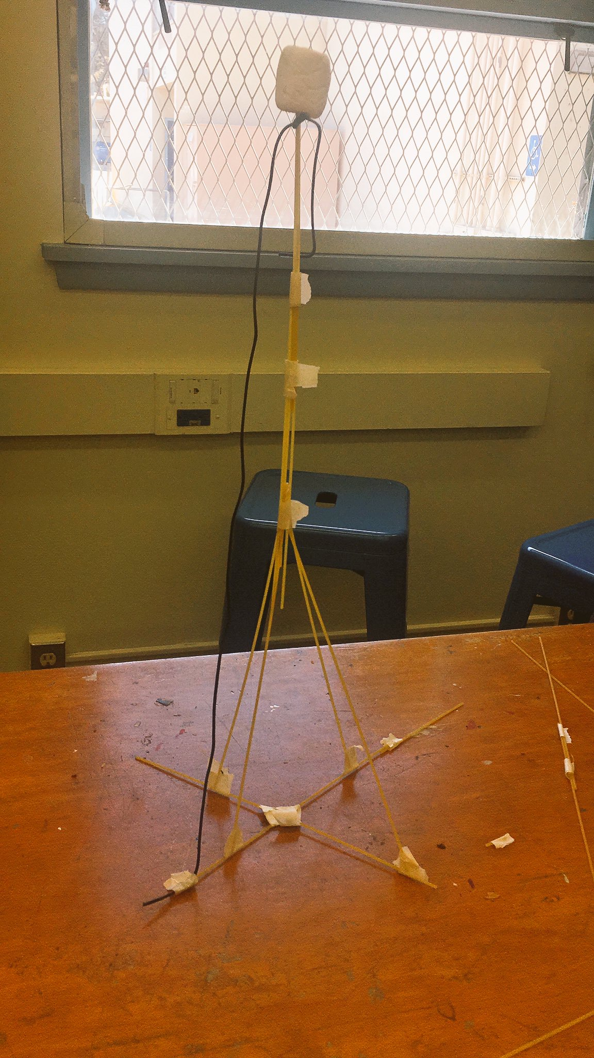
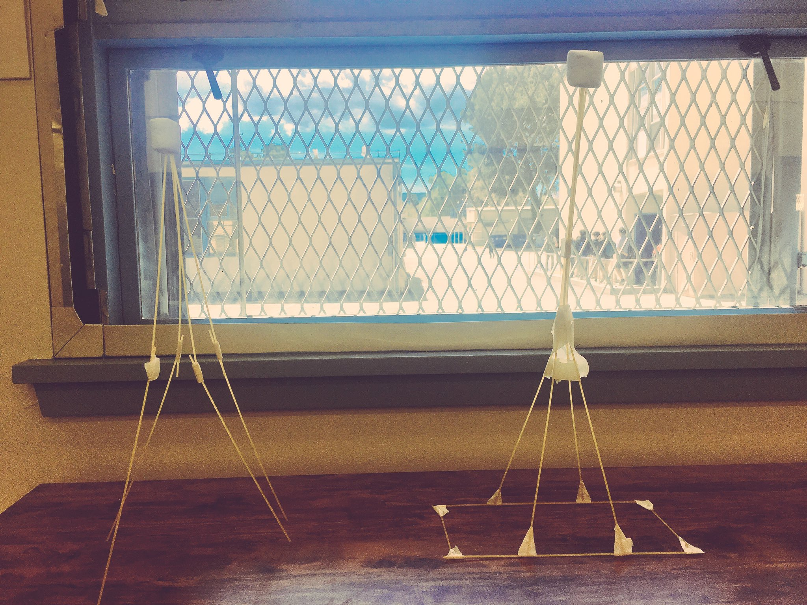
Evidence

Slide 11
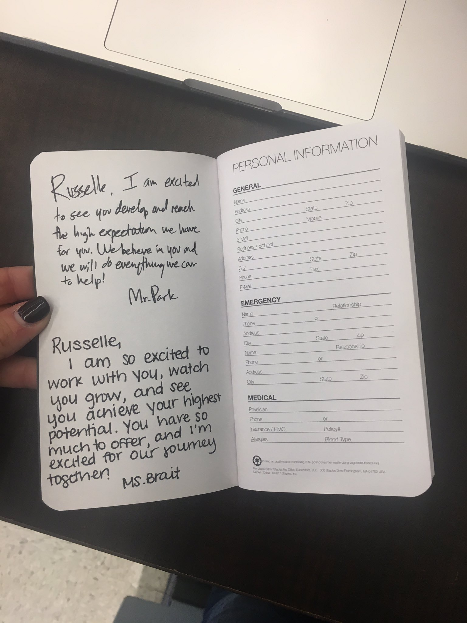
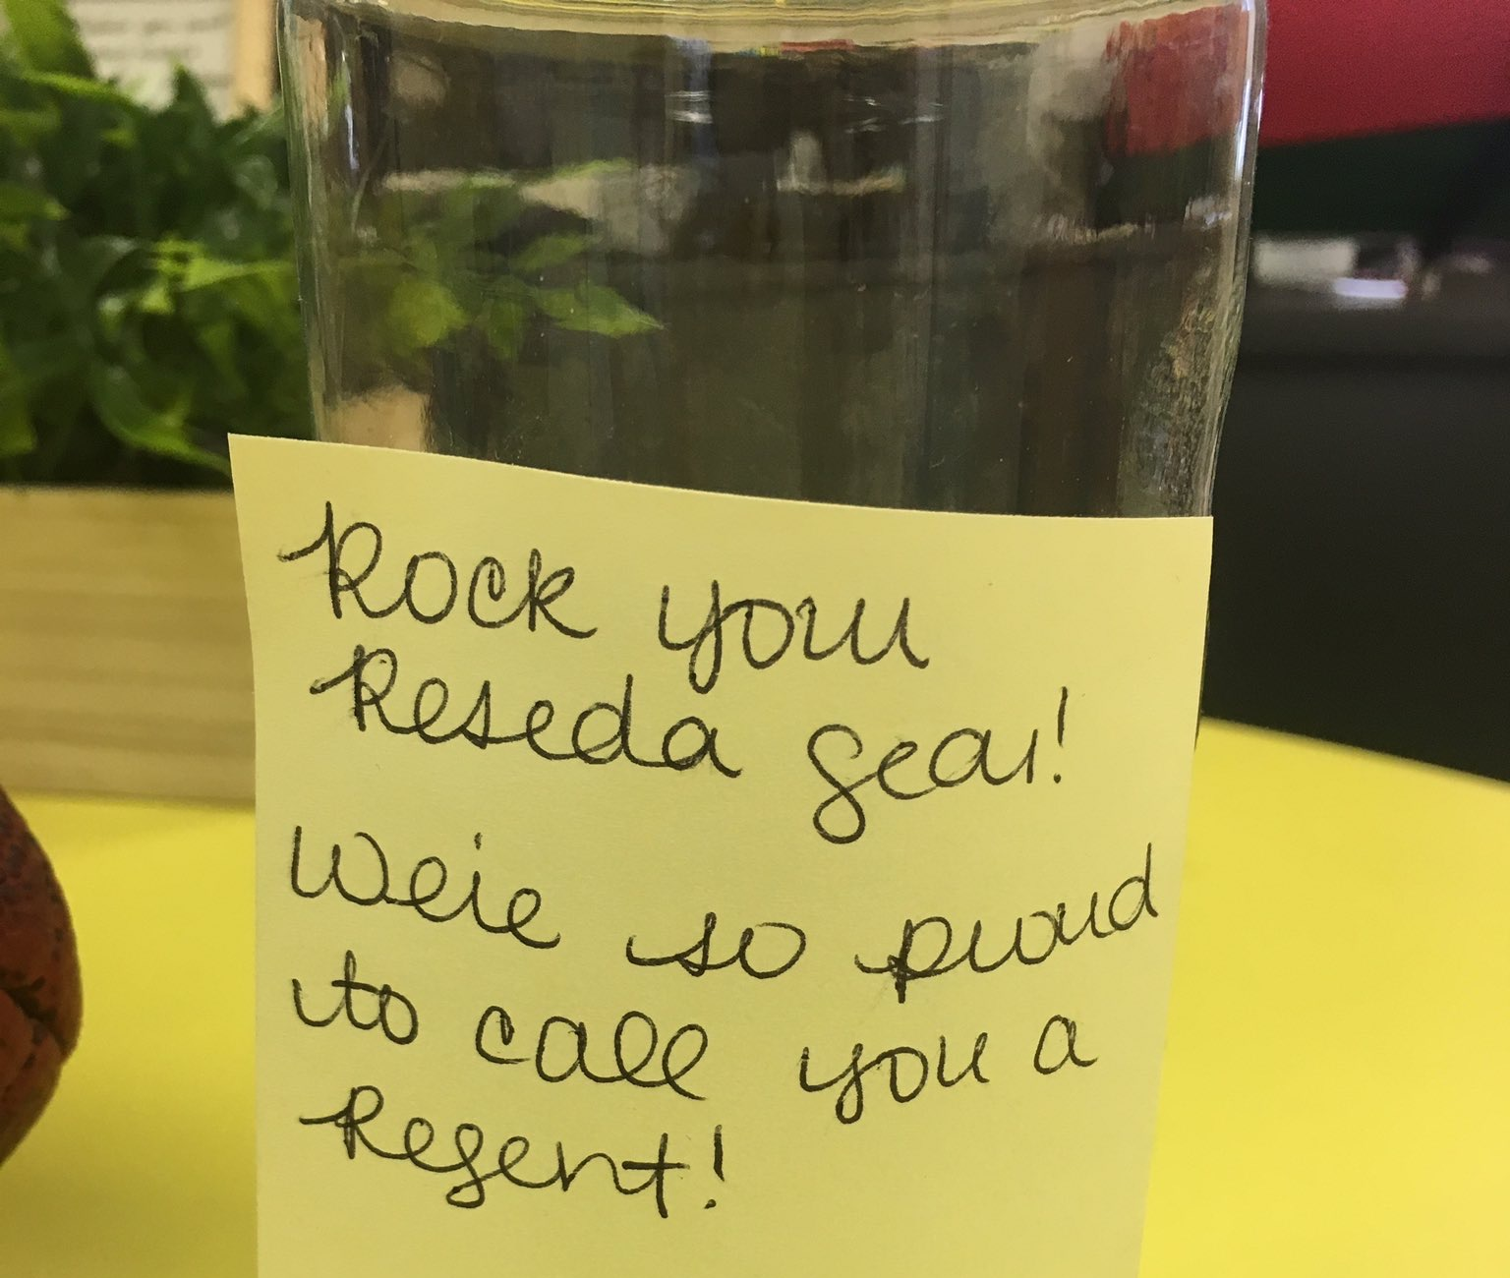
Evidence

Slide 12
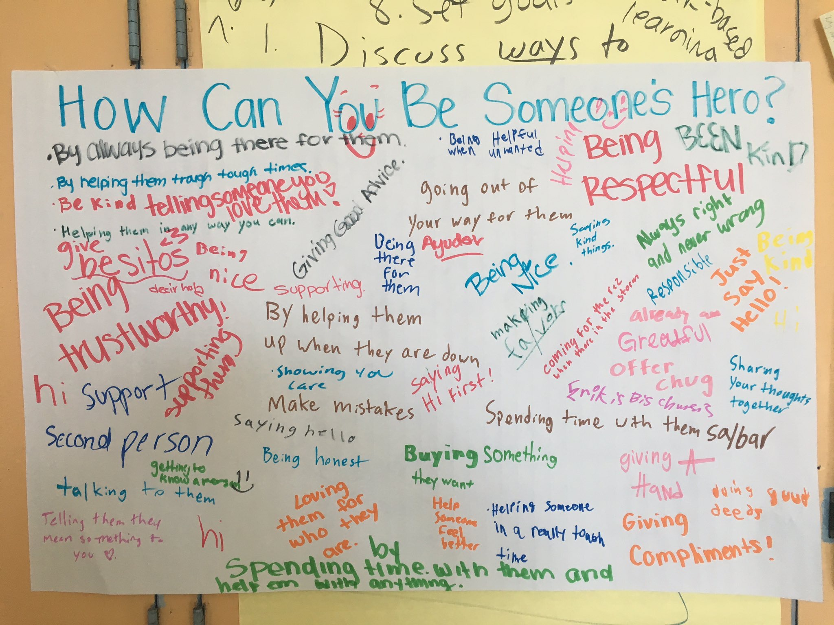
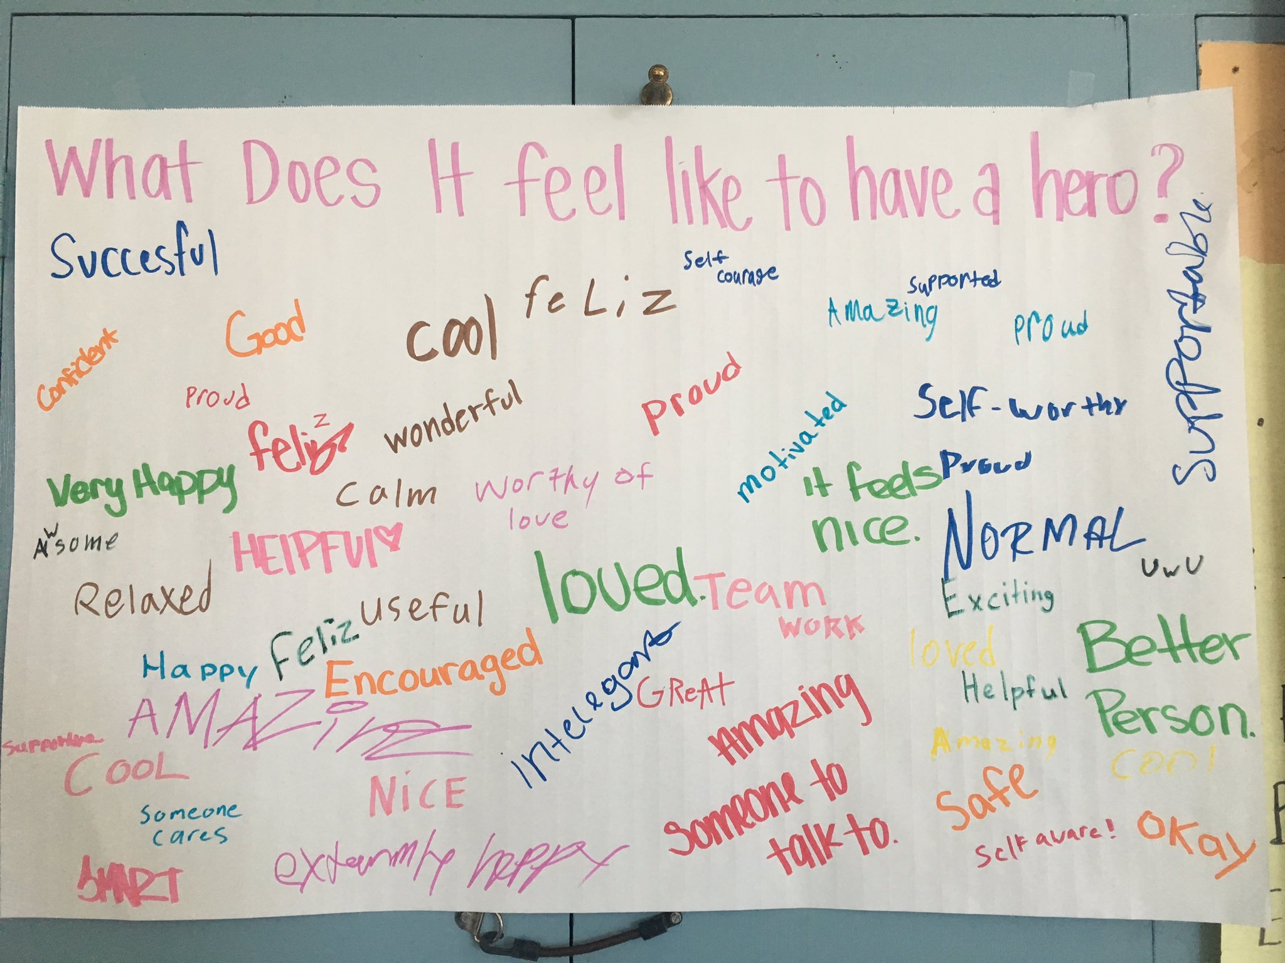
Evidence

Slide 13
Evidence

Slide 14
Evidence (Mentor Anecdotes)
“My mentees were also students in my class, and SAAP allowed me to understand what they needed to be successful as a whole person. It made me feel like my job was more important than just giving information”
“Being a mentor has inspired me to strengthen my dedication in teaching. I continue to connect with students at a level to be right by their side as they transition between quadrants. My classes value the power of student voice in and out of the classroom”
“I have noticed the tremendous growth that my mentee has undergone emotionally and academically due to the SAAP program. He feels more connected to the school and has so much more motivation to achieve his goals”
“SAAP has put me in a position to interact with students who may never come across my path. I really think it has made me more purposeful with how I try to advise and support students”
“The opportunity to work and develop relationships with students outside of my class was a rewarding experience. When you see the student pass their classes or just greet you when they see you in the hall, you know it was worth the extra work”
“You don’t always know if what you are doing is making a difference, but you keep doing it because every student matters. It could just be that one interaction that might have a bearing on their future”

Slide 15
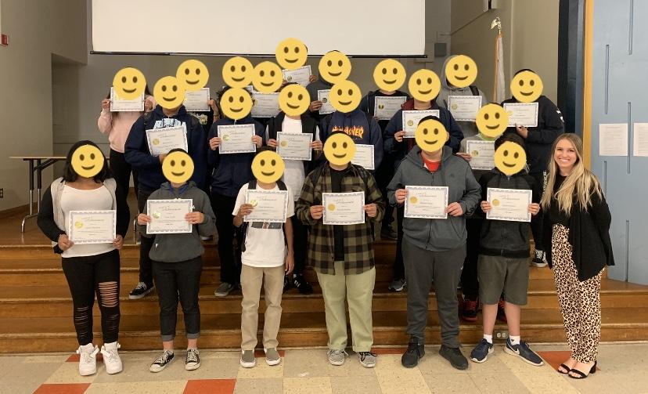
Evidence (SAAP Celebration Lunch!)

Slide 16
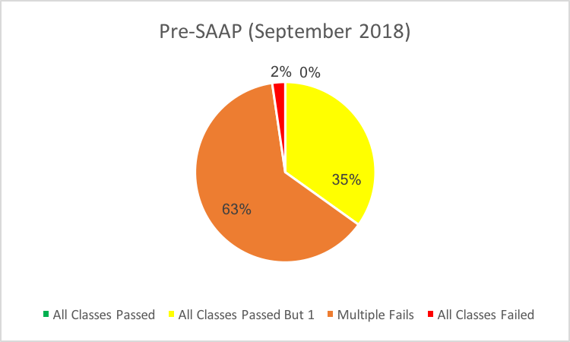
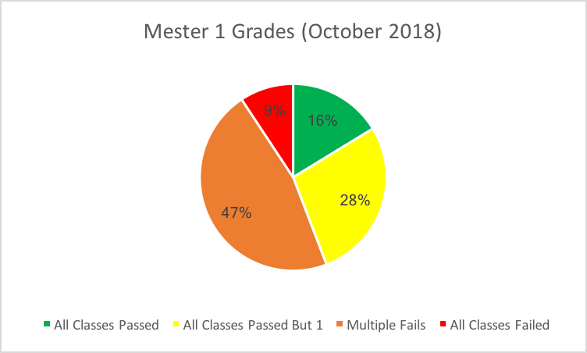
Outcomes (Student Grades)

Slide 17
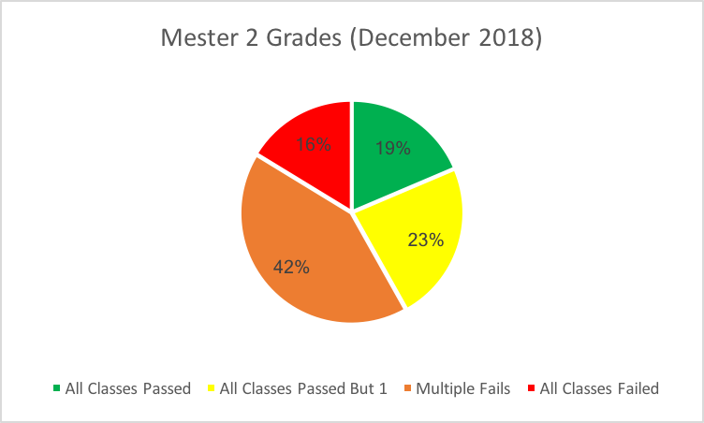
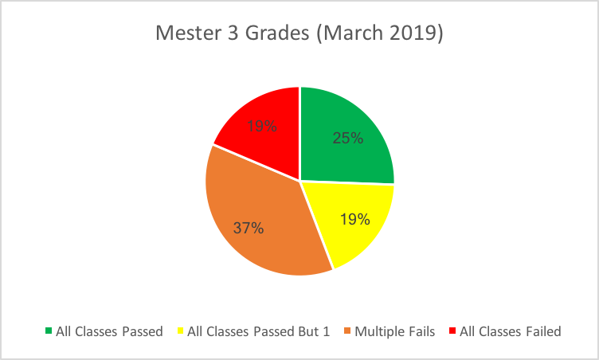
Outcomes (Student Grades)

Slide 18
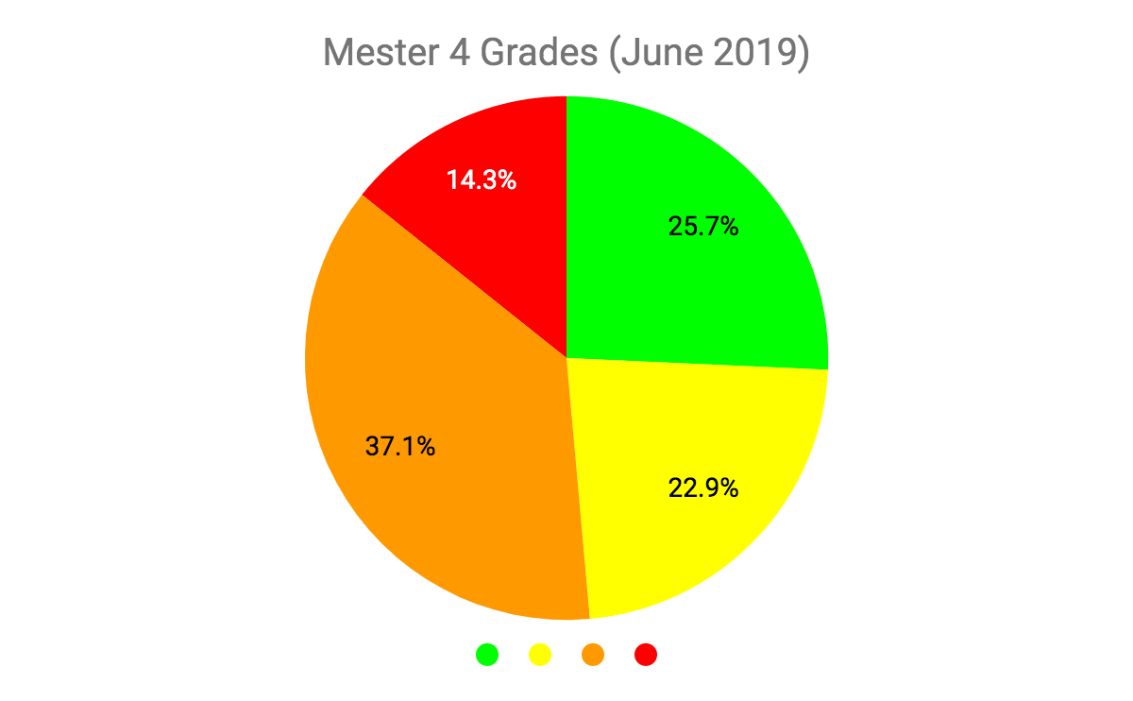
Outcome (Student Grades)

Slide 19
Parent Outreach
Outreach to parents at the beginning of the year to explain the SAAP program and Aspirations Framework
Follow-up with parents and teachers as needed
Remote Teaching: Weekly check-ins with families

Slide 20
Next Steps
10th Grade SAAP Program
Aspiration Coordinator follows SAAP Year 2 Cohort
Mentorship continues informally
6th Grade Aspirations Work
Build Advisory using Aspirations Framework
Continued Conversations around SVA
Principal’s Advisory and Aspirations Council (PAC)
Coffee with the Principal
Local School Leadership Council
School Site Council
Parent Night: Student Voice and Aspirations
Schoolwide Implementation of Aspirations Framework

Slide 21
WASC Accreditation Commendation
“Implementing the Student Voice and Aspirations Framework as part of Social/ Emotional Learning and Student Aspirations Advocacy Program to support students academically”

