Slide 1
Thomas A. Edison Middle school
Quaglia Legacy project
Connected community, voice, and aspirations

Slide 2
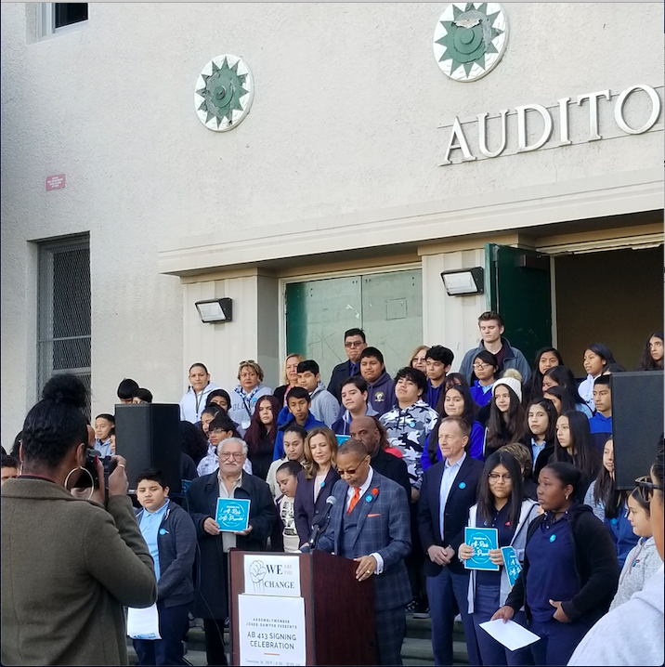
AB-413 At-Promise Press conference at Edison
AB-413, better known as “At-Promise" was signed into effect at the doorsteps of Edison Middle School on December 16, 2019. On this day, our students, staff and community witness how an antiquated phrase “at-risk youth” used to identify their needs, was replaced with a more progressive term, “at-promise youth”. Our connected-community listened to wise and inspiring words of Assembly member Reginald Byron Jones-Sawyer, who authored the bill. A few of our Edison students used their voice to provide their opinions on this change during a brief interview and speech at the front of Edison Middle School’s doorsteps.

Slide 3
At Promise news (Univision) * interview with Edison student

Slide 4
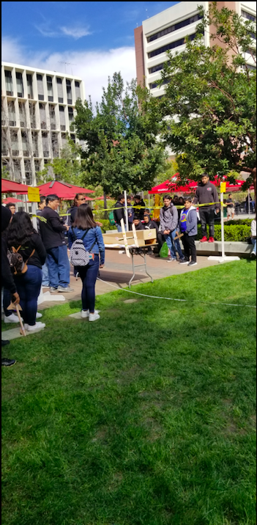
MESA Day
Edison’s community includes MESA Day at USC! Students participated in team-based projects to solve a common math, science, and engineering problem while strolling the walkways of USC. This year, we had two teams represent Edison on the Glider challenge. Students were responsible in creating, designing and testing a Glider made out of common-household goods. We also had a group of mathematicians, compete and successfully rank in 2nd place in the Great Math Escape. Students build their skills by working in teams that consist of the same common tread: community. This day as well as other MESA club activities promote our student’s Self-Worth and Aspirations as they compete and add accomplishments to their school and life experience.

Slide 5
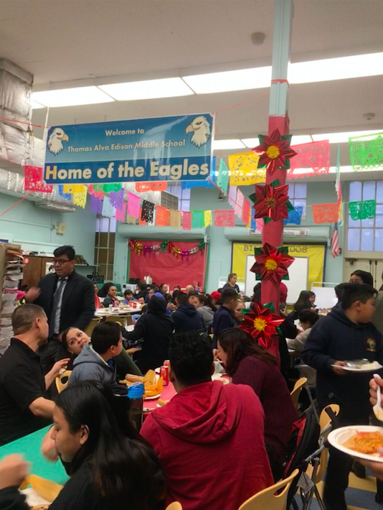
SAS Annual holiday potluck event
Our School For Advanced Studies holiday potluck is an annual event that is very popular with our families, and it's a wonderful way in which we cultivate a connected community. This event occurred in December in our Parent Center which was filled to capacity. Teachers, administrators, parents, grandparents, students and their siblings enjoyed sharing a meal together in a festive atmosphere. Our parent representative helped the little ones build gingerbread houses, and former students returned to Edison to visit with their teachers.

Slide 6
Ceramic art tiles
Every year, Edison staff reach out to local communities to help inspire our youth, and in this case, a College art student, Ellie Whang, reached out to Edison’s Art teacher to collaborate on an art project on ceramic tiles. The theme of the project, was Aspirations (working hard and dreaming to reach success). Students depicted a Soaring Eagle with words such as Dream, Adventure, Creativity, Confidence, Fun, and different occupations on one tile that was pieced together to form one whole picture. The other tiles were independently completed by students, showing symbols or pictures of what they aspire to be for their future. Edison always welcome local communities, organizations, and/or agencies to increase our student’s knowledge, motivate and inspire them, and help them see their possibilities.

Slide 7
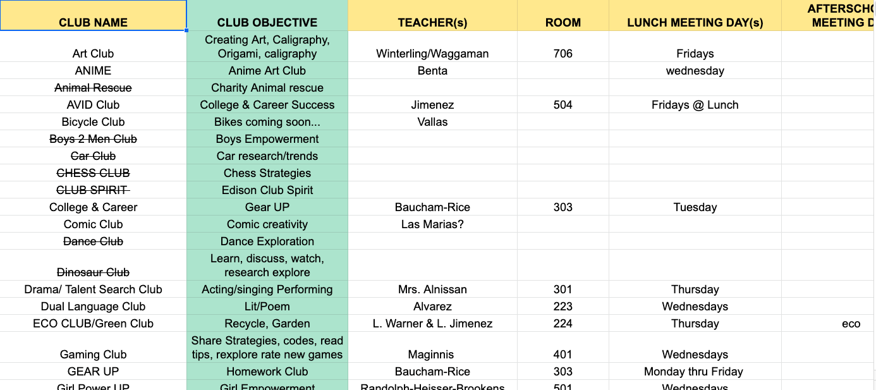
Edison clubs
Edison Clubs has expanded our student’s school community participation by adding additional clubs. In the 2018-2019 school year, Edison had only 8 clubs on campus, this year, 11 more clubs were added, totaling 19 clubs. With the addition of the new clubs on campus, Edison is hoping for more student engagement, increasing student’s purpose and self-worth as they find avenues that interest them. Our goal at the end of the year (before the pandemic) was to have a showcase of each Club’s work throughout the year.

Slide 8
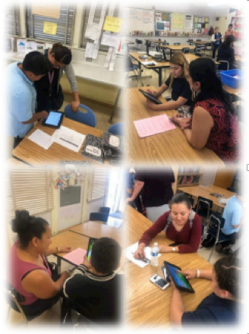
Student-led conferences
This year, Edison added Student-Led Conferences (SLC) to our Student Voice efforts. Instead of the traditional Teacher-Led-Conferences, our school decided to do the Student-Led-Conferences to encourage more parent and student participation. Doing the conferences this way allowed the students to share a more in-depth look at their work to their parents, explain what the assignments are, as well as how they received their grade.

Slide 9
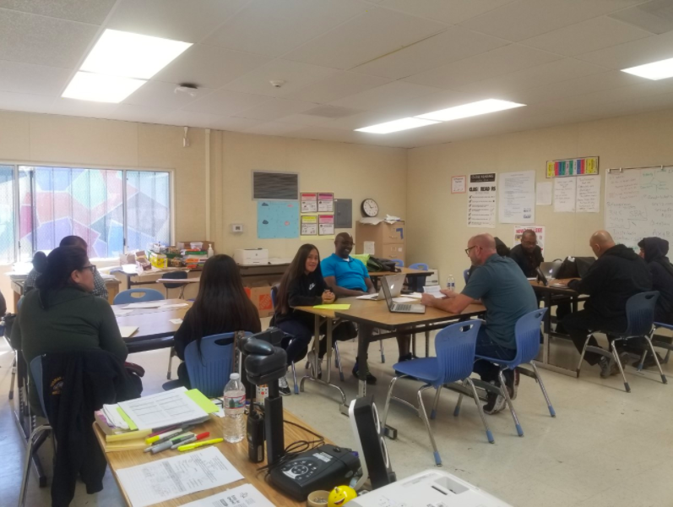
World Cafe
Teachers and students are working together to analyze data, brainstorm and come up with solutions to issues concerning the school. Two World Café discussions took place this year. The Leadership class and the Aspirations Team analyzed the School Voice Report together. In this picture, the RFEP/EO Specialized Team analyzed the School Experience Survey. During the discussion, one student pointed out that the school needed a “Good Deeds” box in the Counseling Office to address bullying issues and recognize good deeds done by students around the school as a model for behavior.

Slide 10
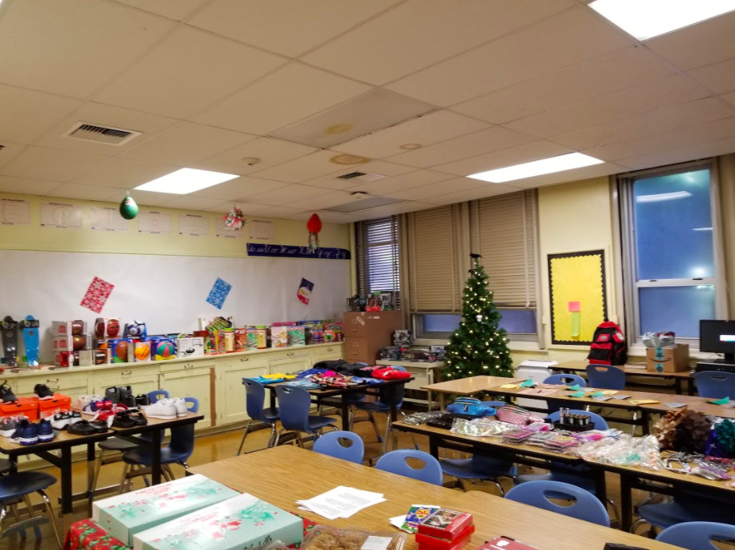
Holiday gift drive
In partnership with UPS, Edison Middle School connected with our school community by bringing a little something special, a present. Students were asked to jot down 3 gift ideas via Google Form and our friends at UPS did their best in meeting the needs of 75 students. Some students were beyond grateful and expressed how the gift would be used as a family present. Students wrote thank you notes to our friends, voluntarily, integrating Gratitude.

Slide 11
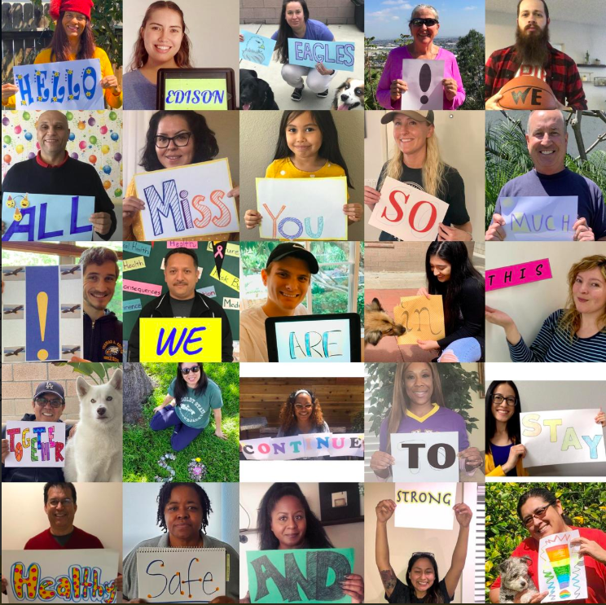
Staff Collage
During the COVID-19 pandemic, Edison teachers and staff created a Teacher Collage showing the students that they are in their thoughts. The message was, “Hello Edison Eagles! We all miss you so much! We are in this together, so continue to stay healthy, safe, and strong!” Our teachers are staying connected with the students via Distance Learning, teaching our students necessary academic materials but also checking in on them to make sure that they are okay and that they are receiving technical help during Wednesdays and Thursdays where our Technical Support Team can assist them to ensure that they are successful. Edison Middle School is open for our students and the community for the Grab and Go Meals where sometimes up to 6,000 families stop by to get the food. Edison is also hosting a Foodbank where families can receive much needed food during this time.

Slide 12
Other ways edison ms builds connected community, voice, and aspirations
School Grams
Attendance Matters Campaign
Holiday Gift-Drive (UPS Donations)
World Café Activities
Project Aspire in Specialized Team Meetings
iKnow My Class Surveys through Department Meetings
Monthly Parent Workshops
Coffee with the Principal

Slide 13
Other ways edison ms builds connected community, voice, and aspirations
Student Recognition Awards Ceremonies
WASC Parent, Student, Staff Surveys
Breakfast in the Classroom Ambassadors
Parent Center and Community Workshops
Annual Eco-Fair and/or SAS/Dual Language events
Food Banks (Edison MS is a Food Bank Center location during COVID 19 pandemic)
Meals to Go (during COVID 19)
Technology Services 2x a week for students and/or parents (during COVID 19)

Slide 14
