Slide 1
Quaglia Student Voice
Coffee with the Principal
March 4, 2021
3:00 pm
Presented by: Anne Marie Goldsmith, Elizabeth Lee, Coach Runnels, Socorro Vazquez

Slide 2
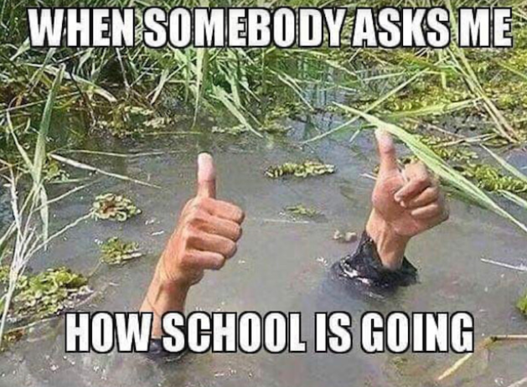

Slide 3
Fundamental Beliefs
Students are the potential, not the problem.
Students have something to teach us.
Working WITH students is the only way forward.

Slide 4
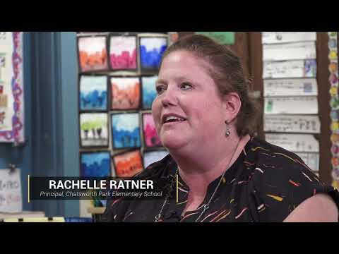
LAUSD
Quaglia Institute

Slide 7
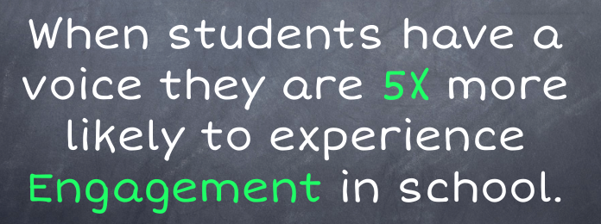

Slide 8
The 3 Components of Student Voice
Sharing thoughts & ideas in an environment underpinned by trust and respect.
Offering realistic suggestions for the good of the whole.
Accepting responsibility for not only what you say but what needs to be done.

Slide 11
8 Conditions
Belonging
Heroes
Sense of Accomplishment
Fun & Excitement
Curiosity & Creativity
Spirit of Adventure
Leadership & Responsibility
Confidence to Take Action

Slide 12
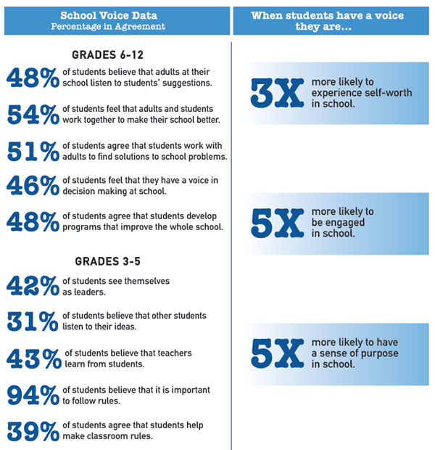

Slide 13
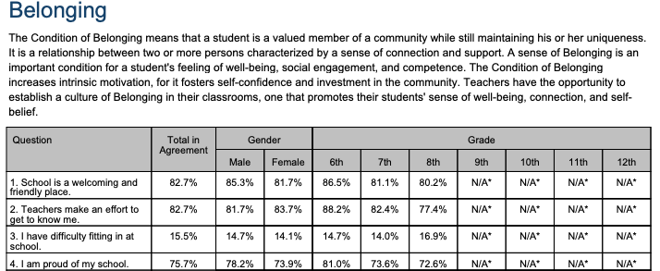

Slide 16
The MGMS Quaglia Voice & Aspirations Team!
Elizabeth Lee
exk9218@lausd.net
Anne Marie Goldsmith
axg3951@lausd.net
Socorro Vazquez
sxv7205@lausd.net
Coach Runnels
mjr4801@lausd.net

Slide 17
Thank you!
Do you have any questions?

